Slide 1
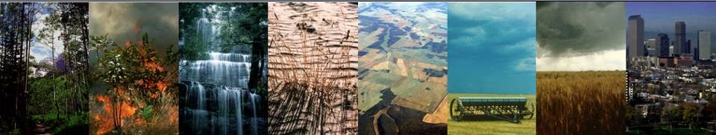

The Community Land Model:
Introduction and Biogeophysics
David Lawrence
Co-chair of Land Model Working Group
Climate and Global Dynamics Lab
Terrestrial Sciences Section
dlawren@ucar.edu
NCAR is sponsored by the National Science Foundation
Notes:
So I will be talking about the Community Land Model which is the land surface component of CESM.
I’ll be focusing on the biogeophysics aspects of CLM while Peter Lawrence will focus more on biogeochemistry.
I’d like to thank Dave Lawrence, the co-chair of the Land Model Working Group, and Gordon Bonan, the head of the Terrestrial Sciences Section) for providing most of the material for this lecture.
The general purpose of this talk is to basically familiarize you with what is in the model, there’s not time to go into too much detail about any of this.

Slide 2
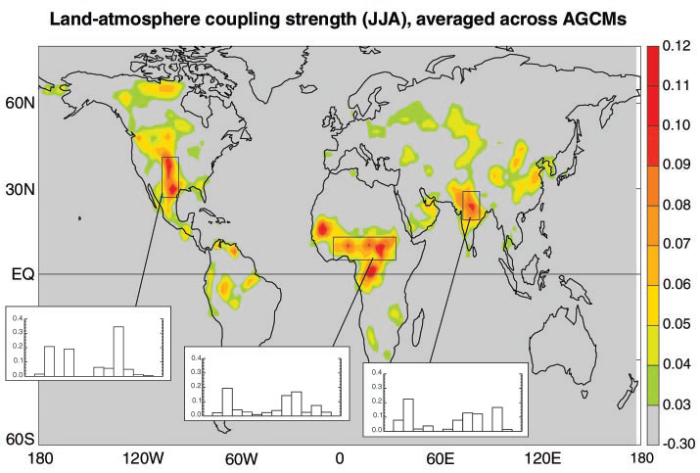
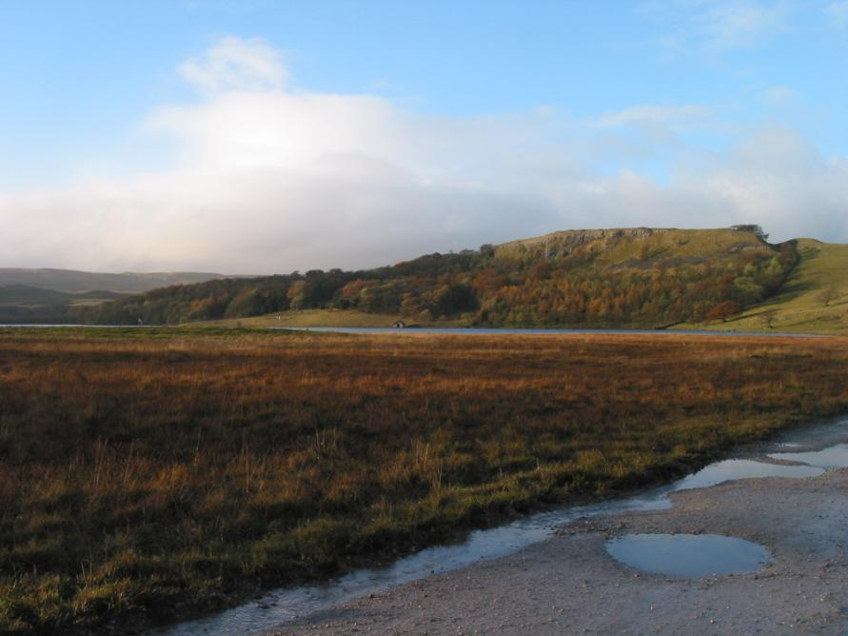

Land in Earth System: Land-atmosphere interactions
How much does a precipitation-induced soil moisture anomaly influence the overlying atmosphere and thereby the evolution of weather and the generation of precipitation?
Koster et al., 2004
Notes:
Another important issue is land – atmosphere interactions, in particular the soil moisture-precipitation feedback.
How much does a precipitation-induced soil moisture anomaly influence the overlying atmosphere and thereby the evolution of weather and the generation of precipitation?
The strength of this feedback has important implications as to whether you can make seasonal forecasts of precipitation.
What if you have a rainy spring, how much does that influence subsequent summer rainfall?

Slide 3
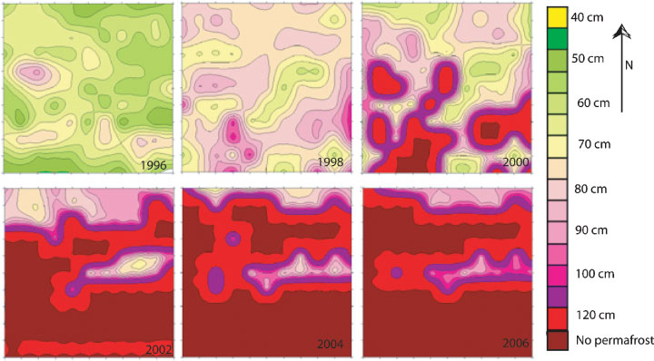
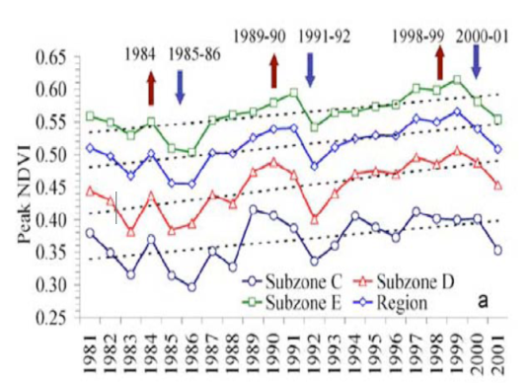
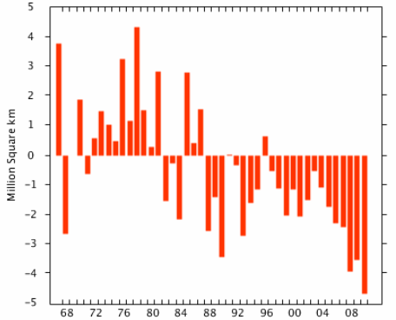
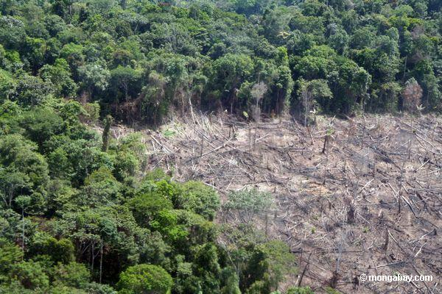
Land in Earth System: Terrestrial system is showing change
Permafrost degradation
(Akerman, 2008)
Arctic greening (Bunn et al. 2007)
How do these changes feedback on climate system?
NH snow cover anomaly (Rutger’s Global Snow Lab)
Deforestation
Notes:
These are some example of some of the dramatic changes occurring over land.
A documented increase in Arctic vegetation, growing season getting longer.
Field study in Sweden, green is permafrost close to surface, shows how significantly permafrost has degraded over just 10 years.
Deforestation which is human caused and has serious implications for climate and ecosystem services.
There are also indications that snow cover has been decreasing in recent years (record low in 2010).

Slide 4

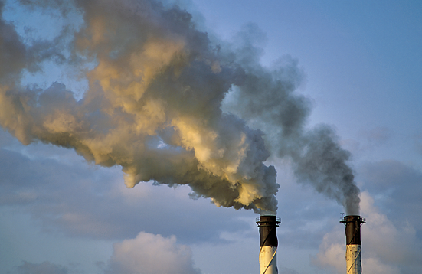
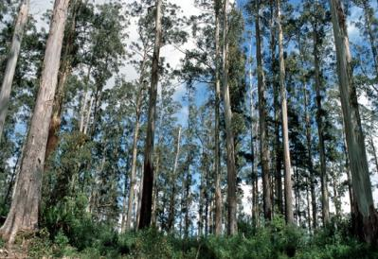
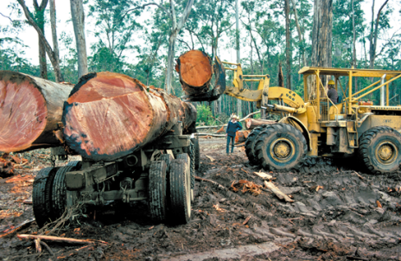
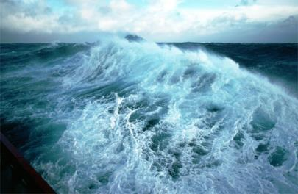
Land in Earth System: Land is critical sink of CO₂ emissions
8.3±0.4 PgC/yr 90%
4.3±0.1 PgC/yr
46%
2.6±0.8 PgC/yr
28%
Calculated as the residual
of all other flux components
+
1.0±0.5 PgC/yr 10%
26%
2.5±0.5 PgC/yr
Source: Le Quéré et al. 2012; Global Carbon Project 2012

Slide 5
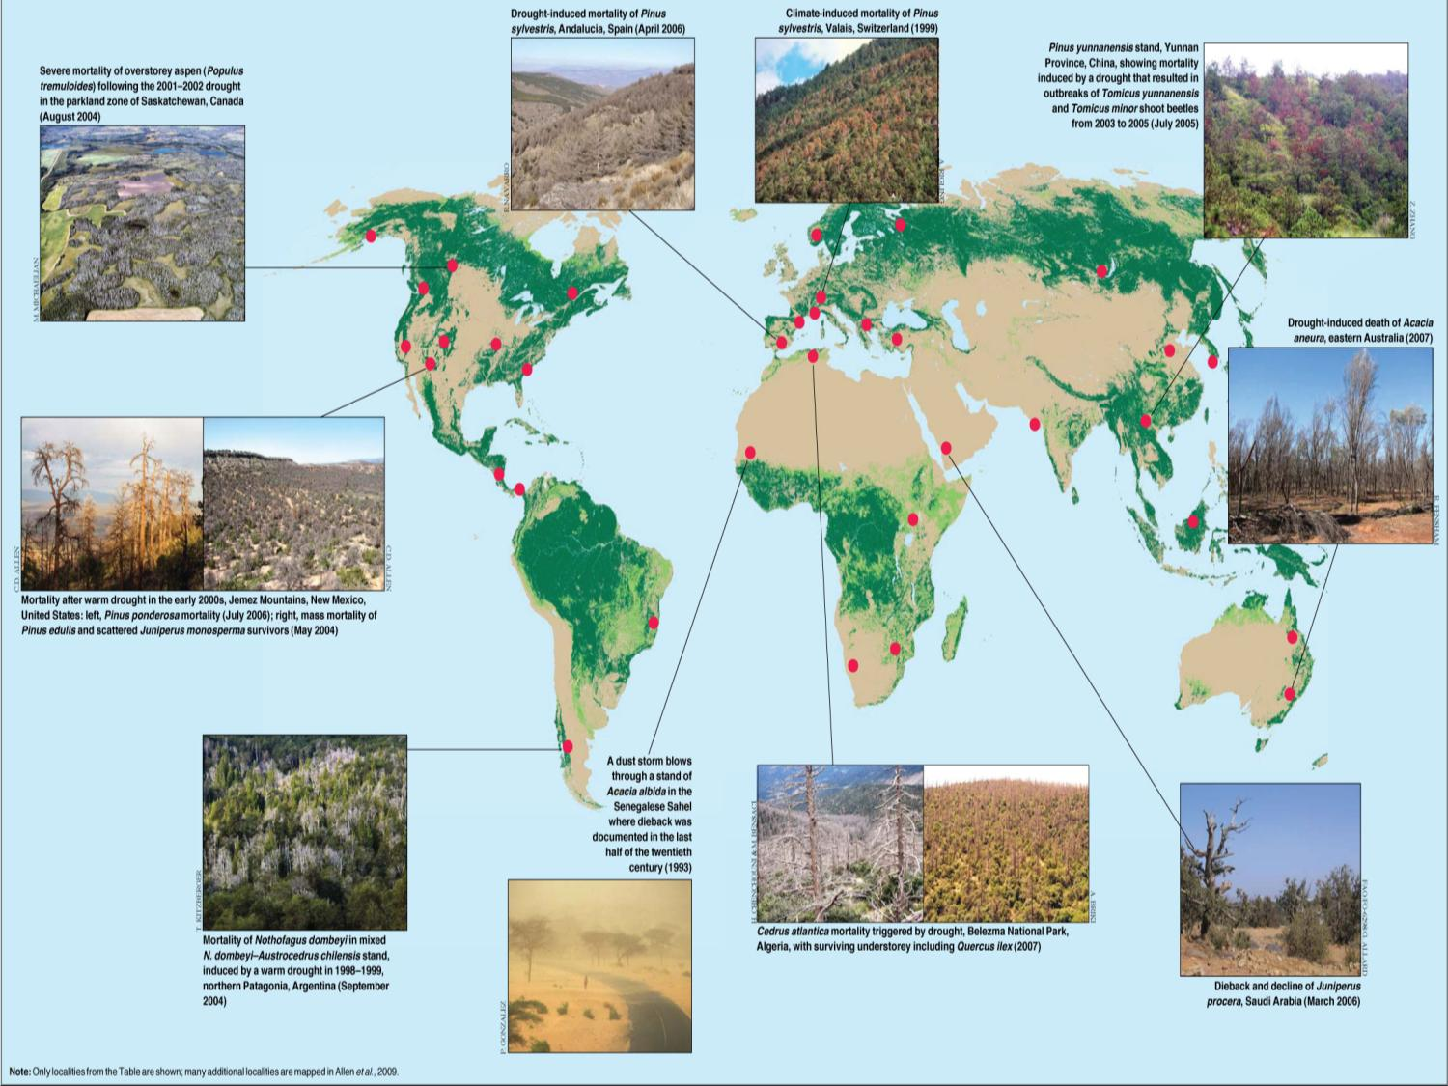
Land in Earth System: But, trees (carbon sinks) are dying due to fire, insects, drought, and deforestation
Notes:
Climate envelopes. Simplistic view of vegetation distribution. If climate changes, plants necessarily die.
Introduce many types of trees into the model with a range of plant traits and then let them compete. Plants whose strategy it is to conserve water (drought tolerant) do better than those that aim to produce biomass. Work in progress, but will provide a much more stable and defensible analysis of SW forest vulnerability.
Leaf water

Slide 6
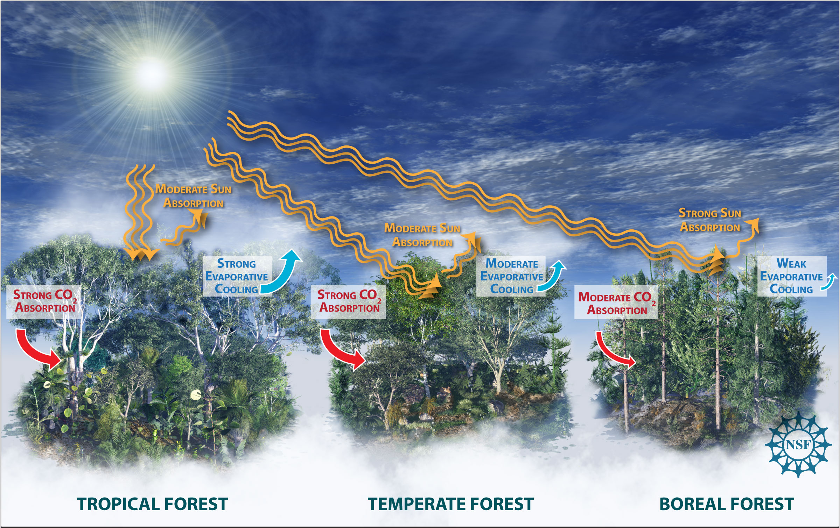
Land in Earth System: Not all forest ecosystems have the same impact on climate
Multiple competing influences of forests
Bonan (2008) Science 320:1444-1449
Credit: Nicolle Rager Fuller, National Science Foundation

Slide 7
Differences in ecosystem functioning have implications for land climate
mitigation policy
Multiple competing influences of forests
Planetary savior – promote avoided deforestation and reforestation
Reforestation benefits are unclear due to competing effects
Menace to society – no need to promote conservation
Bonan (2008) Science 320:1444-1449
Credit: Nicolle Rager Fuller, National Science Foundation

Slide 8
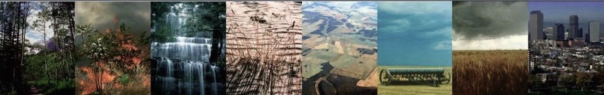



Community Land Model (CLM)
Motivation:
Land is the critical interface through which humanity affects, adapts to, and mitigates global environmental change
Glacier
Lake
Runoff
Wetland
River
Routing
Disturbance
Competition
Flooding
Crops
Irrigation
Vegetation Dynamics
River discharge
Land Use
Change
Urban
Wood
harvest
Growth
Comprehensive representations of land biogeophysics, hydrology, plant physiology, biogeochemistry, anthropogenic land use, and ecosystem dynamics

Slide 9
Scientific goals driving CLM development and use
Improve understanding of carbon and nitrogen cycle interactions and their impact on long term trajectory of terrestrial carbon sink
Assess response and vulnerability of ecosystems to climate change and disturbances (human and natural)
Evaluate utility of ecosystem management as mechanism to mitigate climate change
Ascertain vulnerability of water resources under climate change; establish role of land in drought and flood
Quantify land feedbacks to climate change: e.g. permafrost-carbon, snow- and vegetation-albedo, soil moisture-ET feedbacks

Slide 10

Terrestrial Processes within the Earth System

Slide 11
The role of a land model in an Earth System Model
  exchanges of momentum, energy, water vapor, CO₂, dust, and other trace gases/materials between land surface and the overlying atmosphere (and routing of runoff to the ocean)
  states of land surface (e.g., soil moisture, soil temperature, canopy temperature, snow water equivalent, C and N stocks in vegetation and soil)
  characteristics of land surface (e.g., soil texture, surface roughness, albedo, emissivity, vegetation type, cover extent, leaf area index, and seasonality)
Notes:
The role of the land model within an ESM is about three things really, exchanges, states, and characteristics.
The land model is responsible for exchanges of quantities between the land surface and the atmosphere

Slide 12




Community Land Model (CLM4.5)
Key Processes
Surface energy fluxes
Biogeochemical cycles
Hydrology
Diffuse solar
Precipitation
Photosynthesis
BVOCs
Direct solar
Downwelling
longwave
Momentum flux
Wind speed
Fire
Autotrophic
respiration
0
u_{a}
Transpiration
Sensible heat flux
Evaporation
Latent heat flux
Reflected solar
Absorbed
solar
Emitted
longwave
Throughfall
Phenology
Vegetation C/N
Aerosol
deposition
Sublimation
Evaporation
Dust
Infiltra-
tion
N dep
N fix
CH₄
Heterotrop.
respiration
Melt
Surface
runoff
N₂O
SCF
Litterfall
Surface
water
Ground heat flux
Saturated
fraction
Soil (sand, clay, organic)
Soil
Root litter
Aquifer recharge
Soil
C/N
Denitrification
N leaching
Water table
N mineral-
ization
N
uptake
Sub-surface
runoff
Bedrock
Unconfined aquifer
Notes:
Snow on lake?

Slide 13
At each time step the land model solves Surface Energy Balance
S⬆ - S⬇ + L⬆ - L⬇ = λE + H + G
S⬆, S⬇ are down(up)welling solar radiation,
L⬆, L⬇ are up(down)welling longwave rad,
λ is latent heat of vaporization,
E is evaporation,
H is sensible heat flux
G is ground heat flux
Direct solar
Diffuse solar
Downwelling
longwave
Sensible heat flux
Latent heat flux
Reflected solar
Absorbed
solar
Emitted
longwave
Aerosol
deposition
SCF
Surface
water
Ground heat flux
Soil (sand, clay, organic)
Bedrock
Notes:
The model has to solve the surface energy balance at each time step.

Slide 14
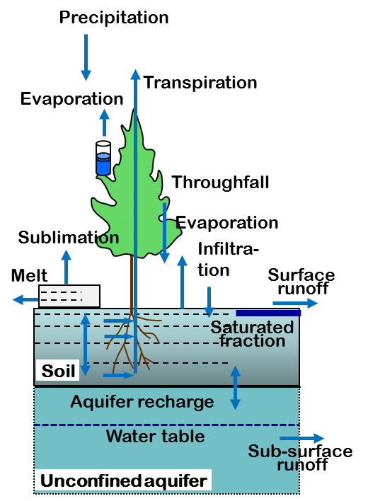
… and the Surface Water Balance
  P = E_{S} + E_{T} + E_{C} + R +
  (∆W_{soi}+∆W_{snw} +∆W_{sfcw} +∆W_{can}) / ∆t
      P is rainfall/snowfall,
      E_{S} is soil evaporation,
      E_{T} is transpiration,
      E_{C} is canopy evaporation,
      R is runoff (surf + sub-surface),
      ∆W_{soi} / ∆t, ∆W_{snw} / ∆t, ∆W_{sfcw} / ∆t, ∆W_{can} / ∆t, are the changes in soil moisture, surface water, snow, and canopy water over a timestep
Notes:
And it has to solve the surface water balance at each time step.

Slide 15
Land water and energy cycles intricately linked
“The ability of a land-surface scheme to model evaporation correctly depends crucially on its ability to model runoff correctly. The two fluxes are intricately related through soil moisture.”
(Koster and Milly, 1997).
Runoff and evaporation vary non-linearly with soil moisture
Evaporation, Runoff
Soil wetness

Slide 16
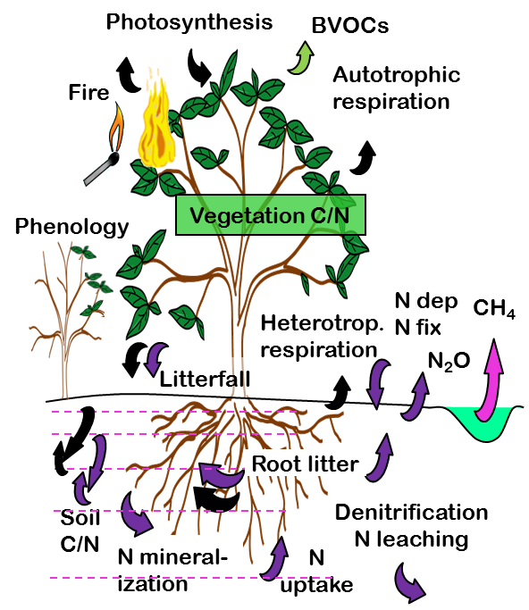
… and Surface Carbon Exchange
NEE = GPP – HR – AR –
Fire – LUC
NEE is net ecosystem exchange
GPP is gross primary productivity
HR is heterotrophic respiration
AR is autotrophic respiration
Fire is carbon flux due to fire
LUC is C flux due to land use change
Notes:
And also the carbon exchange.
Heterotrophic – soil
Autotrophic - plants

Slide 17
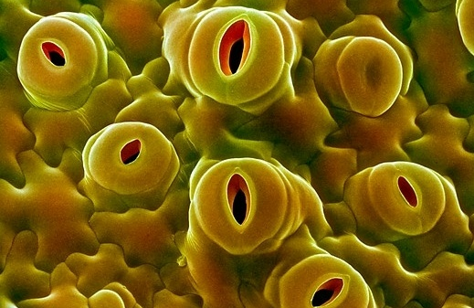
Photosynthesis model
Plant physiological controls on CO₂ exchange and transpiration
Function of solar radiation, humidity deficit, soil moisture, [CO2], temperature, leaf N content
CO₂
H₂O
Leaf cuticle
Guard cell
Guard cell
Photosynthetically
active radiation
Chloroplast
light
CO₂ + 2 H₂O ➔ CH₂O + O₂ + H₂O
Bonan (1995) JGR 100:2817-2831
Denning et al. (1995) Nature 376:240-242
Denning et al. (1996) Tellus 48B:521-542, 543-567
Cox (1999)
Figure courtesy G. Bonan

Slide 18
Land complexity: Submodels of CLM
  Biogeophysics
    Photosynthesis and stomatal resistance
    Hydrology
    Snow
    Soil thermodynamics
    Surface albedo and radiative fluxes
  Biogeochemistry
    Carbon / nitrogen pools, allocation, respiration
    Vegetation phenology
    Decomposition
    Plant Mortality
    External nitrogen cycle
    Methane production and emission
  Vegetation dynamics
  Urban
  Crop and irrigation
  Lakes
  Glaciers and ice sheets
  Fire and fire emissions
  Dust emissions
  River flow
  Biogenic Volatile Organic Compound emissions
Notes:
That is some background on model structure and surface/input datasets.
On to component submodels. I’ll mainly be talking about the submodels related to vegetation and soil.

Slide 19

Land complexity: Snow model example
Up to 5-layers of varying thickness
Treats processes such as
  Accumulation and fresh snow density
  Snow melt and refreezing
  Snow aging
  Water and energy transfer across layers
  Snow compaction
    destructive metamorphism due to temperature and wind
    overburden
    melt-freeze cycles
  Sublimation
  Aerosol deposition
  Canopy snow storage and unloading
  Snow burial of vegetation
State Variables
Snow depth
T_{snow}
Notes:
The state variables of snow that are calculated at each time step are the number of layers, their water and ice content, their thickness, and their temperature.
Here, we are showing temperature profile of the snow, with warmer layers near the snow. Snow is a good insulator, keeps the soil warm.
The snow model treats processes such as…

Slide 20

Urban Model
Atmospheric Forcing
Roof
Canopy Air Space
H
Conduction
Convection
Radiation
Ventilation
Sunlit Wall
Shaded Wall
Floor
Oleson et al. 2010
Impervious
Canyon Floor
Pervious
W
Notes:
We have an urban canyon model to represent urban climate, for instance the urban heat island effect.
These urban components are arranged in an infinite urban canyon configuration characterized by a height to width ratio.
For each of these surfaces, sensible and latent heat fluxes are simulated.
Fluxes are combined in a urban canopy airspace where temperature, humidity, and air speed are predicted. These then determine the aggregate fluxes to the atmosphere.
Atmospheric quantities are required to force this model: wind, temperature, specific humidity, precipitation, solar and longwave radiation.
We’ve also been working recently on an improved but simplified building energy submodel.
We account for conduction through each of these surfaces including a floor, convection from each surface to building air, radiation interactions between the surfaces, as well as building ventilation. Maximum and minimum interior building temperatures are specified to simulate space heating and air conditioning processes and we account for the wasteheat from these processes as a flux into the canopy air space.
When I talk about urban air temperature in this talk I’m referring to the air temperature in the urban canopy air space

Slide 21
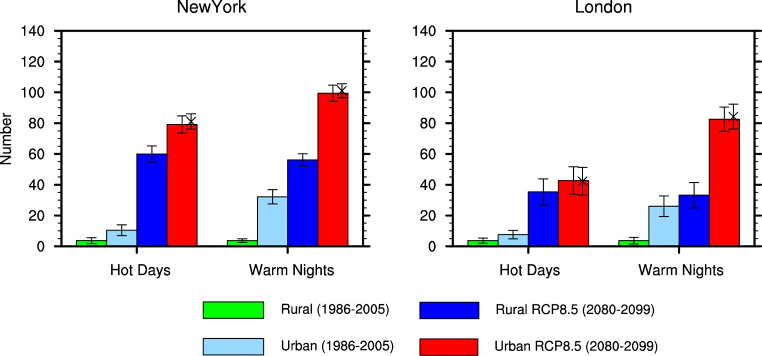
Changes in hot days and warm nights – RCP8.5
Hot days (warm nights) – Number of days per year that daily TMAX (TMIN) exceeds 99th percentile of present day Rural daily TMAX (TMIN)
Present-day climate
Cities have more hot days and warm nights than rural land
21st century climate change
Cities increase more in hot days and warm nights than does rural land
Slide courtesy K. Oleson
Notes:
Changes in the mean climate are important but changes in extremes are also important. This simple example shows the number of days per year with “hot days” and “warm nights”, i.e., daytime and nighttime temperatures above some threshold, for New York and Beijing.
Under present day climate (the green and light blue colors), these two cities have more hot days and warm nights than rural land.
Under 21st century climate (the dark blue and red colors), cities increase more in hot days and warm nights than does rural land.
New York:
Rural hot days: +56
Urban hot days: +69
Rural warm nights: +52
Urban warm nights: +67
Beijing:
Rural hot days: +31
Urban hot days: +36
Rural warm nights: +43
Urban warm nights: +57

Slide 22
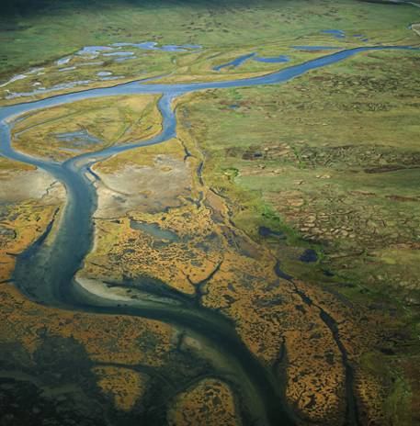
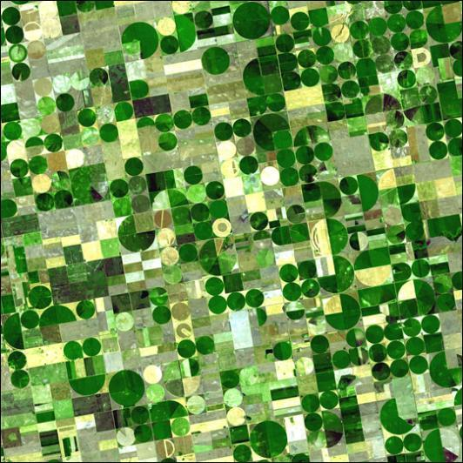
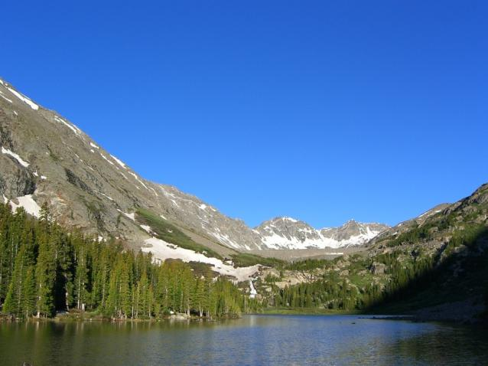
Land surface heterogeneity

Slide 23
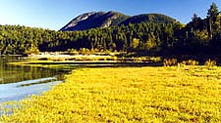
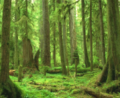
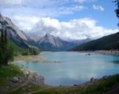

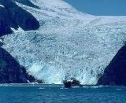
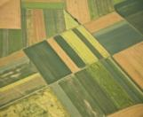


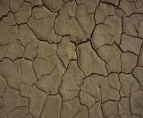



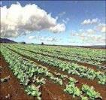
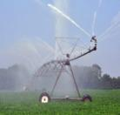



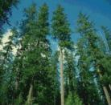
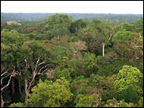
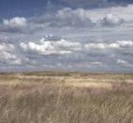
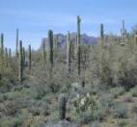
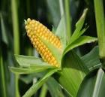

Land surface heterogeneity
CLM subgrid tiling structure
Gridcell
V
PFT1
G
V
PFT3
Landunit
V
PFT2
L
TBD
C1I
C1U
V
PFT4
HD
Vegetated
Lake
MD
Glacier
Crop
C2I
C2U
Urban
UT,H,M
Column
Roof
Shade
Wall
Impervious
Soil
Sun Wall
Pervious
Unirrig
Irrig
Unirrig
Irrig
PFT
PFT1
PFT2
PFT3
PFT4 …
Crop1
Crop1
Crop2
Crop2 …
Notes:
This is a schematic of the subgrid structure of the land model. There are four distinct heirarchies in the model. There is the gridcell level. A gridcell is divided up into landunits, columns, and plant functional types or pfts.
Landunits are glacier, wetland, vegetated, lake, and now urban. Beneath the vegetated landunit is at least one soil type. Plant functional types then share this soil type and the energy and water budgets associated with this.

Slide 24
Land surface heterogeneity
CLM subgrid tiling structure
Gridcell
Landunit
TBD
HD
Vegetated
Lake
MD
Glacier
Crop
Urban
Column
Roof
Shade
Wall
Impervious
Soil
Sun Wall
Pervious
PFT
PFT1
PFT2
PFT3
PFT4 …
Notes:
This is a schematic of the subgrid structure of the land model. There are four distinct heirarchies in the model. There is the gridcell level. A gridcell is divided up into landunits, columns, and plant functional types or pfts.
Landunits are glacier, wetland, vegetated, lake, and now urban. Beneath the vegetated landunit is at least one soil type. Plant functional types then share this soil type and the energy and water budgets associated with this.

Slide 25
Plant Functional Type Parameters
Optical properties (visible and near-infrared):
  Leaf angle
  Leaf reflectance
  Stem reflectance
  Leaf transmittance
  Stem transmittance
Fire:
  Combustion completeness
  Fire mortality
Land surface models are parameter heavy!!!
Morphological properties:
  Leaf area index (annual cycle)
  Stem area index (annual cycle)
  Leaf dimension
  Roughness length/displacement height
  Canopy top and bottom height
  Root distribution
Photosynthetic parameters:
  Specific leaf area
  m (slope of conductance-photosynthesis relationship)
  Vcmax (maximum rate of carboxylation)
  Leaf carbon to nitrogen ratio
  Fraction of leaf nitrogen in Rubisco
  Soil water potential at stomatal open/closure
Notes:
Large number of parameters associated with each PFT.
Optical, fire, morphological, and photosynthetic parameters.
If the carbon-nitrogen model is active, there are over 40 parameters for each PFT.
Some of these we know pretty well from observation. For example, in the SP or satellite version of the model, leaf and stem area index are estimated from MODIS.
Some are more an educated guess. So a lot of uncertainty in the land model is associated with these parameters.

Slide 26
Land surface heterogeneity
CLM subgrid tiling structure
Gridcell
V
PFT1
G
V
PFT3
Landunit
V
PFT2
L
TBD
C1I
C1U
V
PFT4
HD
Vegetated
Lake
MD
Glacier
Crop
C2I
C2U
Urban
UT,H,M
Column
Roof
Shade
Wall
Impervious
Soil
Sun Wall
Pervious
Unirrig
Irrig
Unirrig
Irrig
PFT
PFT1
PFT2
PFT3
PFT4 …
Crop1
Crop1
Crop2
Crop2 …
Notes:
This is a schematic of the subgrid structure of the land model. There are four distinct heirarchies in the model. There is the gridcell level. A gridcell is divided up into landunits, columns, and plant functional types or pfts.
Landunits are glacier, wetland, vegetated, lake, and now urban. Beneath the vegetated landunit is at least one soil type. Plant functional types then share this soil type and the energy and water budgets associated with this.

Slide 27
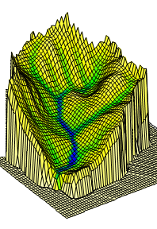
Subgrid-scale soil moisture heterogeneity
A major control on soil moisture heterogeneity and thus runoff is topography.
Lowland soils tend to be zones of high soil moisture content, while upland soils tend to be progressively drier.
Three main sources of runoff:
Infiltration excess occurs over the unsaturated fraction
Saturation excess occurs over the saturated fraction
Baseflow (drainage)
Notes:
So runoff and evaporation vary non-linearly with soil moisture, plus soil moisture is very heterogeneous.
This is an exaggerated example of what a single grid cell in our model could actually look like.
A major control on soil moisture heterogeneity and thus runoff is topography.
Lowland soils tend to be zones of high soil moisture content, while upland soils tend to be progressively drier.
So somehow need to represent this kind of a surface in the model through a sub-grid parameterization.
So we try to represent three types of runoff:
Infiltration excess – so even though the soil may not be saturated, precipitation may be falling at a rate that exceeds the rate at which the soil can accept the water.
Saturation excess – where basically everything runs off.
Baseflow – what is happening below the water table.

Slide 28
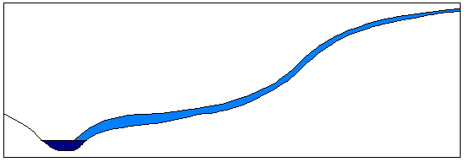
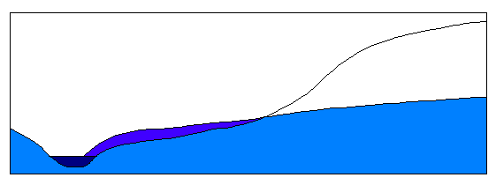
Subgrid-scale soil moisture heterogeneity
SIMTOP: TOPMODEL-based runoff
P
Infiltration excess
Severe storms
P
f
Urban area
P
q_{o}
Frozen surface
f
Saturation excess
P
P
P
q_{o}
q_{r}
z_{wt}
q_{s}

Slide 29

Glacier
Lake
Runoff
Disturbance
Wetland
River
Routing
Competition
Crops
Irrigation
Flooding
Vegetation Dynamics
River discharge
Land Use
Change
Urban
Wood harvest
Growth
G
V
PFT1
Landscape-scale dynamics
Long-term dynamical processes that affect fluxes in a changing environment (disturbance, land use, succession)
V
PFT3
V
PFT2
L
C1I
C1U
V
PFT4
C2I
C2U
UT,H,M
Notes:
Snow on lake?

Slide 30
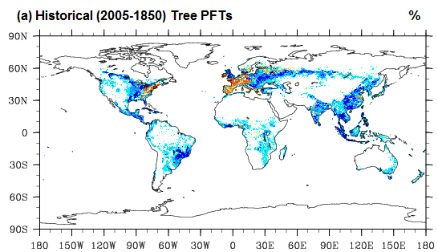
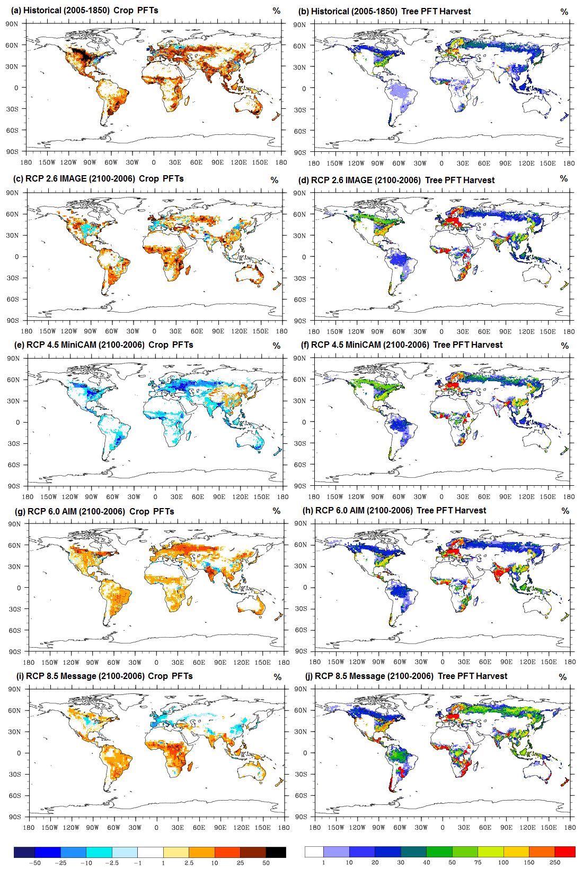
Historical land use & land cover change, 1850-2005
Change in tree and crop cover (percent of grid cell)
Cumulative percent of grid cell harvested
Historical LULCC in CLM4
Loss of tree cover and increase in cropland
Farm abandonment and reforestation in eastern U.S. and Europe
Extensive wood harvest
P. Lawrence et al. (2012) J Climate 25:3071-3095
Notes:
So for example, this is for a simulation that runs from 1850 to 2005 with prescribed landcover change.
These plots are showing the changes in fractional cover of trees and crops for 2005 minus 1850.
We can clearly see deforestation and increase in crop cover over most of the land surface although there is some farm abandonment and reforestation in the Eastern U.S. and Western Europe.
We can also see extensive wood harvest has occurred in Europe and Southeast U.S.

Slide 31

Land cover / land use change (prescribed)
Land Use
Change
Wood harvest
BET
BET
C4
Grass
C4
Grass
Crop
Crop
Notes:
A development in CLM related to PFTs is that we can now represent changes in these over time.
For instance we can represent removal of trees (deforestation) for crops by changing the fractional covers of PFT over time. This is done by reading in a dataset every year that contains the fractional covers of the PFTS. These weights are then interpolated in time to the model time step.
We can now also account for wood harvest, the conversion of wood to, e.g., paper products, which removes carbon stock.

Slide 32

What’s New for CLM5
A LOT!
More than 50 scientists and software engineers from 15 different institutions involved in development of CLM5

Slide 33



What’s New for CLM5
Hydrology: dry surf. layer, var. soil depth w/ deeper (8.5m) max soil, revised GW and canopy interc
Snow: canopy snow updates, wind effects, firn model (12 layers), glacier MEC, fresh snow dens.
Rivers: MOSART(hillslope → tributary → main channel)
Nitrogen: flexible leaf C:N ratio, leaf N optimization, C cost for N (FUN)
Carbon: revisions to carbon allocation and decomposition
Fire: updates, trace gas and aerosol emissions
Vegetation: plant hydraulics and hydraulic redistribution, deep rooted tropical trees,
Ecosystem Demography (FATES), prognostic roots, ozone damage
Crops: global crop model with transient irrig. and fertilization (8 crop types), grain prod. pool
Land cover/use: dynamic landunits, revised PFT-distribution, wood harvest by mass, shifting cultivation
Isotopes: carbon and water isotope enabled
CLM5 default configuration
CLM5 optional feature
Land Use
Change

Slide 34
CLM as a community modeling tool
Climate
Change
Air Quality
and
Atmos
Chemistry
Weather
Climate
Variability
CLM
LMWG
Community Earth System Model or other atm model
Land-
Atmosphere
Interactions

Slide 35
CLM as a community modeling tool
Hydrology
Ecology
Climate
Change
Air Quality
and
Atmos
Chemistry
Societal
Dimensions
Weather
Climate
Variability
CLM
LMWG
Biogeo-
Chemistry
Community Earth System Model or other atm model
Land-
Atmosphere
Interactions
Cryosphere

Slide 36
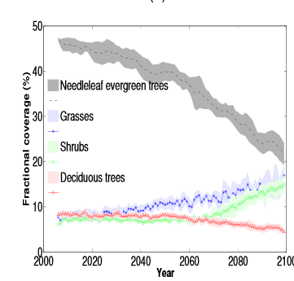
Ecosystem vulnerability to climate change
e.g., how vulnerable are western US forests to climate change?
CLM4(DGVM), suggests widespread die-off of forests by 2100, but simple representation of hydrology, plant water use, mortality, ecosystem dynamics
But … these results are likely unreliable; tree response to soil moisture deficits represented in ad hoc way in land models. Forest loss is complex problem that requires combined consideration of climate, hydrology, ecology, and plant physiology and diversity
Jiang et al. 2013
Notes:
Climate envelopes. Simplistic view of vegetation distribution. If climate changes, plants necessarily die.
Introduce many types of trees into the model with a range of plant traits and then let them compete. Plants whose strategy it is to conserve water (drought tolerant) do better than those that aim to produce biomass. Work in progress, but will provide a much more stable and defensible analysis of SW forest vulnerability.
Leaf water

Slide 37
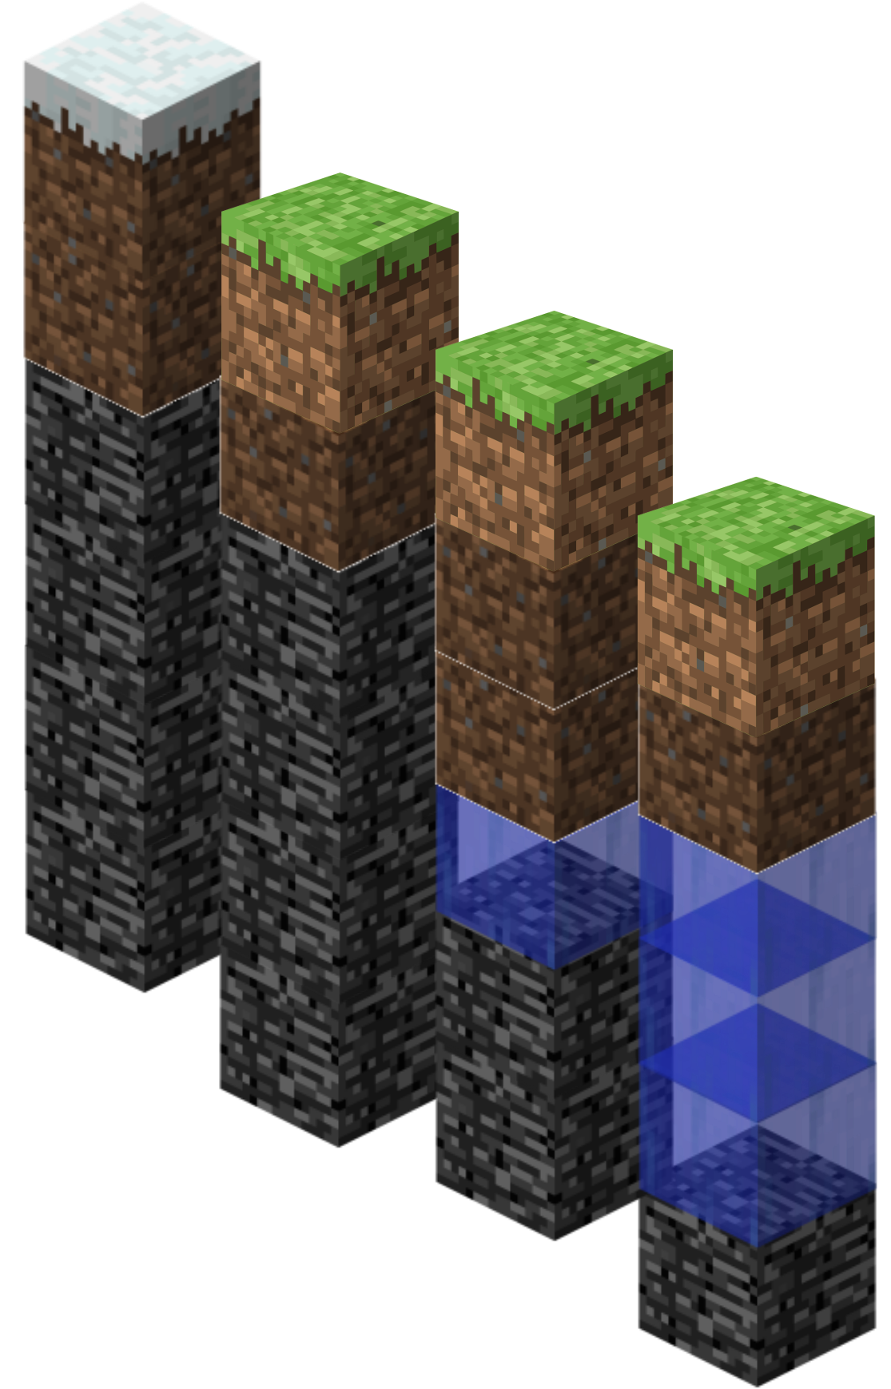
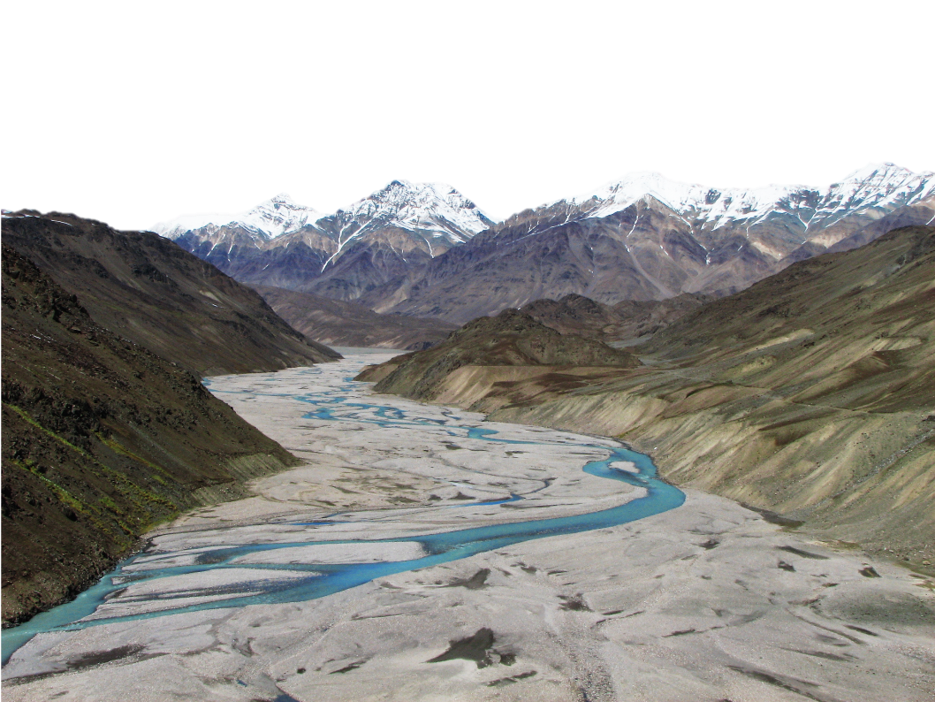

Implementing Hillslope Hydrology in CLM
Justin Perket,
Sean Swenson , Martyn Clark, Dave Lawrence, Ying Fan Reinfelder, and CUASHI-INSPIRE Hydrology Process team
Photo Credit: NSIDC, A. Racoviteanu

Slide 38
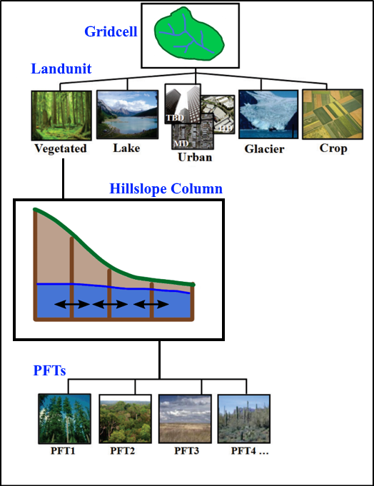
Intra-gridcell hillslope representation for CLM
Gridcell level assumes role of drainage basin
Few representative hillslopes per basin
Lateral connections between neighboring columns in hillslope
Modified CLM Hierarchy

Slide 39
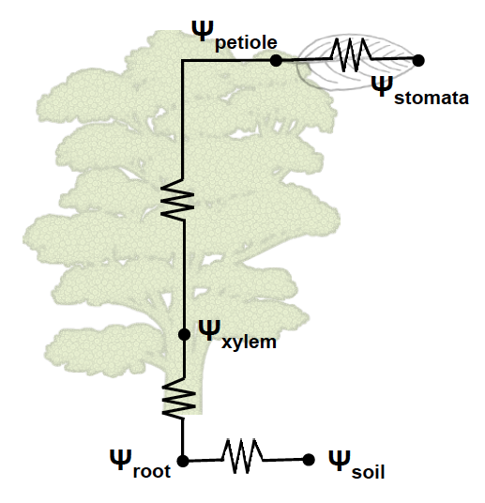
CLM5: Plant Hydrodynamics
Why plant hydrodynamics
BTRAN (soil moisture stress), and it’s parameters, 𝛳_{crit} and 𝛳_{wilt}, have no physical meaning and cannot be measured.
Flux tower ET convolutes transpiration with canopy and soil evap making it difficult to use for process-level assessment. With plant hydrodynamics, sap flow measurements could be utilized.
Satellites increasingly observe properties related to canopy or leaf water content.

Slide 40
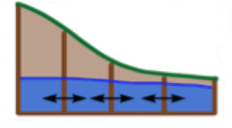
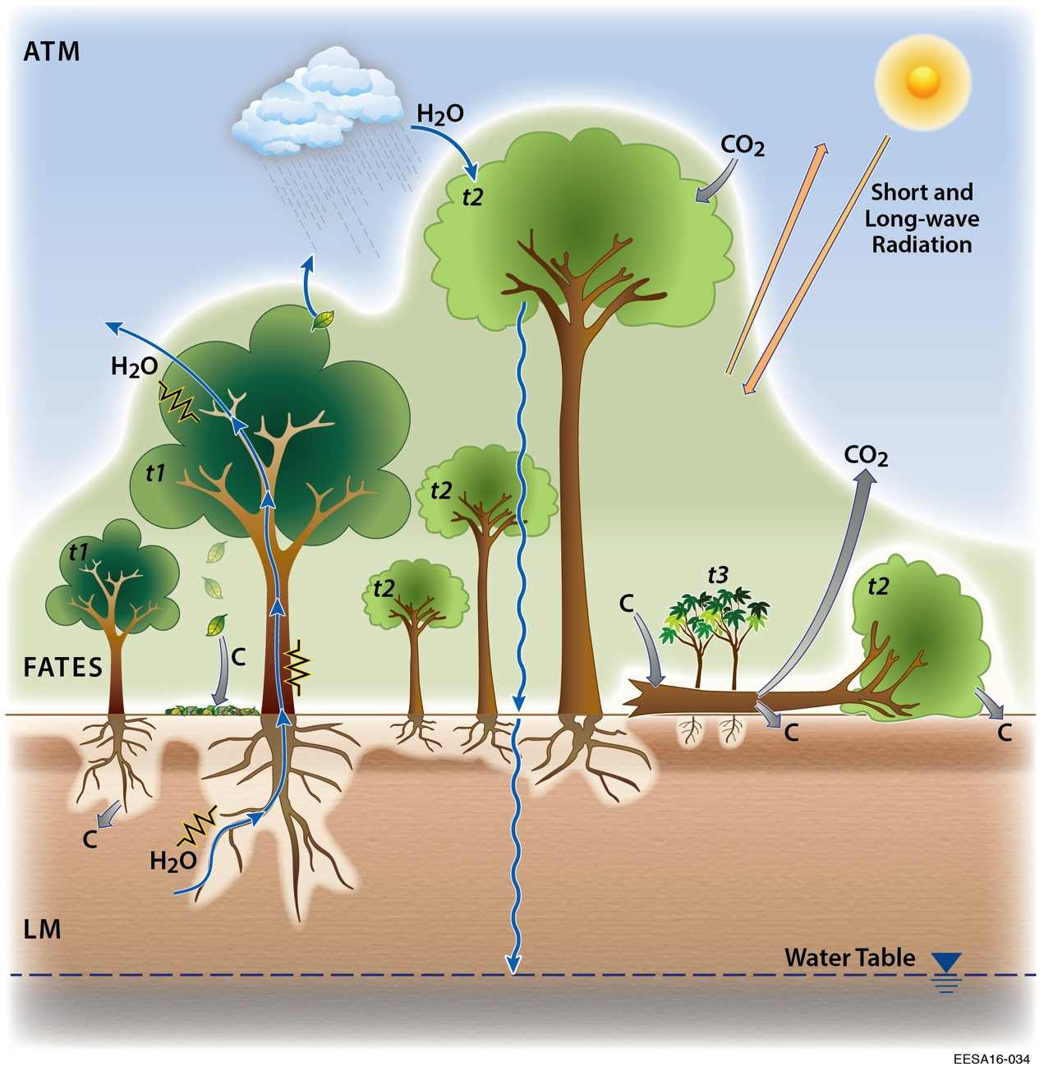
The future of CLM
Hillslope hydrology
Ecosystem Demography
/ multi-layer canopy
Plant hydrodynamics

Slide 41
Questions?

Slide 42
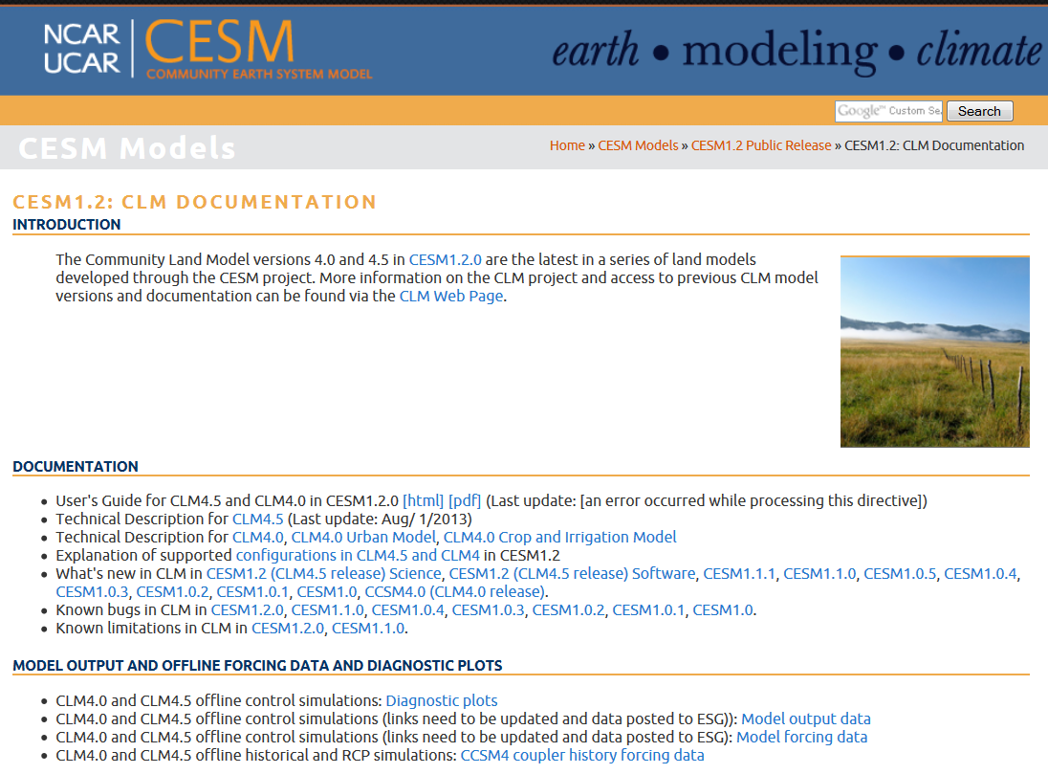
www.cesm.ucar.edu/models/cesm1.2/clm

Slide 43
Model design constraints and philosophy
Coupling with the atmosphere every model timestep is a fundamental constraint (< 30 minute timestep)
So is the need to represent the global land surface, including Antarctica, the Tibetan Plateau along with forests, grassland, croplands, tundra, desert scrub vegetation, and cities
Conservation of energy and mass is required
We strive to develop a process-level understanding across multiple ecosystems and at multiple timescales (instantaneous, seasonal, annual, decadal, centuries)
Top-down, empirical modeling
Process modeling
Thornthwaite: Monthly potential evapotranspiration driven by air temperature
Penman-Monteith equation
Farquhar photosynthesis model
Ball-Berry stomatal conductance model
Fick’s law of diffusion
Darcy’s law and Richards equation (soil water)
Fourier’s law (heat conduction)
Priestley–Taylor equation: Daily potential evapotranspiration driven by radiation
Production efficiency model driven by radiation and empirical scalars
Annual NPP driven by temperature and precipitation
Slide courtesy G. Bonan
Notes:
There are some design constraints and philosophies we try to follow.
First, …
Second, …
Can’t gain or lose energy or mass in the system. There are numerous checks for energy and mass conservation throughout the model.
Process level modeling versus empirical modeling. We try to apply fundamental process-level equations and models to our modeling.

Slide 44
The role of CLM in CESM:
Land to Atmosphere
Notes:
In a more practical quantitative sense, the role of CLM in CESM is to provide certain quantities to the atmosphere…

Slide 45
The role of CLM in CESM:
Atmosphere to Land
Notes:
In order to do this, the land model needs certain quantities from the atmosphere.

Slide 46
Main Features of the Community Land Model
Structural aspects (surface and input datasets)
  Heterogeneity of landscape (vegetated, urban, lake, glacier, crop)
  Plant Functional Types and associated parameters (optical, morphological, photosynthetic, fire)
  Land cover/use change (changes in PFTs over time, wood harvest)
  Soil texture (sand, silt, clay, organic matter) and color (albedo)
  River directional map
  Aerosol (snow albedo) and nitrogen deposition datasets
  Max fractional saturated area, slope, elevation
  Managed crop fraction (corn, soybean, cereals) and irrigation
  CO₂
  Biogenic Volatile Organic Compounds emission factors
  Population density, gross domestic productivity, peat area, agricultural waste burning
  Urban characteristics
Parameterizations and submodels
Notes:
So that is the purpose of a land model in a climate model.
Now I’m going to describe some of the main features of CLM.
These are split up into two categories; structural aspects, i.e., what we call surface and input datasets, and then parameterizations and submodels.
First of all structural aspects. I’ll describe these in more detail..
We deal with the significant heterogeneity of the landscape through a tiling method, as many land surface models do, we have broad landcover types.
Vegetation is broadly categorized by plant functional types – 17 currently in the model. Parameters describing the characteristics of each of these types are specified.
We also have datasets that describe changes in these PFTs over time.
Soil texture determines soil thermal and hydraulic properties and soil color determines soil albedo.
We need a map of how rivers proceed across the landscape (directional maps) to get the runoff that is generated by the soil model to the ocean
Other datasets include aerosol deposition which affects the albedo of snow and nitrogen deposition which affects plant growth in our carbon-nitrogen model.
If the crop model is active then we need datasets of the fractional coverage of different crop types and whether these are irrigated or not.
Of course, CO2 levels and then BVOC emission factors for plants (e.g., isoprene)
These next are required for the fire model and then there is a whole set of parameters needed to describe urban areas.
All of this has to be described globally in a spatially and temporally distributed manner in the climate model.

Slide 47
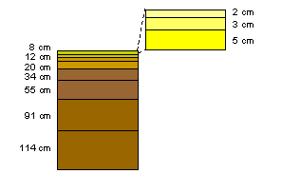
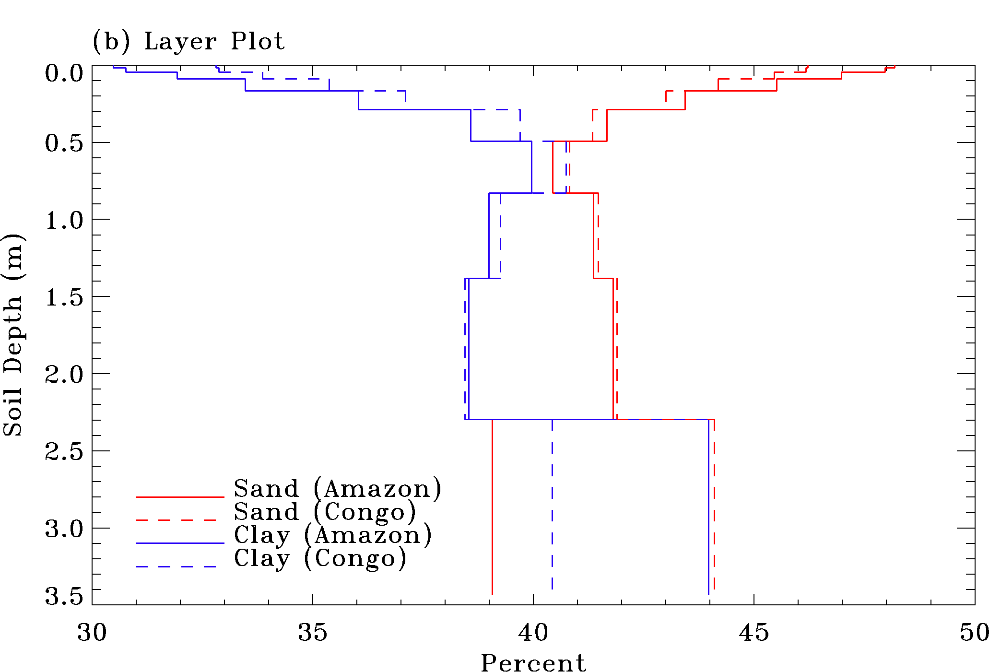
Soil Texture – thermal/hydrologic parameters
Soil parameters are derived from sand / clay percentage and soil organic matter content which is specified geographically and by soil level
      Soil moisture concentration at saturation
      Soil moisture concentration at wilting point
      Hydraulic conductivity at saturation
      Saturated soil suction
      Thermal conductivity
      Thermal capacity
150 cm
Soil profile
10 soil levels (~3.8m)
5 bedrock levels (~42m)
Notes:
Currently we have 10 layers of soil that goes to about 3.8 meters deep. These layers increase in thickness deeper into the soil column. They are thinner at the top to better represent the diurnal cycle of soil moisture and temperature.
Recently we’ve added 5 more layers that are characterized as bedrock to better capture the thermal evolution of the soil, this is particularly important for representing permafrost. These layers go down to about 42 meters.
The thermal and hydrologic parameters of the soil are derived from equations based on datasets of soil texture, i.e., sand/clay and soil organic matter…
Again, this is another source of uncertainty in the model.
This is showing soil texture for the Amazon and Congo. These tropical soils are sandy near the surface with higher clay content deeper in the soil.

Slide 48
Plant Function Type distribution in CLM45 based on MODIS/Crop datasets
Lawrence and Chase, 2007
Notes:
Here’s a map of what we are currently using. Year 2000
MODIS data reclassified into PFTS. Here we are grouping these into more general categories.
Here you can see the boreal forest, tropical forests and savannahs. You can see some of the shrubs are in Australia and southwest U.S., etc., but mostly in the Arctic. Our Arctic guy, Dave Lawrence, has been to the Arctic, and thinks there might be too many shrubs.
We use some separate datasets to determine cropping. We currently have one generic crop type but recently we’ve been developing other crop types.

Slide 49
On average, dry seasons will get drier and wet seasons will get wetter
Anthropogenic GW withdrawal can be detected with CLM
Urban areas will see larger ⬆ in heat waves than rural areas
Permafrost-carbon feedback likely to amplify climate change; methane ‘bomb’ unlikely
Western US forests vulnerable to climate change
Crop yields ⬆ due to CO₂ fertilization, but ⬇ due to climate change
Land use and land cover change impact on climate depends on location
Nutrient cycling uncertainty amplifies C cycle uncertainty

Slide 50
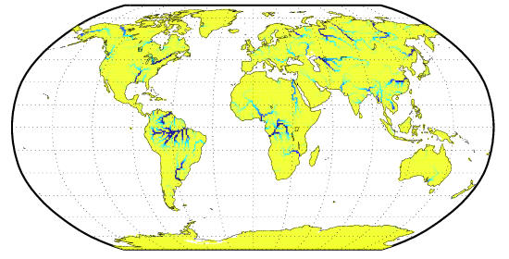


River Directional Map
20-yr average river flow (m³ s⁻¹)
River discharge
Raw GCM runoff
Routed GCM runoff
Observed riverflow
Notes:
The runoff that is generated by the land model (surface and sub-surface) needs to be routed to the ocean. We use a dataset that is essentially a directional map.
So here is a plot of river flow in m3 per second. You can see the major rivers here, for example, the Amazon, the Congo, and the Mississippi. This water is passed to the ocean at the ocean gridcells that are nearest the river mouth.
This directional map is at 0.5 degree resolution currently, although we’ve been starting to work with finer resolution maps of 0.1 degrees.
Need the river transport model to spatially distribute the runoff and also get the seasonal cycle correct.
The right plot shows river discharge at the mouth of the Mackenzie River.
So if we were to dump the raw runoff into the ocean, the peak runoff would be in April which is the snow melt season. However, routing it through RTM delays the peak to June/July which is closer to what is observed.

Slide 51
Parameterizations and submodels
Parameterizations and Submodels
  Surface albedo and radiative fluxes (3,4)
  Momentum, sensible and latent heat fluxes (5)
  Soil and snow thermodynamics (6)
  Stomatal resistance and photosynthesis (8)
  Hydrology (7)
  Carbon / nitrogen pools, allocation, respiration (13)
  Vegetation phenology (14)
  Decomposition (15)
  External nitrogen cycle (16)
  Plant Mortality (17)
  Carbon isotopes (25)
  Lake model (9)
  Glacier model (10)
  River Transport model (11)
  Urban model (12)
  Fire model (18)
  Methane model (19)
  Crops and irrigation (20)
  DGV model (22)
  BVOC model (23)
  Dust emissions model (24)
Notes:
That is some background on model structure and surface/input datasets.
On to parameterizations and submodels.
The items on the left here can be regarded as parameterizations while the ones on the right are mainly landcover type and process submodels. For example, we have submodels for lake, glacier, etc.
I can’t cover all of this so I’ll mainly be talking about the biophysical aspects related to vegetation and soil, focusing on the ones that are related to biogeophysics in red here. I’ll also show some things about the urban model which is my own research focus. The numbers here refer to the chapter in the CLM4.5 technical note if you want more information.
A physical process or climate system variable, say latent heat flux, is parameterized as a function of certain parameters (e.g., surface albedo, aerodynamic roughness length, and surface moisture availability). The parameterization will involve a mathematical description of how the parameters interact to represent the climate system variable.

Slide 52


Modeling surface albedo
Surface albedo a function of
  Vegetation cover and type
  Snow cover
  Snow age
  Soil moisture
  Soil color
  Solar zenith angle
  Amount of direct vs diffuse solar radiation
  Amount of visible vs IR solar radiation
Note: MODIS albedo biased low for snow at high zenith angle
(Wang and Zender, 2010)
Notes:
We model surface albedo as a function of…
Here we are comparing modeled albedo to that from MODIS satellite-derived albedo for boreal summer and boreal winter.
ASA is all-sky albedo (direct+diffuse in vis+nir).
You can see the model is doing a decent job here over most of the land except most obviously for high-latitudes in boreal winter. Part of this is due to the fact that MODIS albedo is biased low for snow-covered areas at high solar zenith angles.

Slide 53

Two-stream radiative transfer
Radiative transfer uses the two-stream approximation (Dickinson, Sellers) to determine reflected and absorbed solar radiation
Unscattered direct beam
Scattered direct beam
Slide courtesy G. Bonan
Notes:
These albedos are used in our radiative transfer model to determine the reflected and absorbed solar radiation.
We use what’s called a two-stream radiative transfer model (upward and downward fluxes) and apply it to diffuse and direct solar radiation for vegetation canopy and ground.
For an incoming unit of diffuse radiation (scattered), some is absorbed by the canopy (represented by a leaf area index), some is scattered upward, and some is transmitted downward through the canopy. Of the transmitted radiation, some is absorbed by the ground according to the ground albedo and some is scattered upward and we assume that this upward scattered radiation is all absorbed by the canopy. We then get our upward diffuse radiation. The “rhos” are effectively the albedos that are passed to the atmosphere model.
For an incoming unit of direct beam radiation, some is absorbed by the canopy, some is transmitted downward as unscattered radiation (this is a function of the extinction coefficient Kb and the leaf area index L). Again, some of this is absorbed by the ground and some is scattered upward to be absorbed by the canopy.
Some of the incoming direct beam is also scattered downward and upward to either be absorbed/reflected by the ground or escape the canopy.

Slide 54
Momentum, and sensible heat and evaporation fluxes
Momentum flux
and
Sensible heat flux
and
Evaporation
and
z
Height
r_{aM}
r_{aM}
r_{aH} = r_{aM} + r*_{b}
d+z_{0M}
r*_{b}
d+z_{0H}
u_{s} = 0
Wind speed
u_{z}
θ_{z}
Temperature
θ_{s}
Slide courtesy G. Bonan
Notes:
These are called bulk formulations for momentum (drag of the land on the atmosphere), sensible, and latent heat fluxes. CLM’s approach is actually more complicated than this, but this is a simple way of understanding how these fluxes are formulated.
Fluxes are written in a manner analogous to diffusion, proportional to a gradient times a conductance.
For momentum, it is the difference in wind speed between the atmosphere and the wind speed at the surface which is taken at a height where the wind speed is zero, divided by the aerodynamic resistance to momentum transfer. This height is z0 (roughness length) but is adjusted relative to a reference height known as the zero-plane displacement height (protrusion of roughness elements above the surface displaces turbulent flow upward).
Sensible heat and evaporation are similar except that we use the differences in temperature for sensible heat and humidity for evaporation.
There is an extra resistance term for sensible heat and evaporation because transfer of momentum is effected by pressure fluctuations in the turbulent wakes behind the roughness elements, whilst for heat and water vapor transfer no such dynamical mechanism exists. Rather, heat and water vapor must ultimately be transferred by molecular diffusion across the interfacial sublayer. The rb* term is the additional boundary layer resistance for sensible/latent heat exchange from the canopy and accounts for the smaller roughness length for heat/moisture compared with momentum.
Thus the apparent sources of heat and moisture occur at a lower height in the canopy than the apparent sink of momentum.

Slide 55
Plant canopies
Sensible Heat
T_{a}
T_{a}
T_{a}
r_{a}
r_{a}
r_{a}
r_{b}
r_{b}
T_{ac}
T_{v}
T_{s}
T_{s}
r_{ac}
T_{g}
Bulk Surface
No Vegetation
Bulk Surface
With Vegetation
Dual Source
Latent Heat
e_{a}
e_{a}
e_{a}
r_{a}
r_{a}
r_{a}/β
r_{c}
r_{c}
e_{v}
e_{s}
e_{ac}
e_{s}
r_{ac}
e_{g}
Bare Surface
No Vegetation
Bulk Surface
With Vegetation
Dual Source
Notes:
What I just described is shown here, for a bulk surface with vegetation. The approach CLM actually uses is called a dual source approach. Quite similar to what I showed, but instead of a single source for the fluxes as in the bulk surface approach there are two sources, one from the ground with a ground temperature and one from the vegetation with a canopy temperature. These sources are combined in a canopy air space where we prognose temperature and humidity.

Slide 56

Snow/Soil thermodynamics
      Solve the heat diffusion equation for multi-layer snow and soil model
where C_{p} (heat capacity) and K (thermal conductivity) are functions of:
temperature
total soil moisture
soil texture
ice/liquid content
Notes:
We put our snow pack on top of the soil column I described earlier and we solve the heat diffusion equation for the multi-layer snow and soil column.
We need to calculate heat into the soil, so we use a heat diffusion equation that solves the snow and soil layers together. This depends on the thermal properties of the soil/snow, namely heat capacity and thermal conductivity which in turn depend on temperature, soil moisture, soil texture, and ice/liquid content.
This is showing a site at high latitudes that’s very cold. Snow on the ground in winter and soil temperatures are cold but not as cold as the air temperature because of the insulative effects of the snow. The snow melts in spring and the soil is now warming in summer but still below freezing at lower soil layers.

Slide 57




Modeling Permafrost in CLM
Lawrence et al., J. Climate, 2011
Notes:
Because we account for these effects we can also provide an estimate of permafrost.
Purple area in the right figure describes where most of the continuous permafrost is. So you can see here we are doing a pretty good job in CLM4 with this.
We are also doing a good job of capturing the depth of thaw each summer.

Slide 58

Leaf photosynthesis
Slide courtesy G. Bonan
Notes:
A variety of factors influence net photosynthesis. This is an example for jack pine trees.
Increases with light, increases with temperature to an optimum temperature at which it decreases.
Stomata start closing at high vapor pressure deficits to reduce water loss during transpiration and also at when foliage water potential decreases (when transpiration exceeds root uptake of water).
Net photosynthesis increases with higher CO2 concentration and with higher foliage nitrogen as well. (nitrogen is an essential component of chlorophyll and rubisco)

Slide 59
Leaf photosynthesis and stomatal conductance
Farquhar photosynthesis model
w_{c} is the rubisco-limited rate of photosynthesis, w_{j} is light-limited rate allowed by RuBP regeneration, w_{p} is product limited rate of carboxylation
Light Response Curve
20
18
16
14
W_{j}
12
Photosynthesis (μmol CO₂⋅m⁻²⋅s⁻¹)
10
8
W_{c}
rubisco-limited rate is
6
W_{j}
4
2
0
0
100
200
300
400
500
600
700
800
900
1000
Photosynthetic Photon Flux Density (μmol photons⋅m⁻²⋅s⁻¹)
RuBP regeneration-limited rate is
product-limited rate is
Ball-Berry stomatal conductance
Slide courtesy G. Bonan
Notes:
All of this is incorporated into the leaf photosynthesis and stomatal conductance models that we use.
We use the Farquar photosynthesis model in which net photosynthesis is the lesser of three rates, a rubisco-limited rate, a light-limited rate, and a product limited rate, and Rd is dark respiration (CO2 loss during leaf respiration – the process by which organic compounds are oxidized to produce the energy needed to maintain plant functions and grow new plant tissue).
Vmax: maximum rate of carboxylation
Ci: partial pressure of CO2 in leaf chloroplast
Gamma*: CO2 compensation point
Kc/Ko: Michaelis-Menten constants for the carboxylation and oxygenation of rubisco
Oi: partial pressure of oxygen in leaf chloroplast
Jmax: maximum potential rate of electron transport.
Tp: triose phosphate utilization rate which is a function of Vcmax
Then we use the Ball-Berry stomatal conductance model where stomatal conductance is a function of a constant g1 (which is essentially the slope of the stomatal conductance-net photosynthesis relationship), the humidity hs, CO2 partial pressure at the leaf surface Cs, atmospheric pressure, the minimum leaf conducance g0, and then a factor which describes soil moisture limitation effects.

Slide 60

Plant canopy as a “big leaf”
Leaf
Boundary
Layer
Atmosphere
Surface
Layer
Stomata
Canopy
Total Resistance
Total Resistance
r_{b}/2
r_{b}/(2L)
r_{a}
Sensible Heat
T_{s}
Sensible Heat
T_{s}
T_{a}
r_{b}/2
T_{ac}
T_{a}
r_{b}/(2L)+r_{a}
r_{s}
r_{b}
r_{s}/L
r_{b}/L
r_{a}
e_{i}=e*(T_{s})
Latent Heat
e_{i}=e*(T_{s})
Latent Heat
e_{s}
e_{a}
(r_{s}+r_{b})
e_{s}
e_{ac}
e_{a}
(r_{s}+r_{b})/L+r_{a}
1.6r_{s}
1.4r_{b}
1.6r_{s}/L
1.4r_{b}/L
c_{i}
Photosynthesis
c_{i}
Photosynthesis
c_{s}
c_{a}
(1.6r_{s}+1.4r_{b})
c_{s}
c_{a}
(1.6r_{s}+1.4r_{b})/L
Most models use two-leaves (sunlit and shaded)
Dai et al. (2004) J Climate 17:2281-2299
Slide courtesy G. Bonan
Notes:
Then we essentially scale up leaf photosynthesis to canopy photosynthesis by using leaf area index. We do this separately for sunlit and shaded leaves, recognizing that leaves growing in shade generally have lower photosynthetic capacity and maximum stomatal conductance than leaves growing in sun.

Slide 61






Evaluating the model with tower flux data
Global Flux Tower Network
Notes:
One way to evaluate all of these processes in the model is to use tower flux sites. There are literally hundreds of these around the world. Here we can set the model up for a single point or gridcell and run the model with atmospheric forcing derived from the tower site.
We can compare the model fluxes to those observed at the tower site.

Slide 62



Evaluating CLM4.5 with tower flux data
Howland Forest, Maine, July, 1996
Notes:
This is an example of evaluating CLM4.5 using hourly data from a tower site in the Howland Forest in Maine.
These are scatter plots of net radiation, sensible and latent heat flux, and GPP (gross primary production – photosynthesis).
These are a summary of statistics, r is the correlation coefficient and RMSE is the root mean square of model hourly fluxes compared to observed.
So you can see here that CLM4.5 is doing a decent job overall. There seems to be a problem with the model having higher net radiation than observed. Albedo could be too low or surface temperature too low.

Slide 63

Evaluation of radiation/photosynthesis models using global synthesis of tower flux data
Gross Primary Production
117 Pg C yr⁻¹
165 Pg C yr⁻¹
Control
155 Pg C yr⁻¹
130 Pg C yr⁻¹
Radiative transfer for sunlit and shaded canopy
Radiative transfer and photo-synthesis
CLM4 overestimates GPP. Model revisions improve GPP.
Fluxnet-MTE: Beer et al. 2010, Jung et al. 2010
Bonan et al. 2011, 2012
Notes:
Lately, we have also been using a dataset that is a global synthesis of all of this tower flux data, called the FLUXNET-MTE product, so that we can do a global evaluation of the model.
For example, this is a comparison of gross primary production between the FLUXNET-MTE product which is at 117 Pg C yr-1 and CLM4 at 165 Pg C yr-1, and then CLM with a revised two-stream radiative transfer scheme at 155 Pg C yr-1 and CLM with the new radiative transfer scheme and an updated leaf photosynthesis scheme. This last is essentially CLM4.5.
We can see that CLM4 overestimates GPP particularly in the tropics and CLM4.5 is much closer to observations in the tropics and in the global mean.

Slide 64

Evaluation of radiation/photosynthesis models using global synthesis of tower flux data
Latent Heat Flux
65 x 10³ km³ yr⁻¹
68 x 10³ km³ yr⁻¹
65 x 10³ km³ yr⁻¹
Model improvements reduce ET biases, especially in tropics, and improve monthly fluxes
Fluxnet-MTE: Beer et al. 2010, Jung et al. 2010
Bonan et al. 2011, 2012
Notes:
We see similar improvements for latent heat flux as well.
CLM4a: RAD+PSN+KN (revised canopy scaling) (effectively this is CLM4.5)

Slide 65

Manhattan-Mannahatta: on right is a reconstruction of Manhattan Island circa 1609 (called “Mannahatta” by the Lenape native Americans), as compared to today, based on historical landscape ecology and map data.
Markley Boyer / The Mannahatta Project / Wildlife Conservation Society and the aerial view of modern Manhattan, Amiaga Photographers. In: Climate Change and Cities: First Assessment Report of the Urban Climate Change Research Network (ARC3) (2011)
Notes:
The last thing I want to mention is the urban model.
So if one takes a closer look at the land surface we can see that urban areas are among the most profoundly altered landscapes away from natural ecosystems and processes.
Figure illustrates a recent reconstruction of the verdant “Mannahatta” island circa 1609 as compared to the current landscape 400 years later
So this is typically what land models are parameterized for whereas this is actually what the landscape looks like.
You can imagine that living here is going to be a great deal different from living here in terms of climate and weather among other things. This is particularly important when one considers that just more than 50% of the global population lives in urban areas and the percentage of urban dwellers is expected to increase in the future.

Slide 66
Main Features of the Community Land Model
Structural aspects (surface and input datasets)
  Heterogeneity of landscape, tiling (vegetated, urban, lake, wetland, glacier)
  Plant Functional Types and associated properties (optical, morphological, photosynthetic)
  Land cover change (changes in PFTs over time)
  Soil texture (sand, silt, clay, organic matter) and color (albedo)
  River routing
  Aerosol (snow albedo) and nitrogen deposition (CN)
Notes:
First of all structural aspects. I’ll describe these in more detail..
We deal with the significant heterogeneity of the landscape through a tiling method, as many land surface models do, we have broad landcover types.
Vegetation is broadly categorized by plant functional types – 17 currently in the model. Parameters describing the characteristics of each of these types are specified.
We also have datasets that describe changes in these PFTs over time.
Soil texture determines soil thermal and hydraulic properties and soil color determines soil albedo.
We need a map of how rivers proceed across the landscape (directional maps) to get the runoff that is generated by the soil model to the ocean
Other datasets include aerosol deposition which affects the albedo of snow and nitrogen deposition which affects plant growth in our carbon-nitrogen model.
All of this has to be described globally in the climate model.

Slide 67



River Discharge
Annual discharge into
Global ocean
River flow at outlet
Top 50 rivers (km³ yr⁻¹)
Obs
CLM4CN
CLM4SP
CLM3.5
CLM4SP
CLM3
Accumulated discharge from 90 ºN (10⁶ m³ s⁻¹)
CLM3: r = 0.86
CLM3.5: r = 0.87
CLM4SP: r = 0.94
CLM4CN: r = 0.77
Notes:
RTM turns out to be a good way to evaluate the model because we have a lot of observations of river discharge.
We can compare CLM to observed data and see if we getting enough runoff. Plot on the left shows accumulated discharge from north to south for various model versions compared to observed (black line).
Have problems in the Amazon.
You can see that the latest version of the model, CLM4SP, is improved over previous versions, although we still have problems in the Amazon.
The plot on the right is for river flow at outlet for the world’s top 50 rivers. The correlation between model and observations indicates that again CLM4 is improved over previous versions of the model.
It’s important to note here that part of our good agreement is due to the fact that we are running here with observed precipitation. Here we are not coupled with the atmosphere model so there are no model biases being translated into runoff.
Another point I wanted to make here is that you can see that the carbon-nitrogen version of the model, CLM4CN, has degraded performance compared to the satellite phenology version, CLM4SP. This is because leaf area and photosynthesis/transpiration is too high and so runoff is lower. This is something we are working on.

Slide 68
Main Features of the Community Land Model
Component submodels
  Vegetation/Soil
    Hydrology (evapotranspiration, runoff, soil moisture, groundwater, river transport)
    Snow
    Soil thermodynamics
    Surface albedo and radiative fluxes
  Urban, Crop, Lake, Wetland, and Glacier
  Biogeochemistry
    Dust
    Biogenic Volatile Organic Compounds
    Carbon-Nitrogen
    Dynamic Vegetation
Notes:
That is some background on model structure and surface/input datasets.
On to component submodels. I’ll mainly be talking about the submodels related to vegetation and soil.

Slide 69



Groundwater in CLM
Groundwater controls runoff
(Yeh and Eltahir, 2005)
Yeh and Eltahir, 2005
Groundwater affects soil moisture and ET (Gutowski et al, 2002; York et al., 2002)
Streamflow (mm/mon)
Precipitation (mm/mon)
GW level (m)
Groundwater model (SIMGM) determines water table depth
water table
Subsurface runoff is exponential function of water table depth
Niu et al. 2007
Notes:
Groundwater or the water table depth is an important aspect of hydrology that has been recently added to the model.
We can see here that streamflow and precip are not very well correlated. But streamflow is highly correlated with groundwater or the water table depth.
So we also have a simplified ground water model (SIMGM) that calculates a mean water table position based on mean soil water properties.
The third runoff term, the subsurface runoff or baseflow, is also tied to the water table depth. As the water table rises, baseflow increases. As the water table lowers, baseflow decreases.
If the water table is in the soil column, the baseflow water is removed from the soil layers within the water table. If the water table is below the soil column, the baseflow water is removed from the aquifer.

Slide 70



Abracos tower site (Amazon)
Latent Heat Flux
Latent Heat Flux
Model
Model
CLM3
CLM3.5/4
OBS
OBS
Total soil water
CLM3.5/4
CLM3
Notes:
So why does this improvement in water storage matter?
This is an example of comparison of CLM to observations from a flux tower in the Amazon.
One of the errors we had in CLM3 was that if you look at latent heat flux, we weren’t able to simulate high values of latent heat flux.
Biggest latent heat fluxes happen in the dry season in the Amazon when there is a lot of solar radiation.
In CLM3 the soil was too dry in the dry season because we didn’t store enough water from the wet season and we couldn’t support these high ET rates.
With the new version of the model our soil water storage is improved and our latent heat fluxes are higher and closer to observations.

Slide 71



Snow cover fraction
How much of a grid cell is covered with snow for a given snow depth?
Niu and Yang 2007
Notes:
Another important snow parameterization is snow cover fraction, in other words how much of the grid cell is covered by snow. Need this information to model albedo.
Blue is what we used to have, red is what we have now, dashed line is observations. So again we are showing a model improvement.
The reason for this is that we’ve switched to a formulation that computes SCF as a function of snow density in addition to snow cover depth
For a given snow depth, you can get different SCFs just from different snow densities, in other words different SCFs during snow accumulation and melt phases. Denser snow (spring, melt phase) yields lower SCF for the same snow depth.
The density dependent formulation accounts for the observation that there is a sharper rise in fsno with snow depth early in the snow season (e.g., October), when snowpack density is comparatively low than there is during the warmer melt season (e.g., May) when the snowpack is comparatively dense.

Slide 72



Prognostic vegetation state with CN active
LAI
Alaskan Arctic
Annual discharge into
Global ocean
Obs
CLM4CN
CLM4SP
CLM3.5
Northwest Europe
Accumulated discharge from 90 ºN (10⁶ m³ s⁻¹)
Amazonia

Slide 73
Photosynthesis model
Plant physiological controls on evapotranspiration
Function of solar radiation, humidity deficit, soil moisture, [CO2], temperature
Stomatal Gas Exchange
CO₂
H₂O
Leaf cuticle
Guard cell
Guard cell
Photosynthetically
active radiation
Chloroplast
light
CO₂ + 2 H₂O → CH₂O + O₂ + H₂O
Bonan (1995) JGR 100:2817-2831
Denning et al. (1995) Nature 376:240-242
Denning et al. (1996) Tellus 48B:521-542, 543-567
Cox (1999)
Figure courtesy G. Bonan

Slide 74
Land models have come a long way
1st Generation: Bucket Model
Precipitation
Evaporation
E = β E_{p}
β = 1 for w ≥ w₀
β = w/w₀ for w < w₀
Critical depth, w₀
Runoff
Water depth, w
Bucket Model
Manabe (1969) Mon Wea Rev 97:739-774
Williamson et al. (1987) NCAR/TN-285+STR
Figure courtesy G. Bonan

Slide 75
Model components: Snow Model
Up to 5-layers of varying thickness
Treats processes such as
  Accumulation
  Snow melt and refreezing
  Snow aging
  Water transfer across layers
  Snow compaction
    destructive metamorphism due to wind
    overburden
    melt-freeze cycles
  Sublimation
  Aerosol deposition
Snow depth
T_{snow}
Snow depth
T_{snow}
Notes:
The number of layers and their thickness, their water and ice content and temperature, are calculated at each time step of the model.
Here, we are showing temperature profile of the snow, with warmer layers near the snow. Snow is a good insulator, keeps the soil warm.

Slide 76

Urban Heat Island in CCSM4
Present day Urban Heat Island (UHI) simulated by CLM Urban (°C)
Modeled UHI ranges from near-zero up to 4°C with spatial and seasonal variability controlled by urban to rural contrasts in energy balance.
Notes:
This plot shows the urban heat island generated by the model.
In the model, the urban heat island is defined at each grid cell by the difference between the urban air temperature and the rural (the vegetated surfaces) air temperature.
The color scale emphasizes the fact that urban areas are almost always warmer than rural areas, up to 4 degrees C warmer
This particular plot is from the CORE 20th century CCSM4 simulation (1986-2005).

Slide 77


Morgan Monroe State Forest tower site
OBS
CLM3
Latent
Heat
Flux
OBS
CLM3
Sensible
Heat
Flux
Stöckli et al. 2008
Notes:
Here’s an example of how a tower site comparison has identified another problem.
This is showing the seasonal cycle of latent and sensible heat.
In version 3 of CLM3, we were not getting enough latent heat flux and too much sensible heat flux in summer. So bowen ratio is completely wrong which could certainly affect the boundary layer for example.

Slide 78

Morgan Monroe State Forest tower site
OBS
CLM3
CLM3.25
Reduced canopy interception
Permits more water to enter soil
Groundwater/aquifer model
Stores/releases moisture on seasonal-decadal timescales
Latent
Heat
Flux
Stöckli et al. 2008
Notes:
We found that our canopy interception was too high so we reduced canopy interception and added our groundwater model which improved our soil water storage. You can see we are doing somewhat better with latent heat in this interim version of the model.
However, getting too much latent heat in winter/spring, even more than previously, and we still seem to have this summer drought that doesn’t exist in the observations.

Slide 79

Tower flux statistics (15 sites incl. tropical, boreal, mediterranean, alpine, temperate; hourly)
 | Latent Heat Flux |  | Sensible Heat Flux
 | r | RMSE (W/m²) | r | RMSE (W/m²)
CLM3 | 0.54 | 72 | 0.73 | 91
CLM3.5 | 0.80 | 50 | 0.79 | 65
CLM4SP | 0.80 | 48 | 0.84 | 58
Notes:
So we have a number of sites we use to test the various versions of the model as we develop it.
These are a summary of statistics, r is the correlation coefficient and RMSE is the root mean square of model hourly fluxes compared to observed.
So you can see here that as we go from CLM3 to CLM4 we are improving our modeling of both latent heat and sensible heat. From CLM3 to CLM3.5 we improved mainly latent heat but there was some improvement in sensible heat. From CLM3.5 to CLM4 the improvement was mainly in sensible heat.

Slide 80
River Transport Model (RTM)
20-yr average river flow (m³ s⁻¹)
Notes:
The runoff that is generated by the land model (surface and sub-surface) needs to be routed to the ocean. We use a dataset that is essentially a directional map.
So here is a plot of river flow in m3 per second. You can see the major rivers here, for example, the Amazon, the Congo, and the Mississippi. This water is passed to the ocean at the ocean gridcells that are nearest the river mouth.
This directional map is at 0.5 degree resolution currently, although we’ve been starting to work with finer resolution maps of 0.1 degrees.

Slide 81
Other CLM development activities
  Soil carbon and nitrogen biogeochemistry
  Ecosystem demography, temporal response to disturbance
  Sub-surface hydrological processes
  Sub-grid soil moisture and snow heterogeneity
  3-D canopy radiation
  Integrated Assessment Modeling
  Water (and carbon?) Isotopes
  N₂O emissions
  Phenology
  Phosphorous
  Data assimilation
  Riverine transport of nutrients and sediments

Slide 82
CLM Development
http://www2.cesm.ucar.edu/working-groups/lmwg/developer-guidelines

Slide 83



Land cover change (prescribed)
2005 – 1850
Trees Crops
Deforestation across Eastern North America, Eastern Europe, India, China, Indonesia, SE South America for Crops
Lawrence, P et al. J. Climate, 2012
Notes:
So for example, these are the changes in fractional cover of trees and crops from 1850 to 2005.
We can clearly see deforestation across…
Some reforestation is evident in the Eastern U.S. and Western Europe.

Slide 84

Impact of historical land cover change on climate
1976 to 2005 – 1850 to 1879
Notes:
These changes of course will have effects on the surface energy and water balances.
Here for example we are showing the effect on surface albedo and near-surface air temperature.
These are showing differences between present day and 1850 essentially.
Here we compare a full transient simulation to one with land cover change alone.
The full transient is our best representation of how CO2, aerosols, nitrogen deposition, and landcover has changed over the 20th century.
So in the full transient you can see a decrease in albedo mainly at high latitudes due to decreases in snow cover. In the land cover change only simulation there are mainly increases in albedo related to the replacement of forest with higher albedo cropland.
In the full transient there is a warming everywhere due to mainly to CO2 but also due to lower albedo at high latitudes, but there is not as much warming over the U.S. The landcover change only experiment shows that the change in landcover is providing some cooling in the full transient simulation.
This is of course the result from one model, CLM4.

Slide 85





Arctic climate-change feedbacks
Arctic
warming
Carbon
sequester
Global
warming
Shrub
growth
CO₂
efflux
CH₄
efflux
Permafrost
warms and
thaws
Enhanced
nitrogen
Expanded
wetlands
Microbial
activity
increases
Lakes drain,
soil dries
Arctic runoff
increases
Adapted from McGuire et al., 2006
Notes:
Another thing we want to be able to do is to represent the terrestrial feedbacks going on in the earth system. This is an example of Arctic climate-change feedbacks in the Earth system.
We know that arctic temperatures are increasing faster than anywhere else in the world (about twice the global rate), this is warming and thawing permafrost. This increases microbial activity which liberates more nitrogen in the system which increases shrub growth and carbon sequestration (negative feedback because we are taking up more CO2). But shrubs also have a lower albedo than the tundra they are replacing which can lead to surface warming.
We could also get changes in hydrology. Wetlands can expand, but also can get situations where lakes drain and the soils dry and runoff increases. Wetlands result in more methane flux which contributes to global warming. Methane is a more potent greenhouse gas than CO2.
If lakes drain and soil dries and warms this could release the carbon stored in the soils.
So what exactly happens here can determine what happens to all the carbon in the soils.
At this point we can’t really represent most of these feedbacks in CLM, although we are working very actively on several aspects of this diagram.

Slide 86


What a land model within an Earth System Model that consists of so many important pieces?
distinguishes
The land is a critical interface through which:
1. Climate and climate change impacts
humans and ecosystems
and
2. Humans and ecosystems can force global
environmental and climate change
Notes:
What distinguishes a land model…
In other word, why do we care about the land?
The way we like to think about it is the land is a critical…
The land is really where we are feeling the effects of climate change.

Slide 87
Fate of anthropogenic CO₂ emissions (2002-2011 average)
8.3±0.4 PgC/yr 90%
4.3±0.1 PgC/yr
46%
2.6±0.8 PgC/yr
28%
Calculated as the residual
of all other flux components
+
1.0±0.5 PgC/yr 10%
26%
2.5±0.5 PgC/yr
Source: Le Quéré et al. 2012; Global Carbon Project 2012

Slide 88
Soil moisture – Precipitation feedback
How much does a precipitation-induced soil moisture anomaly influence the overlying atmosphere and thereby the evolution of weather and the generation of precipitation?
Notes:
Another important issue is land – atmosphere interactions, in particular the soil moisture-precipitation feedback.
How much does a precipitation-induced soil moisture anomaly influence the overlying atmosphere and thereby the evolution of weather and the generation of precipitation?
The strength of this feedback has important implications as to whether you can make seasonal forecasts of precipitation.
What if you have a rainy spring, how much does that influence subsequent summer rainfall?

Slide 89

Land-atmosphere interactions
GLACE: To what extent does soil moisture influence the overlying atmosphere and the generation of precipitation?
How does the representation of land-atmosphere interactions
affect simulation of droughts, floods, extremes?
Koster et al., 2004; IPCC
Notes:
This is an issue that we really don’t have a handle on as a community.
Regarding this, there was a study a few years ago called GLACE (Global Land Atmosphere Coupling Experiment) with major models around the world to evaluate land atmosphere coupling strength.
A metric was developed for coupling strength between soilwater and precipitation. Furthermore this experiment broke it down into soilwater and ET and ET and precipitation.
The higher the number, the larger the coupling strength.
So here we note that the models are all over the place. GFDL model has the highest overall coupling strength between soilwater and precipitation.
The Hadley center model had the lowest, it almost doesn’t matter what the soilwater is in determining seasonal precipitation.
CAM3 and CLM3 were participants in this study, we see that they had a pretty high coupling strength also, especially the coupling strength between ET and precipitation. I think that in the new model this is quite a bit lower.
Can see that CAM3 is very sensitive to changes in ET, while in CLM3 ET is not very sensitive to changes in soilwater.

Slide 90
The Community Land Model (CLM4.5)
Fluxes of energy, water, carbon, and nitrogen and the dynamical processes that control these fluxes in a changing environment
Oleson et al. (2013) NCAR/TN-503+STR
Spatial scale
1.25° lon × 0.9375° lat
(288 × 192 grid)
Temporal scale
30-minute coupling with atmosphere
Seasonal-to-interannual (phenology)
Decadal-to-century climate (disturbance, land use, succession)
Paleoclimate (biogeography)
Notes:
One of the biggest challenges in land surface modeling is trying to represent your model on a single slide or figure.
Dave Lawrence has attempted to do this in the JAMES paper that describes CLM4.
So what I’m going to do in this talk is to try to describe how CLM models these processes; surface energy fluxes, hydrology, biogeochemical cycles, and some of these other aspects such as urban climatology, river routing and discharge, landcover change including wood harvest, and vegetation dynamics.

Slide 91
The Community Land Model (CLM4.5)
Fluxes of energy, water, carbon, and nitrogen and the dynamical processes that control these fluxes in a changing environment
Oleson et al. (2013) NCAR/TN-503+STR
D. Lawrence et al. (2011) JAMES, 3, doi: 10.1029/2011MS000045
D. Lawrence et al. (2012) J Climate 25:2240-2260
Spatial scale
1.25° longitude × 0.9375° latitude (288 × 192 grid)
Temporal scale
30-minute coupling with atmosphere
Seasonal-to-interannual (phenology)
Decadal-to-century climate (disturbance, land use, succession)
Paleoclimate (biogeography)
Notes:
One of the biggest challenges in land surface modeling is trying to represent your model on a single slide or figure.
Dave Lawrence has attempted to do this in the JAMES paper that describes CLM4.
So what I’m going to do in this talk is to try to describe how CLM models these processes; surface energy fluxes, hydrology, biogeochemical cycles, and some of these other aspects such as urban climatology, river routing and discharge, landcover change including wood harvest, and vegetation dynamics.

Slide 92
Community Land Model (CLM4.5)
Surface energy fluxes
Biogeochemical cycles
Hydrology
Diffuse solar
Precipitation
Photosynthesis
BVOCs
Direct solar
Downwelling
longwave
Momentum flux
Wind speed
Fire
Autotrophic
respiration
0
u_{a}
Transpiration
Sensible heat flux
Evaporation
Latent heat flux
Reflected solar
Absorbed
solar
Emitted
longwave
Throughfall
Phenology
Vegetation C/N
Aerosol
deposition
Sublimation
Evaporation
Dust
Infiltra-
tion
N dep
N fix
CH₄
Heterotrop.
respiration
Melt
Surface
runoff
N₂O
SCF
Litterfall
Surface
water
Ground heat flux
Saturated
fraction
Soil (sand, clay, organic)
Soil
Root litter
Aquifer recharge
Soil
C/N
Denitrification
N leaching
Water table
N mineral-
ization
N
uptake
Sub-surface
runoff
Bedrock
Unconfined aquifer
Notes:
Snow on lake?

Slide 93
Land model processes - Hydrology
Rainfall
Canopy
evaporation
Transpiration
Throughfall
Sublimation
Surface runoff
Soil evaporation
Infiltration
α, T*, z_{o}
Sub-surface runoff
Notes:
This is a conceptual diagram of hydrologic processes in the model.
Starting with rainfall…

Slide 94
Land model processes - Hydrology
Rainfall
Canopy
evaporation
Stomatal conductance:
solar radiation, temp,
humidity deficit,
soil moisture, [CO₂] …
Nitrogen fertilization
Transpiration
Photosynthesis model
Throughfall
Sublimation
Surface runoff
Soil evaporation
Infiltration
α, T*, z_{o}
Sub-surface runoff
Notes:
For example we need a photosynthesis model to calculate transpiration.
Photosynthesis is the process of taking up CO2 from the atmosphere and is driven by solar radiation.
As plants fix or take up CO2 they lose water through stomata which is transpiration.
Stomatal conductance, the inverse of resistance, essentially a measure of the speed at which the plants take up CO2 and lose water, is a function of environmental variables such as solar radiation, temperature, humidity, soil moisture, CO2, nitrogen fertilization.

Slide 95
Land model processes - Hydrology
Rainfall
Canopy
evaporation
Transpiration
Photosynthesis model
Throughfall
Sublimation
Surface runoff
Soil evaporation
α, T*, z_{o}
Soil hydrology
model
T₁,
T₂,
T₃,
Runoff
Vertical water flow
Phase change
Sub-surface runoff
T₁₀,
Notes:
We also need a soil hydrology model to figure out what the transpiration rate is and whether the plant are water-stressed and also to determine runoff, vertical water flow and phase change in the soil (water to ice and ice to water).

Slide 96
Land model processes - Hydrology
Rainfall
Canopy
evaporation
accumulation
compaction
melt
Transpiration
Photosynthesis model
Snow
model
Throughfall
Sublimation
Surface runoff
Soil evaporation
α, T*, z_{o}
Soil hydrology
model
T₁,
T₂,
T₃,
Sub-surface runoff
T₁₀,
Notes:
And we need a snow model to calculate things like snow accumulation, compaction or densification, melt, and sublimation.

Slide 97


Snow, Ice, and Aerosol Radiative Model (SNICAR)
  Snow darkening from deposited black carbon, mineral dust, and organic matter
  Vertically-resolved solar heating in the snowpack
  Snow aging (evolution of effective grain size) based on:
    Snow temperature and temperature gradient
    Snow density
    Liquid water content and
    Melt/freeze cycling
Flanner et al (2007), JGR
Flanner and Zender (2006), JGR
Flanner and Zender (2005), GRL
Notes:
Another feature we’ve recently added to the snow model is called SNICAR developed by Mark Flanner now at the University of Michigan.
Due to the industrial revolution we’ve been depositing more black and organic carbon, and mineral dust onto snow (aerosol deposition) which changes its albedo.
We also account for the fact that solar radiation can penetrate into the snow pack and so we account for vertically-resolved solar heating.
Snow aging, changes in grain size also affect albedo, so this is also accounted for.

Slide 98

What distinguishes a land model within an Earth system model?
Earth system models use mathematical formulas to simulate the physical, chemical, and biological processes that drive Earth’s atmosphere, hydrosphere, biosphere, and geosphere
A typical Earth system model consists of coupled models of the atmosphere, ocean, sea ice, and land
Land is represented by its ecosystems, watersheds, people, and socioeconomic drivers of environmental change
The land model provides a comprehensive understanding of the processes by which people and ecosystems affect, adapt to, and mitigate global environmental change
(IPCC 2007)
Prominent terrestrial feedbacks
Snow cover and climate
Soil moisture-evapotranspiration-precipitation
Land use and land cover change
Carbon cycle
Reactive nitrogen
Notes:
What distinguishes a land model…
In other word, why do we care about the land?
The way we like to think about it is the land is a critical…
The land is really where we are feeling the effects of climate change.

Slide 99

Impact of historical land cover change on climate
Full transient (all forcings)
Land cover change only
Historical changes in annual surface albedo and temperature (1850 to 2005)
Key points:
LULCC forcing is counter to all forcing
LULCC forcing is regional, all forcing is global
P. Lawrence et al. (2012) J Climate 25:3071-3095
Notes:
These changes of course will have effects on the surface energy and water balances.
Here for example we are showing the effect on surface albedo and near-surface air temperature.
These are showing differences between present day and 1850 essentially.
Here we compare a full transient simulation to one with land cover change alone.
The full transient is our best representation of how CO2, aerosols, nitrogen deposition, and landcover has changed over the 20th century.
So in the full transient you can see a decrease in albedo mainly at high latitudes due to decreases in snow cover. In the land cover change only simulation there are mainly increases in albedo related to the replacement of forest with higher albedo cropland.
In the full transient there is a warming everywhere due to mainly to CO2 but also due to lower albedo at high latitudes, but there is not as much warming over the U.S. The landcover change only experiment shows that the change in landcover is providing some cooling in the full transient simulation.
This is of course the result from one model, CLM4.

Slide 100



Surface albedo (CLM offline compared to MODIS)
 | Bias (%) |  | RMSE (%)
Model | Snow-free | Snow depth> 0.2m | Snow-free | Snow depth > 0.2m
CLM3.5 | 2.7 | -5.0 | 4.1 | 11.9
CLM4SP | 0.4 | 2.9 | 2.0 | 13.2
Note: MODIS albedo biased low for snow at high zenith angle
(Wang and Zender, 2010)
Notes:
This shows a comparison of our surface albedo sub model for versions of CLM with the MODIS maps.
We had some biases in CLM3.5. Too high in tropics and too low in some of high latitudes.
CLM4 is better in tropics, but maybe a bit too low in boreal forest. Too high at the highest latitudes, however, there is some indication that the MODIS albedo may be biased low for snow at high solar zenith angles, so it might not be as bad as all that.

Slide 101


Soil (and snow) water storage (MAM − SON)
CCSM4
GRACE (obs)
CCSM3
GRACE satellite measures small changes in gravity which on seasonal timescales are due to variations in water storage
CCSM3 and CCSM4 data from
1870 and 1850 control
300 200 100 0 -100 -200 -300 (mm)
Notes:
The groundwater and water table depth turn out to be important for determining water storage in the model. This slide is showing the effects of including a groundwater model in CLM.
GRACE stands for Gravity Recovery and Climate Experiment and is a satellite product that measures minute changes in gravity which can be attributed mostly to seasonal changes in water storage.
So in GRACE data we can see Negative MAM – SON in SE Asia is a monsoon signal (pre minus post monsoon). The positive signal in southern tropics is due to the rainy season. Positive signal in high latitudes is snow accumulation in spring.
You can see we did a pretty poor job in CCSM3. Now we are doing better due in part to the fact that there was big emphasis on improving the hydrology parameterizations in CLM from CCSM3 to CCSM4. The groundwater parameterization is a big reason for this improvement.
Results are from 1850 CCSM4 and 1870 CCSM3 controls (years 871-900).

Slide 102


Modeling surface albedo
Surface albedo a function of
  Vegetation cover and type
  Snow cover
  Snow age
  Soil moisture
  Soil color
  Solar zenith angle
  Amount of direct vs diffuse solar radiation
  Amount of visible vs IR solar radiation
Notes:
We talked a bit about surface albedo.
We model surface albedo as a function of…

