Slide 1
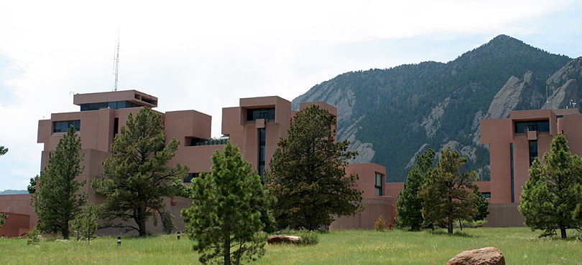
Slide 1 - Title
Land Modeling II - Biogeochemistry: Ecosystem Modeling and Land Use
Dr. Peter Lawrence
Project Scientist
Terrestrial Science Section Climate and Global Dynamics Division
(With thanks to TSS and IAM groups for their many contributions)
Notes:
Opening Slide

Slide 2
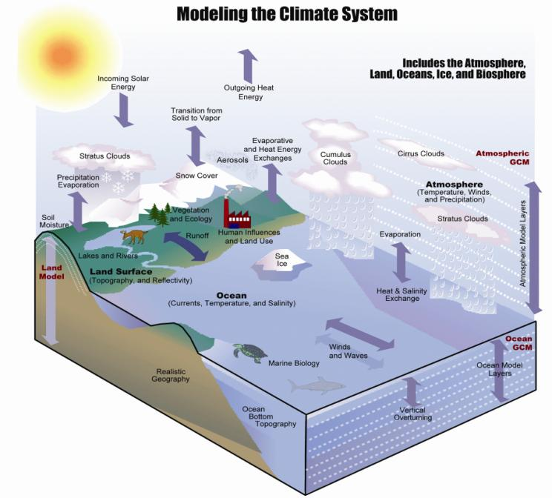
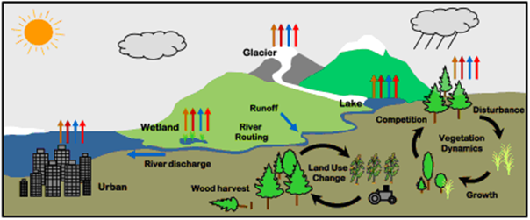
Understanding the Land Surface in the Climate System: Investigations with an Earth System Model (NCAR CESM)
The land is a critical interface through which:
1. Climate and climate change impacts humans and ecosystems
and
2. Humans and ecosystems can force global environmental and climate change

Slide 3
Understanding the Land Surface in the Climate System: Investigations with an Earth System Model (NCAR CESM)
Land Management in CESM:
How will Natural Ecosystems respond to changes in climate and CO₂?
How are we transforming Natural Ecosystems through Deforestation, Pasture, Wood Harvesting, or Afforestation?
How will Humanity Feed itself as the population grows, society becomes more affluent, and agriculture is impacted by climate and changing CO₂?

Slide 4
Community Land Model (CLM4.5)
Surface energy fluxes
Biogeochemical cycles
Hydrology
Diffuse solar
Precipitation
Photosynthesis
BVOCs
Direct solar
Downwelling
longwave
Momentum flux
Wind speed
Fire
Autotrophic
respiration
0
u_{a}
Transpiration
Sensible heat flux
Evaporation
Latent heat flux
Reflected solar
Absorbed
solar
Emitted
longwave
Throughfall
Phenology
Vegetation C/N
Aerosol
deposition
Sublimation
Evaporation
Dust
Infiltra-
tion
N dep
N fix
CH₄
Heterotrop.
respiration
Melt
Surface
runoff
N₂O
SCF
Litterfall
Surface
water
Ground heat flux
Saturated
fraction
Soil (sand, clay, organic)
Soil
Root litter
Aquifer recharge
Soil
C/N
Denitrification
N leaching
Water table
N mineral-
ization
N
uptake
Sub-surface
runoff
Bedrock
Unconfined aquifer
Notes:
Snow on lake?

Slide 5
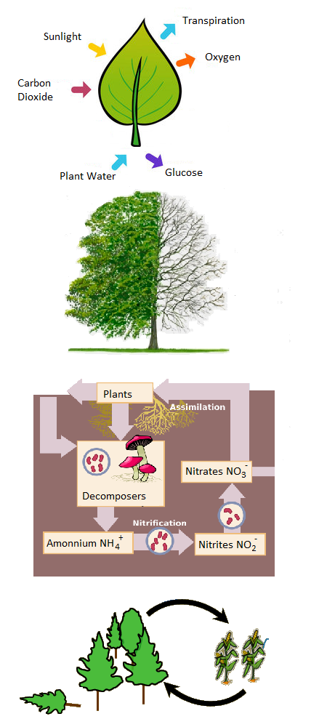
Slide 4 – Land Cover Change
CLM Vegetation Modeling Leaf to Landscape Processes
1. CLM Photosynthesis, Respiration and Transpiration Traits, Sunlight, CO₂, Temperature, Water and Nitrogen
2. Carbon Allocation for Leaf, Stem and Root growth from Photosynthesis, Nitrogen availability and Phenology
3. Soil Hydrology, Soil and Litter Carbon and Nitrogen Cycles, and Heterotrophic Respiration (Organic Matter Decay)
4. Land Cover Change, Wood Harvest, Mortality and Fire
5. Crop modeling with Planting, Fertilizer, Irrigation, Grain fill and Harvest
Notes:
Overview of the talk

Slide 6
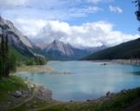
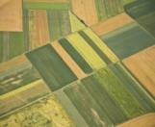
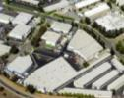
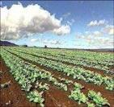
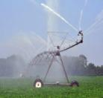
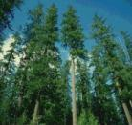
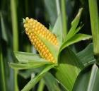
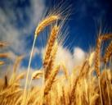
Community Land Model (CLM 4.5) subgrid tiling structure
Gridcell
G
V
PFT1
V
PFT3
Landunit
V
PFT2
L
C1I
C1U
V
PFT4
TBD
HD
Vegetated
Lake
MD
Glacier
Crop
C2I
C2U
Urban
UT,H,M
Column
Roof
Shade
Wall
Impervious
Soil
Sun Wall
Pervious
Unirrig
Irrig
Unirrig
Irrig
PFT
PFT1
PFT2
PFT3
PFT4 …
Crop1
Crop1
Crop2
Crop2 …
Notes:
This is a schematic of the subgrid structure of the land model. There are four distinct heirarchies in the model. There is the gridcell level. A gridcell is divided up into landunits, columns, and plant functional types or pfts.
Landunits are glacier, wetland, vegetated, lake, and now urban. Beneath the vegetated landunit is at least one soil type. Plant functional types then share this soil type and the energy and water budgets associated with this.

Slide 7
Glacier
Lake
Runoff
Disturbance
Wetland
River
Routing
Competition
Crops
Irrigation
Flooding
Vegetation Dynamics
River discharge
Land Use
Change
Urban
Wood harvest
Growth
G
V
PFT1
Landscape-scale dynamics
Long-term dynamical processes that affect fluxes in a changing environment (disturbance, land use, succession)
V
PFT3
V
PFT2
L
C1I
C1U
V
PFT4
C2I
C2U
UT,H,M
Oleson et al. 2013, CLM4.5 Technical Description, 430 pages
Notes:
Snow on lake?

Slide 8
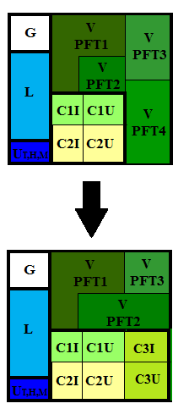
Gridcell
CLM 4.5 LULCC for Natural PFT and Crop
Landunit
TBD
HD
Vegetated
Lake
MD
Glacier
Crop
Urban
Unirrig
Irrig
Unirrig
Irrig
Crop1
Crop1
Crop2
Crop2 …
Notes:
This is a schematic of the subgrid structure of the land model. There are four distinct heirarchies in the model. There is the gridcell level. A gridcell is divided up into landunits, columns, and plant functional types or pfts.
Landunits are glacier, wetland, vegetated, lake, and now urban. Beneath the vegetated landunit is at least one soil type. Plant functional types then share this soil type and the energy and water budgets associated with this.

Slide 9
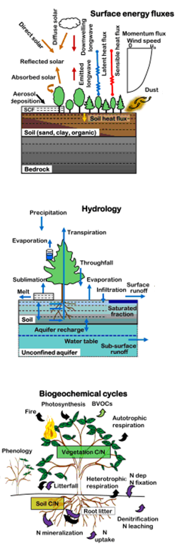
Slide 4 – Land Cover Change
Land Surface in the Climate System
1. Surface Energy Fluxes:
- Solar Energy Fluxes (Albedo – Vegetation, Snow, Soils)
- Long Wave Energy Fluxes (Surface Temp & Emissivity)
- Latent Heat Fluxes (Transpiration, Evaporation)
- Sensible Heat Fluxes (Surface Temp & Roughness)
2. Surface Hydrology:
- Rain and Snow (Vegetation, Snow Pack, Runoff)
- Transpiration, Evaporation, Snow melt, Sublimation
- Soil Hydrology 10 Soil Layers in CLM (Richards Eqns)
- Deep Aquifer recharge and drainage (Top Model)
3. Biogeochemistry (Carbon and Nitrogen Cycles):
- Plant Photosynthesis and Respiration
6 CO₂ + 6 H₂O + light -> C₆H₁₂O₆ + 6 O₂
- Carbohydrates are allocated to Leaves, Roots, Wood
- Leaves, roots and wood become litter, debris, soil C
- Organic decomposition and fire remove carbon
- Nitrogen is cycled impacting growth and decay
Notes:
Overview of the talk

Slide 10
Slide 4 – Land Cover Change
Land Surface in the Climate System
1. Surface Energy Fluxes:
- Solar Energy Fluxes (Albedo – Vegetation, Snow, Soils)
- Long Wave Energy Fluxes (Surface Temp & Emissivity)
- Latent Heat Fluxes (Transpiration, Evaporation)
- Sensible Heat Fluxes (Surface Temp & Roughness)
2. Surface Hydrology:
- Rain and Snow (Vegetation, Snow Pack, Runoff)
- Transpiration, Evaporation, Snow melt, Sublimation
- Soil Hydrology 10 Soil Layers in CLM (Richards Eqns)
- Deep Aquifer recharge and drainage (Top Model)
3. Biogeochemistry (Carbon and Nitrogen Cycles):
- Plant Photosynthesis and Respiration
6 CO₂ + 6 H₂O + light -> C₆H₁₂O₆ + 6 O₂
- Carbohydrates are allocated to Leaves, Roots, Wood
- Leaves, roots and wood become litter, debris, soil C
- Organic decomposition and fire remove carbon
- Nitrogen is cycled impacting growth and decay
Notes:
Overview of the talk

Slide 11
Slide 4 – Land Cover Change
Land Surface in the Climate System
1. Surface Energy Fluxes:
- Solar Energy Fluxes (Albedo – Vegetation, Snow, Soils)
- Long Wave Energy Fluxes (Surface Temp & Emissivity)
- Latent Heat Fluxes (Transpiration, Evaporation)
- Sensible Heat Fluxes (Surface Temp & Roughness)
2. Surface Hydrology:
- Rain and Snow (Vegetation, Snow Pack, Runoff)
- Transpiration, Evaporation, Snow melt, Sublimation
- Soil Hydrology 10 Soil Layers in CLM (Richards Eqns)
- Deep Aquifer recharge and drainage (Top Model)
3. Biogeochemistry (Carbon and Nitrogen Cycles):
- Plant Photosynthesis and Respiration
6 CO₂ + 6 H₂O + light -> C₆H₁₂O₆ + 6 O₂
- Carbohydrates are allocated to Leaves, Roots, Wood
- Leaves, roots and wood become litter, debris, soil C
- Organic decomposition and fire remove carbon
- Nitrogen is cycled impacting growth and decay
Notes:
Overview of the talk

Slide 12
Slide 4 – Land Cover Change
CLM allows us to do Ecosystem Modeling in a Changing World
Changes in Atmospheric CO₂ Impacts: - Photosynthesis rates through carbon availability - Transpiration rates through water use efficiency - Vegetation and air temperature - Rain, snow and evaporative demand through climate change with impacts on soil moisture
Changes in Aerosols and Nitrogen Impacts: - Direct and diffuse shortwave radiation - Nitrogen available for photosynthesis - Nitrogen available for allocating carbohydrate to plant tissues with feedbacks from canopy growth
Land Use and Land Cover Change Impacts: - Deforestation/Afforestation and Wood Harvesting - Agricultural expansion - Urbanization
Notes:
Overview of the talk

Slide 13
Slide 4 – Land Cover Change
CLM allows us to do Ecosystem Modeling in a Changing World
Changes in Atmospheric CO₂ Impacts: - Photosynthesis rates through carbon availability - Transpiration rates through water use efficiency - Vegetation and air temperature - Rain, snow and evaporative demand through climate change with impacts on soil moisture
Changes in Aerosols and Nitrogen Impacts: - Direct and diffuse shortwave radiation - Nitrogen available for photosynthesis - Nitrogen available for allocating carbohydrate to plant tissues with feedbacks from canopy growth
Land Use and Land Cover Change Impacts: - Deforestation/Afforestation and Wood Harvesting - Agricultural expansion - Urbanization
Notes:
Overview of the talk

Slide 14
Slide 4 – Land Cover Change
CLM allows us to do Ecosystem Modeling in a Changing World
Changes in Atmospheric CO₂ Impacts: - Photosynthesis rates through carbon availability - Transpiration rates through water use efficiency - Vegetation and air temperature - Rain, snow and evaporative demand through climate change with impacts on soil moisture
Changes in Aerosols and Nitrogen Impacts: - Direct and diffuse shortwave radiation - Nitrogen available for photosynthesis - Nitrogen available for allocating carbohydrate to plant tissues with feedbacks from canopy growth
Land Use and Land Cover Change Impacts: - Deforestation/Afforestation and Wood Harvesting - Agricultural expansion - Urbanization
Notes:
Overview of the talk

Slide 15
Slide 2 - Outline
Ecosystem Modeling in the Coupled Model Intercomparison Project (CMIP5) – CESM modeling for IPCC AR5
All CMIP5 Earth system models evaluated the impacts on the global carbon cycle from changes in climate, atmospheric CO₂ and aerosols due to Fossil Fuel emissions and Land Cover Change
2. Model simulations were performed for:
- 1850 – 2005 for the Historical period
- 2006 – 2100 Representative Concentration Pathways (RCPs)
3. For each Historical and RCP period land use and land cover change
are described through annual changes in four basic land units:
- Primary Vegetation (Prior to Human Disturbance)
- Secondary Vegetation (Disturbed then abandoned or managed)
- Cropping
- Pasture (Grazing Lands)
4. Harvesting of biomass is also prescribed for both primary and
secondary vegetation land units
Notes:
Overview of the talk

Slide 16
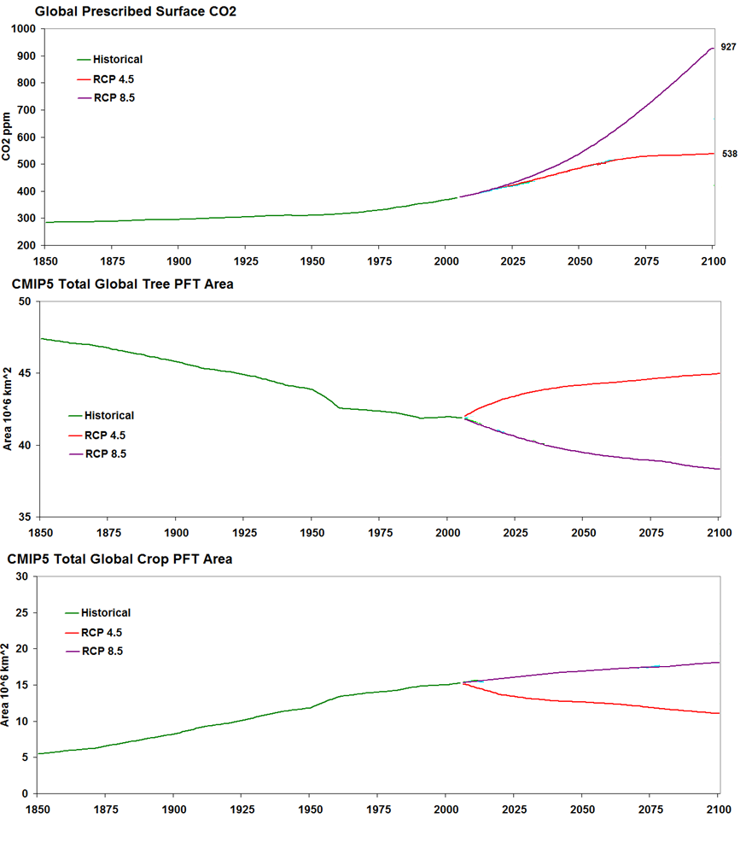
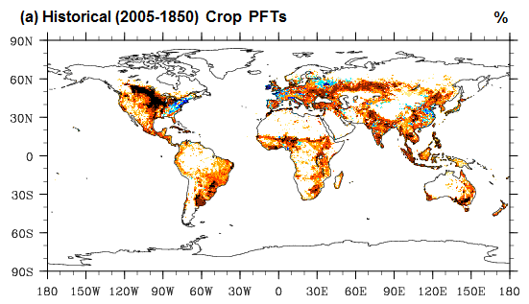
Ecosystems in CMIP5 Historical and RCP CO₂ and LULCC
Changes in Atmospheric CO₂: - Historical (1850 – 2005): 285 – 379ppm - RCP 4.5 (2006 – 2100): 380 – 538ppm - RCP 8.5 (2006 – 2100): 380 – 936ppm
Land Use and Land Cover Change: - Hist: Crop +9.8 ; Tree -5.5 10⁶ km² - RCP 4.5: Crop -4.2 ; Tree +3.0 10⁶ km² - RCP 8.5: Crop +2.8 ; Tree -3.5 10⁶ km²
Notes:
From Keith Lindsay’s interactive CO₂ run (20th Century has completed):
Net Ecosystem Production (+ is sink) shows the net carbon that ecosystems take up every year not accounting for wildfire and land use losses.
Note the increasing NEP due to the CO2 fertilization effect.
Net land-atm carbon flux (not shown) = NEP - Wildfire – Landuse
16

Slide 17
Slide 4 – Land Cover Change
Atmospheric CO₂ Ecosystem Changes: NPP – No Land Use
Changes in Atmospheric CO₂ and climate impacts on Ecosystem Carbon:
- Net Primary Productivity NPP = Photosynthesis – Growth and Maintenance Respiration
- Photosynthesis rates change through carbon availability - Transpiration rates change through water use efficiency - Temperature, rain, snow and
evaporative demand change through climate with impacts on soil moisture
- 1 PgC = 10¹⁵ gC = 1 GtC
Notes:
Overview of the talk

Slide 18
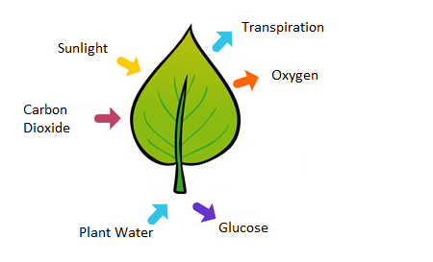
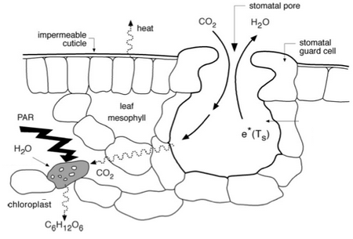
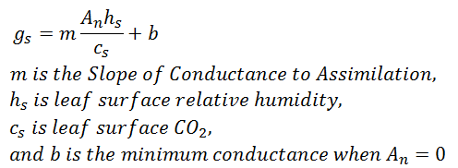
Slide 4 – Land Cover Change
CLM Vegetation Modeling Leaf Level Processes and CO₂
1. Photosynthesis from Farquhar et al. (1980) modified by Harley et al. (1992) and von Caemmerer (2000)
2. Transpiration from Ball and Berry (1991)
Notes:
Overview of the talk

Slide 19
Slide 4 – Land Cover Change
Historical Ecosystem Changes: Ecosys C – No Land Use
Notes:
Overview of the talk

Slide 20
Ecosystem Modeling in (CLM BGC) – No Land Use
Notes:
20

Slide 21
Slide 4 – Land Cover Change
Historical Ecosystem Changes: Ecosys C – No Land Use
Notes:
Overview of the talk

Slide 22
Slide 4 – Land Cover Change
Historical Ecosystem Changes: Ecosys C – No Land Use
Notes:
Overview of the talk

Slide 23
Slide 3 - Outline
CMIP5 Historical and RCP Land Cover Change
CMIP5 Land Cover Change for Historical and RCP Time Series (10⁶ km²
Time Series | Land Use Description | Primary | Secondary | Crop | Pasture
Historical 1850-2005 | Land use and land cover change is from the HYDE 3.0 database. | -48.98 | 13.71 | 9.81 | 25.47
RCP 4.5 GCAM 2006 - 2100 | Decrease in crops with a similar decrease in pasture. Biofuels included in croplands. Expansion of forested areas for carbon storage. | -12.05 | 20.71 | -4.15 | -4.52
RCP 8.5 Message 2006 - 2100 | Medium increases in both cropland and pasture. Biofuels included in wood harvest. Large decline in forest area. | -19.01 | 12.79 | 2.77 | 3.44
Investigate the impacts of Land Use and Land Cover Change (LULCC) on the
Terrestrial Ecosystem Carbon Cycle by comparing CESM Historical and RCP
simulations with LULCC against the same simulations with no LULCC
Notes:
Overview of the talk

Slide 24
Slide 4 – Land Cover Change
Historical Ecosystem Changes: Land Cover Change
Notes:
Overview of the talk

Slide 25
Slide 4 – Land Cover Change
Historical Ecosystem Changes: Ecosys C – Land Use
Notes:
Overview of the talk

Slide 26
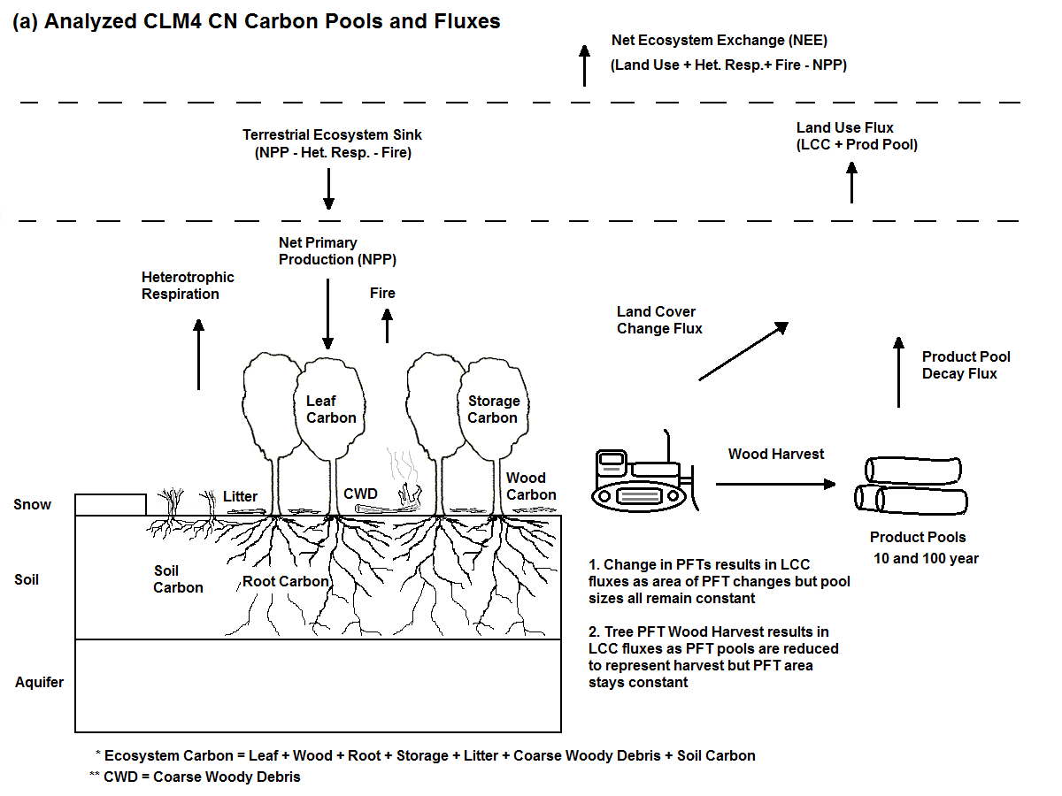
Ecosystem Modeling in (CLM BGC) – Land Cover Change
Notes:
26

Slide 27
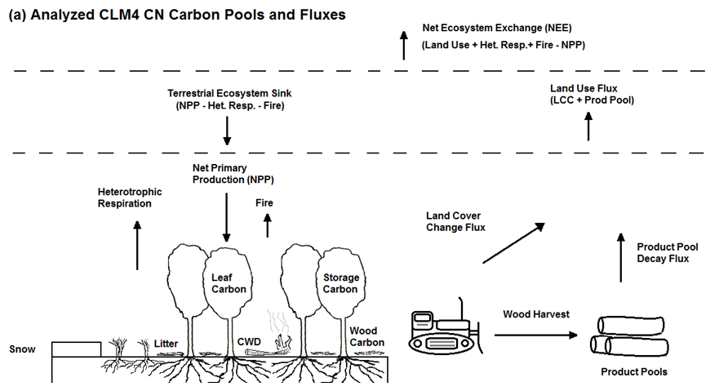
Slide 4 – Land Cover Change
Ecosystem Changes in CMIP5 – Land Cover Change
Direct LULCC Fluxes: - Conversion Fluxes to the Atmosphere - Conversion Fluxes to Wood Products - Wood Harvest Fluxes to Wood Products
- Product Pool Decay to the Atmosphere
Indirect LULCC Fluxes: - Loss of potential Ecosystem Sink from Deforestation
- Increase in Ecosystem Sink from Afforestation - Changes in Fire with new Land Use - Changes in Soil and Litter Carbon Decay
- Changes in nutrient cycling with new Land Use
- This is the change in the Ecosystem Sink from LULCC
Notes:
Overview of the talk

Slide 28
Slide 4 – Land Cover Change
Historical Ecosystem Changes: Direct LULCC Fluxes
LULCC_{DIRECT ECO} = Conversion + Wood Harvest = 126.8 PgC (PgC = 10¹⁵)
Conversion = 63.2 PgC Wood Harvest = 63.6 PgC
Notes:
Overview of the talk

Slide 29
Slide 4 – Land Cover Change
Historical Ecosystem Changes: Direct LULCC Fluxes
LULCC_{DIRECT ECO} = Conversion + Wood Harvest = 126.8 PgC (PgC = 10¹⁵)
Conversion = 63.2 PgC Wood Harvest = 63.6 PgC
Notes:
Overview of the talk

Slide 30
Slide 4 – Land Cover Change
Historical Ecosystem Changes: Land Cover Change
LULCC_{DIRECT ECO} = Conversion_{ATM} + Conversion_{PROD} + Wood Harvest = 126.8 PgC (PgC = 10¹⁵)
Conversion = 63.2 PgC Wood Harvest = 63.6 PgC
Notes:
Overview of the talk

Slide 31
Slide 4 – Land Cover Change
Historical Ecosystem Changes: Indirect LULCC Fluxes
LULCC_{INDIRECT} = ∆NPP_{NOLUC-LU} – ∆HR_{NOLUC-LU} – ∆FIRE_{NOLUC-LU} = 3.6 PgC (PgC = 10¹⁵)
∆NPP_{NOLUC-LU} = 71.6 PgC ∆HR_{NOLUC-LU} = 43.1 PgC ∆FIRE_{NOLUC-LU} = 24.9 PgC
Notes:
Overview of the talk

Slide 32
Slide 4 – Land Cover Change
Historical Ecosystem Changes: Indirect LULCC Fluxes
LULCC_{INDIRECT} = ∆NPP_{NOLUC-LU} – ∆HR_{NOLUC-LU} – ∆FIRE_{NOLUC-LU} = 3.6 PgC (PgC = 10¹⁵)
∆NPP_{NOLUC-LU} = 71.6 PgC ∆HR_{NOLUC-LU} = 43.1 PgC ∆FIRE_{NOLUC-LU} = 24.9 PgC
Notes:
Overview of the talk

Slide 33
Slide 4 – Land Cover Change
Historical Ecosystem Changes: Effective LULCC Flux
LULCC_{EFFECTIVE ECO} = LULCC_{DIRECT ECO} + LULCC_{INDIRECT} = 130.4 PgC (PgC = 10¹⁵)
LULCC_{DIRECT ECO} = 126.8 PgC LULCC_{INDIRECT} = 3.6 PgC
Notes:
Overview of the talk

Slide 34
Slide 4 – Land Cover Change
RCP 4.5 Ecosystem Changes: Direct LULCC Fluxes
LULCC_{DIRECT ECO} = Conversion + Wood Harvest = 152.6 PgC (PgC = 10¹⁵)
Conversion = 9.5 PgC Wood Harvest = 143.2 PgC
Notes:
Overview of the talk

Slide 35
Slide 4 – Land Cover Change
RCP 4.5 Ecosystem Changes: Indirect LULCC Fluxes
LULCC_{INDIRECT} = ∆NPP_{NOLUC-LU} – ∆HR_{NOLUC-LU} – ∆FIRE_{NOLUC-LU} = -49.3 PgC (PgC = 10¹⁵)
∆NPP_{NOLUC-LU} = -33.9 PgC ∆HR_{NOLUC-LU} = 22.2 PgC ∆FIRE_{NOLUC-LU} = -6.7 PgC
Notes:
Overview of the talk

Slide 36
Slide 4 – Land Cover Change
RCP 4.5 Ecosystem Changes: Indirect LULCC Fluxes
LULCC_{INDIRECT} = ∆NPP_{NOLUC-LU} – ∆HR_{NOLUC-LU} – ∆FIRE_{NOLUC-LU} = -49.3 PgC (PgC = 10¹⁵)
∆NPP_{NOLUC-LU} = -33.9 PgC ∆HR_{NOLUC-LU} = 22.2 PgC ∆FIRE_{NOLUC-LU} = -6.7 PgC
Notes:
Overview of the talk

Slide 37
Slide 4 – Land Cover Change
RCP 4.5 Ecosystem Changes: Effective LULCC Fluxes
LULCC_{EFFECTIVE ECO} = LULCC_{DIRECT ECO} + LULCC_{INDIRECT} = 103.3 PgC (PgC = 10¹⁵)
LULCC_{DIRECT ECO} = 152.6 PgC LULCC_{INDIRECT} = -49.3 PgC
Notes:
Overview of the talk

Slide 38
Slide 4 – Land Cover Change
RCP 8.5 Ecosystem Changes: Direct LULCC Fluxes
LULCC_{DIRECT ECO} = Conversion + Wood Harvest = 271.6 PgC (PgC = 10¹⁵)
Conversion = 33.6 PgC Wood Harvest = 238.0 PgC
Notes:
Overview of the talk

Slide 39
Slide 4 – Land Cover Change
RCP 8.5 Ecosystem Changes: Indirect LULCC Fluxes
LULCC_{INDIRECT} = ∆NPP_{NOLUC-LU} – ∆HR_{NOLUC-LU} – ∆FIRE_{NOLUC-LU} = -4.5 PgC (PgC = 10¹⁵)
∆NPP_{NOLUC-LU} = 42.3 PgC ∆HR_{NOLUC-LU} = 18.1 PgC ∆FIRE_{NOLUC-LU} = 28.6 PgC
Notes:
Overview of the talk

Slide 40
Slide 4 – Land Cover Change
RCP 8.5 Ecosystem Changes: Indirect LULCC Fluxes
LULCC_{INDIRECT} = ∆NPP_{NOLUC-LU} – ∆HR_{NOLUC-LU} – ∆FIRE_{NOLUC-LU} = -4.5 PgC (PgC = 10¹⁵)
∆NPP_{NOLUC-LU} = 42.3 PgC ∆HR_{NOLUC-LU} = 18.1 PgC ∆FIRE_{NOLUC-LU} = 28.6 PgC
Notes:
Overview of the talk

Slide 41
Slide 4 – Land Cover Change
RCP 8.5 Ecosystem Changes: Effective LULCC Fluxes
LULCC_{EFFECTIVE ECO} = LULCC_{DIRECT ECO} + LULCC_{INDIRECT} = 267.2 PgC (PgC = 10¹⁵)
LULCC_{DIRECT ECO} = 271.6 PgC LULCC_{INDIRECT} = -4.5 PgC
Notes:
Overview of the talk

Slide 42
Slide 4 – Land Cover Change
CMIP5 Cumulative LULCC Fluxes – Total Ecosystem Carbon
Ecosys Carbon | Eco Direct LULCC | Indirect LULCC | Eco Effective LULCC | CMIP5 Fossil Fuel Emissions
Historical | 126.8 PgC | 3.6 PgC | 130.4 PgC | 313.8 PgC
RCP 4.5 | 152.6 PgC | -49.3 PgC | 103.3 PgC | 791.5 PgC
RCP 8.5 | 271.6 PgC | -4.5 PgC | 267.2 PgC | 1925.0 PgC
*RCP no LULCC simulation have current day wood harvest rates
Notes:
Overview of the talk

Slide 43
Slide 4 – Land Cover Change
CMIP5 Cumulative LULCC Fluxes – Total Ecosystem Carbon
Ecosys Carbon | Eco Direct LULCC | Indirect LULCC | Terrestrial Sink | NEE | ∆ Eco C | ∆ Prod
Historic NoLC | - | - | 67.3 PgC | -67.3 PgC | 67.3 PgC | -
LULCC | 126.8 PgC | 3.6 PgC | 63.6 PgC | 54.8 PgC | -63.2 PgC | 8.4 PgC
RCP4.5 NoLC* | 96.7 PgC | - | 162.7 PgC | -66.5 PgC | 66.0 PgC | 0.5 PgC
LULCC | 152.6 PgC | -49.3 PgC | 212.0 PgC | -65.7 PgC | 59.4 PgC | 6.3 PgC
RCP8.5 NoLC* | 100.4 PgC | - | 219.4 PgC | -120.2 PgC | 119.0 PgC | 1.2 PgC
LULCC | 271.6 PgC | -4.5 PgC | 223.9 PgC | 29.1 PgC | -47.7 PgC | 18.6 PgC
*RCP no LULCC simulation have current day wood harvest rates
Notes:
Overview of the talk

Slide 44
Gridcell
CLM 4.5 LULCC for Natural PFT and Crop
G
V
PFT1
V
PFT3
Landunit
V
PFT2
L
C1I
C1U
V
PFT4
TBD
HD
Vegetated
Lake
MD
Glacier
Crop
C2I
C2U
Urban
UT,H,M
Crop Model
Leaf
emergence
Land Use
Change
Planting
Irrig
Unirrig
Irrig
Unirrig
Irrig /
Fertilize
Harvest
Grain fill
Crop1
Crop1
Crop2
Crop2 …
Notes:
This is a schematic of the subgrid structure of the land model. There are four distinct heirarchies in the model. There is the gridcell level. A gridcell is divided up into landunits, columns, and plant functional types or pfts.
Landunits are glacier, wetland, vegetated, lake, and now urban. Beneath the vegetated landunit is at least one soil type. Plant functional types then share this soil type and the energy and water budgets associated with this.

Slide 45
Understanding the Land Surface in the Climate System: Investigations with an Earth System Model (NCAR CESM)
Land Management in CESM:
How will Natural Ecosystems respond to changes in climate and CO₂?
How are we transforming Natural Ecosystems through Deforestation, Pasture, Wood Harvesting, or Afforestation?
How will Humanity Feed itself as the population grows, society becomes more affluent, and agriculture is impacted by climate and changing CO₂?

