Slide 1
Ecosystem Dynamics and Fire
Next-generation modeling with vegetation demography using the Functionally Assembled Ecosystem Simulator (FATES)
Charlie Koven, Rosie Fisher, Ryan Knox, Jacquelyn Shuman, Adrianna Foster,
and FATES team
Jacquelyn Shuman,
Climate and Global Dynamics, Project Scientist
CESM Tutorial
August 10, 2022

Slide 2
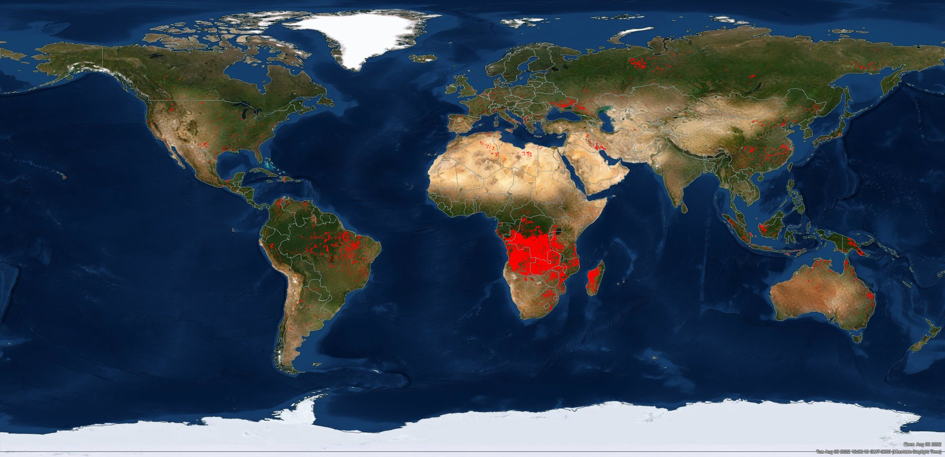
Active fire counts
Image credit: NASA FIRMS https://firms.modaps.eosdis.nasa.gov
Notes:
Daily fire last 1 day (Aug 9, 2022)
Fire counts last 3 weeks (July 20 to Aug 9, 2022)
Broad geographic coverage with high counts across tropics and savanna ecosystems
Fire counts do not equal burned area or emissions. Fires in Siberia are bigger than fires in Greece, Turkey, Italy, US and Canada combined.

Slide 3
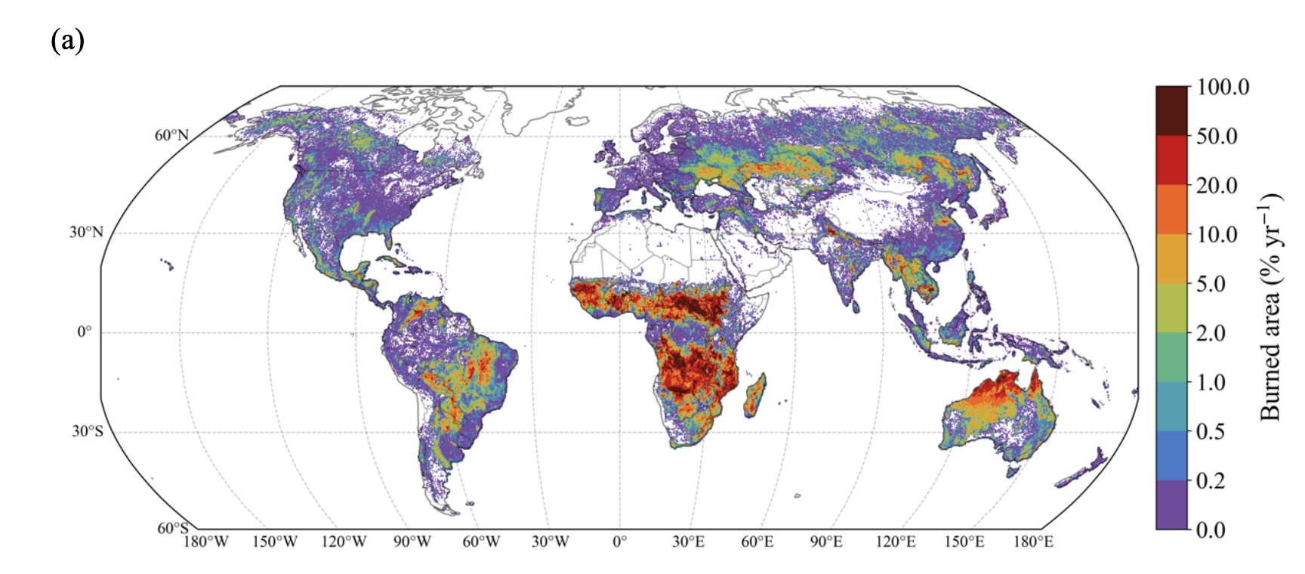
Global burned area (2002-2019)
More burning
Less burning
van Wees et al. preprint Geoscientific Model Development
Notes:
Fire regime is interaction of climate, vegetation and ignitions over decades to centuries
Regime determines composition, biomass accumulation, structure
Western US (fuel load changes due to rainfall variability and drying)
South American transition from forest to savanna (rainfall, fire frequency)
Fire regimes: less burned areas trees have thin bark; boreal species in NA versus EUR alter occurrence of crown fire – fire dynamics result of species in region; forest savanna bi-stability due to climate, fire regime, and veg structure (bark thickness and fire interval)

Slide 4
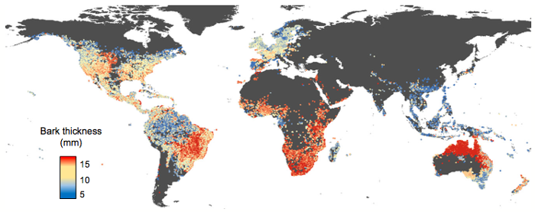
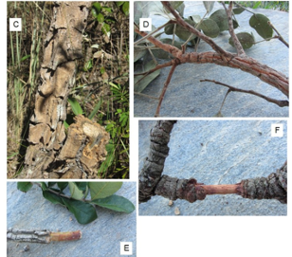
Biogeography shaped by vegetation traits and fire
Thick-barked trees dominate in high fire areas
Thick-barked trees of Brazil
Pellegrini et al. 2017 Ecology Letters
Pausas 2015 Functional Ecology FigS2
Notes:
572 species (classified as forest or savanna) bark thickness at 10, 20 and 30cm stem diameters
Species distribution mapped with burned area and climate
In tropics Bark was 3 times thicker in fire prone savanna than fire infrequent forest (1.4 thicker in temperate regions)
Annual burned area explained 20% of global variation in bark thickness
Climate-fire interaction explains greater investment in bark in wet S.A. savannas relative to drier African savanna

Slide 5
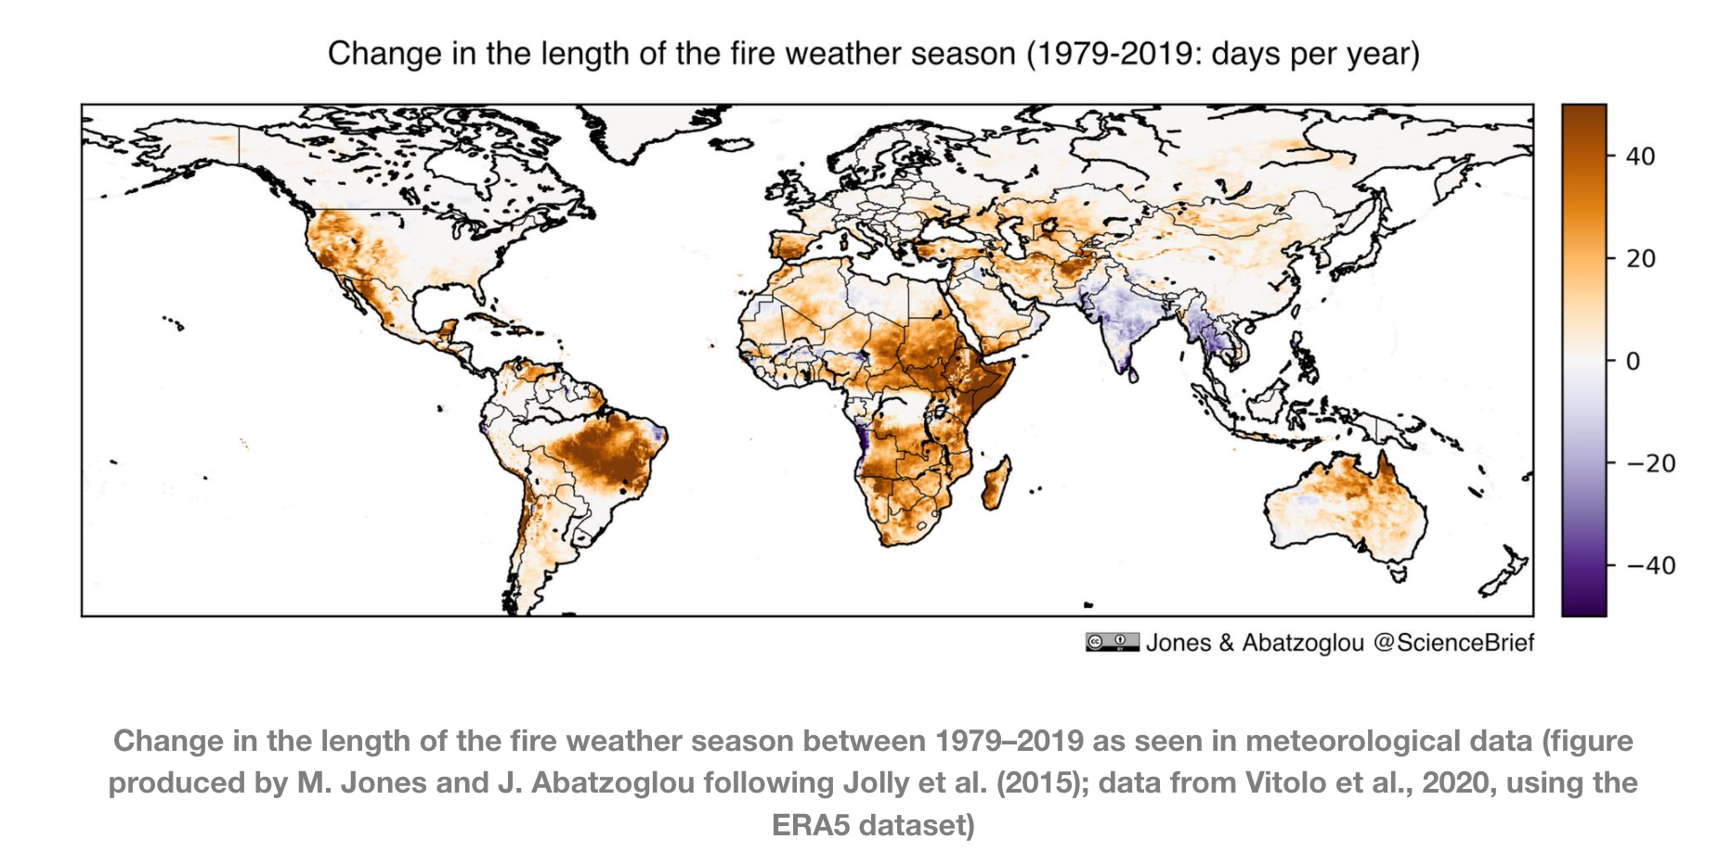
Increasing Fire danger
1980-2005
2006-2029
2030-2054
Extreme Fire Risk Ratio
Touma et al. 2021 Nature Communications
Notes:
Touma et al 2021: CESM1-LE (Large Ensemble) with CAM, POP CLM4 and CICE.
Using Canadian FWI (climate and moisture impacts on fuels and soils) calculated 30 year moving window. Ratio greater than 1 indicates risk of extreme fire weather
Daily variables (Max Temp, Precip, RH, Windspeed

Slide 6
Critical high biomass regions
Shift in fire regime may alter vegetation and C stores
Saatchi et al. 2011
Tropical forests hold 193 Gt carbon aboveground
Notes:
The interaction of climate, fire, vegetation traits and state determine the distribution of tropical forest and savanna biomes.
A shift in the fire regime may alter these biomes and the vast carbon stores of these tropical forests.
Hypothesis/assertion: for global scale simulation, a new axis for biogeography is needed in FATES/VDMs - one driven by fire disturbance

Slide 7
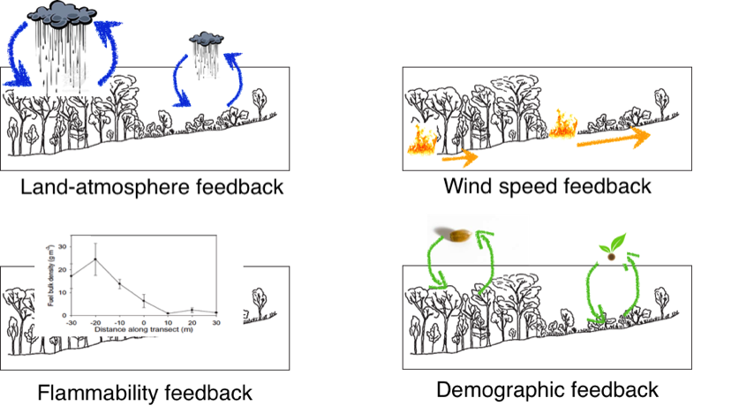
Fire is interactive in CLM, CLM-FATES
Adaptation of SPITFIRE (Thonicke et al 2010) into FATES (Fisher et al 2018)
Adapted from Hoffman et al 2011
Notes:
Land-atmosphere: biomass burning contributes to atmospheric changes (tropics) (need to get interactions with climate correct)
Wind-speed & flammability: fire behavior is dependent on the vegetation type (grasslands promote fast fires, forest promote slow fires; fuels geometry and moisture dictates fire characteristics (intensity, velocity) (need to get fire behavior)
Demography: concept of fire trap where tree vulnerability is related to their size and traits (need to capture forest structure)

Slide 8
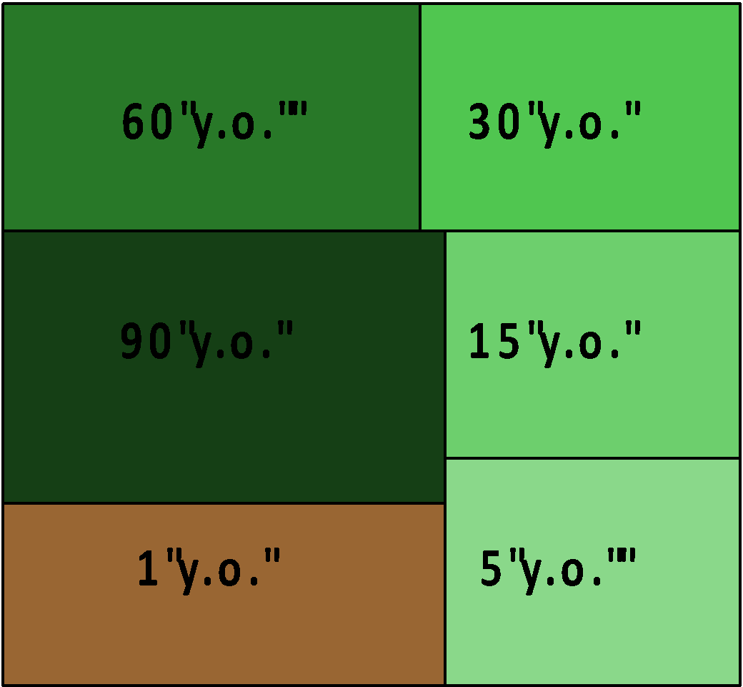
Ecological processes in land surface models
CLM
FATES
Big Leaf
Cohort Model
NL tree
C3 grass
NL tree
BL tree
C4 grass
Bare
Ground
Notes:
Cohort models allow us to capture sizes of different vegetation using number densities associated with each size.
FATES has heterogeneity
This is particularly important for a process such as fire where the death of plants is related to their size, and different plants create different fuels which impacts fire behavior.

Slide 9
FATES has variability
Time since disturbance
Notes:
Multiple patches of different forests with structure that have different impacts on the atmosphere
Cohort models are the in between solution allowing us to capture sizes of different vegetation using numbers associated with each size.
FATES has heterogeneity
This is particularly important for a process such as fire where the death of plants is related to their size, and different plants create different fuels which creates different fire behavior.

Slide 10
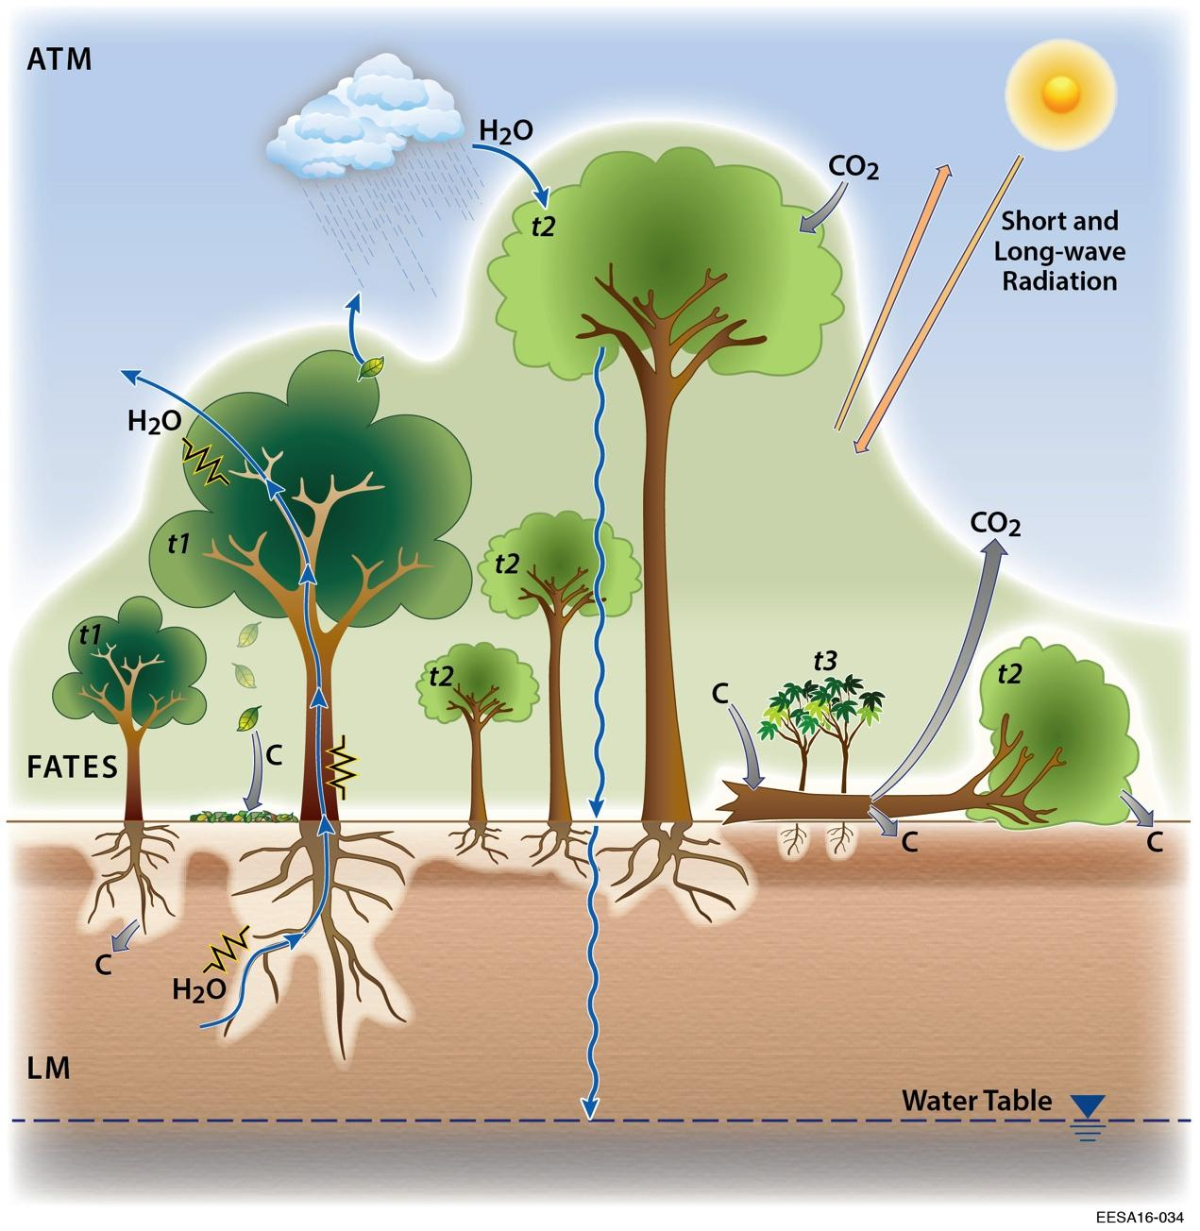
CLM-FATES
Simulates plant cohort growth, death, and regeneration at sub-daily to daily time steps
SPITFIRE
daily process-based fire behavior and effects
six litter & fuel classes
flame scorch height, crown damage, bark damage
size-based tree mortality
Fire Weather
Lightning Strike Temperature
Precipitation
Humidity
Wind
Fire Intensity
Rate of Spread
Area Burned
Fuel load
Bulk density
Surface area
Fuel moisture
Staver et al. 2011
Thonicke et al 2010; Fisher et al. 2015; Fisher et al. 2018
Notes:
Hypothesis/assertion: for global scale simulation, a new axis for biogeography is needed in FATES/VDMs - one driven by fire disturbance
FATES:
SPITFIRE: fires initiated through influence of fire weather. So lightning strike and weather conducive to fire as influenced by temperature, precipitation, relative humidity, and wind speed.
We evaluate six litter and fuel classes. The overall fuel load, geometry and moisture influence the fire behavior, specifically fire intensity (energy release), rate of spread and area burned.
From this we obtain fire scorch height, evaluate crown damage and cambial heating of tree stems, so we have size-based tree mortality.

Slide 11
FATES-SPITFIRE: vegetation traits and structure
Flame scorch
Canopy damage
More canopy
Thin bark
Less canopy
Thick bark
Bark damage
Trees: Trait- and height-level protection from fire
Grasses: no protection and burn with all fires.
Notes:
The interaction of climate, fire, vegetation traits and state determine the distribution of tropical forest and savanna biomes.
Hypothesis/assertion: for global scale simulation, a new axis for biogeography is needed in FATES/VDMs - one driven by fire disturbance
Can FATES-SPITFIRE capture observed distribution of thin vs thick bark trees?
SPITFIRE size-based mortality is important because it captures the influence of canopy structure on future fire behavior.
A fire can come through a patch altering canopy structure and influencing the vulnerability to future fires.

Slide 12
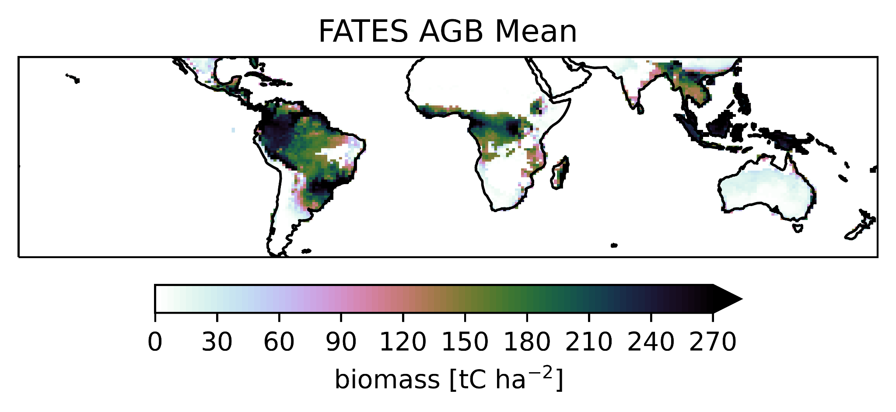
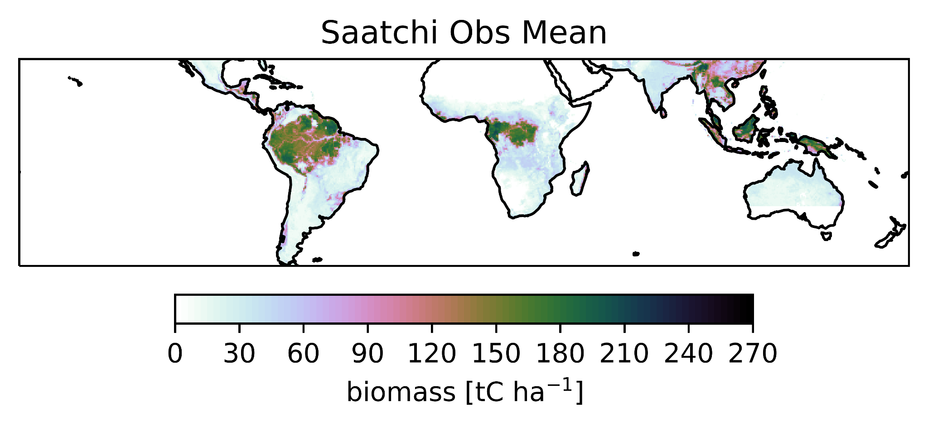
FATES captures biomass accumulation
FATES
with fire
biomass [t C ha⁻¹]
Observations
Saatchi et al 2011
biomass [t C ha⁻¹]
Shuman et al (in prep)
Notes:
We can capture emergent biogeography and biomass accumulation across the tropics using dynamic fire and 3 PFTs (two tropical trees and C4 grass) with size structure and vegetation fire traits of survival, resistance or resilience.
Missing LCLUC so we over predict biomass.
More accurately capturing the fire vegetation feedback for different types of vegetation (grasses vs trees) is essential to this pattern of biomass accumulation and biogeography.

Slide 13
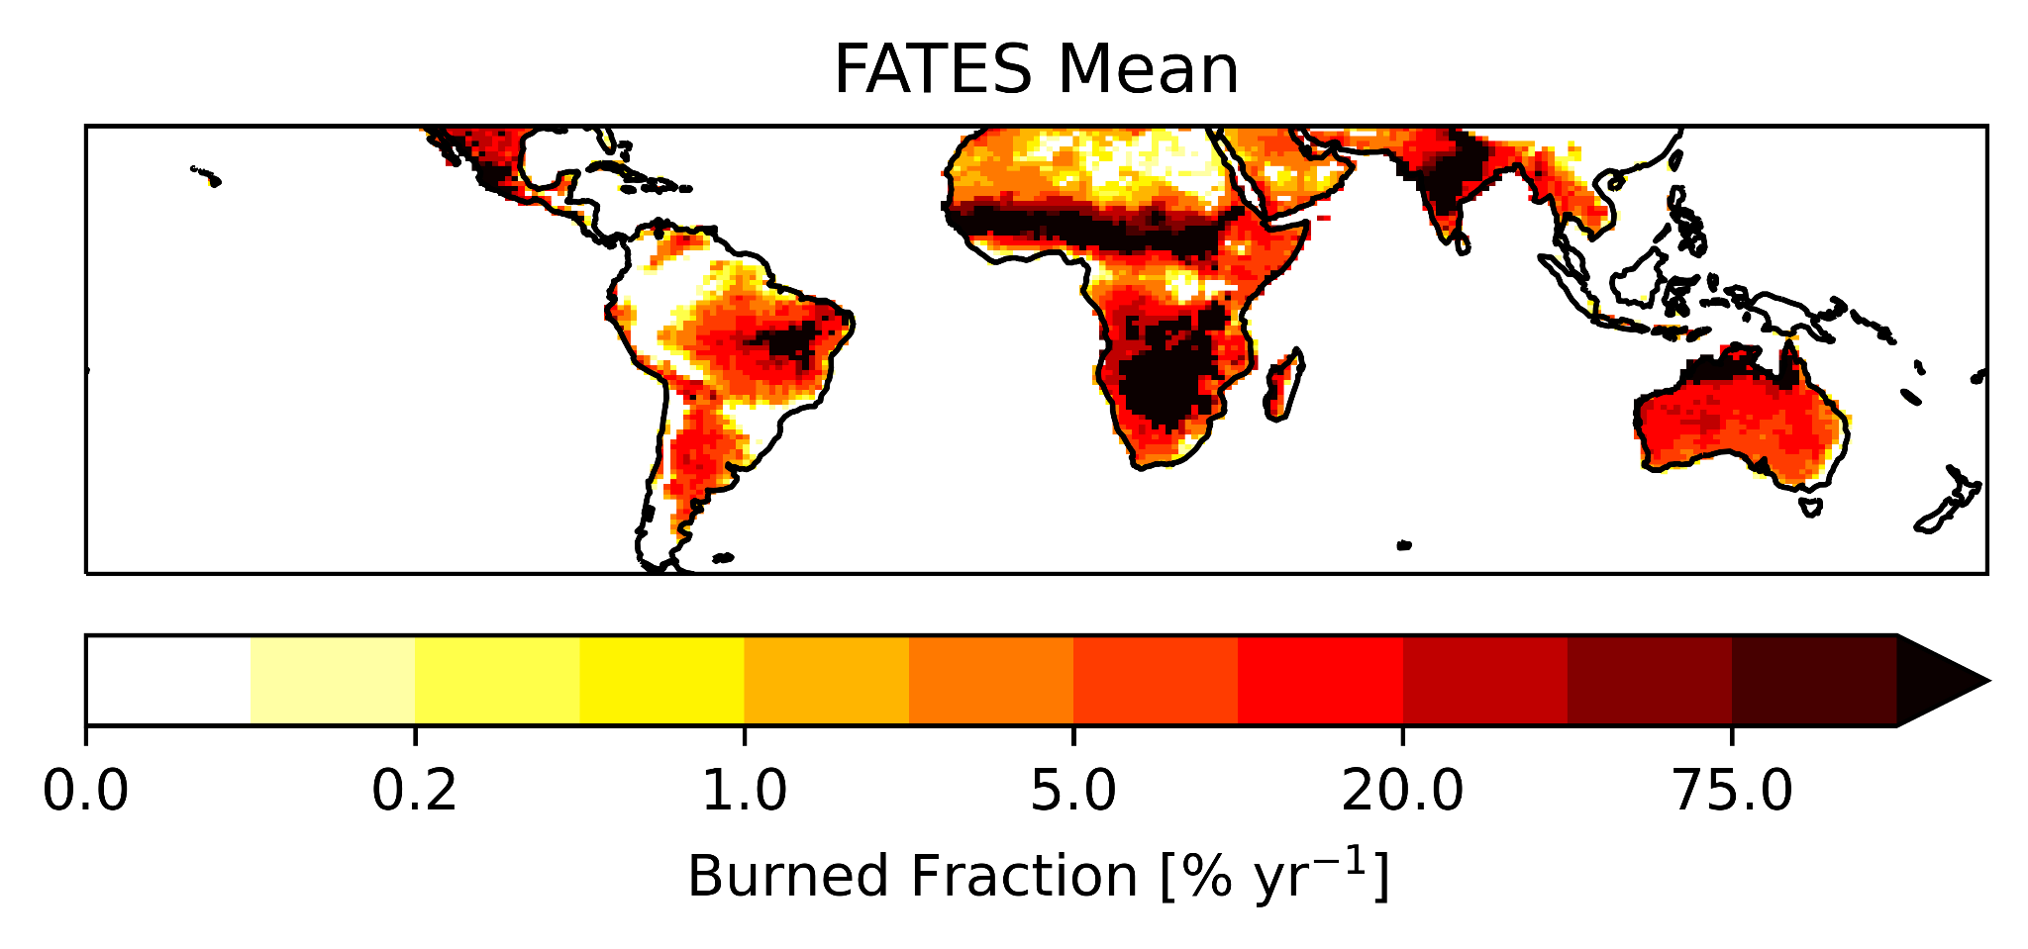
FATES captures broad spatial burn pattern
FATES
with fire
burned fraction [%]
Observations
GFED 4.1S
burned fraction [%]
Shuman et al (in prep)
Notes:
Remembering that the fire vegetation feedback for different types of vegetation (grasses vs trees) is essential we see overactive fire within FATES.
FATES captures broad spatial pattern but has areas with excessive repeat burns.
Some of these areas are low intensity fires, so there is a mismatch between how model and data define fire.
We track more fires than the observations, but there is room for improvement.

Slide 14
Grasses drive high burned area
FATES
with fire
burned fraction [%]
FATES
with fire
C4 grass biomass [g C m⁻²]
Shuman et al (in prep)
Notes:
Looking at areas of repeat burns (shown in black) we see they are associated with grasses that are expected to burn frequently.
Representation of grass fire high priority for improvement.
We do not capture low burning due to grazing and agriculture.

Slide 15
High biomass in areas of low disturbance
FATES
with fire
burned fraction [%]
FATES
with fire
biomass [t C ha⁻¹]
Shuman et al (in prep)
Notes:
We capture high biomass accumulation in areas of lower fire disturbance.
How do the differences in the two tree PFTs contribute to this emergent pattern?

Slide 16
Fire is essential to plant distribution
Observations
Pellegrini et al 2017
Thin bark tree
Active fire
Thick bark tree
Active fire
C4 grass
Active fire
Thin bark tree
no fire
Thick bark tree
no fire
C4 grass
no fire
Biomass [g C m⁻²]
Notes:
These differences in survival create the pattern of emergent biogeography.
We have dynamic assembly through size-based mortality and vegetation traits interacting with disturbance feedbacks
Without fire we have a completely different system
Thick bark tree and grass cannot compete without disturbance
What is the mechanism governing this emergent biogeography?

Slide 17
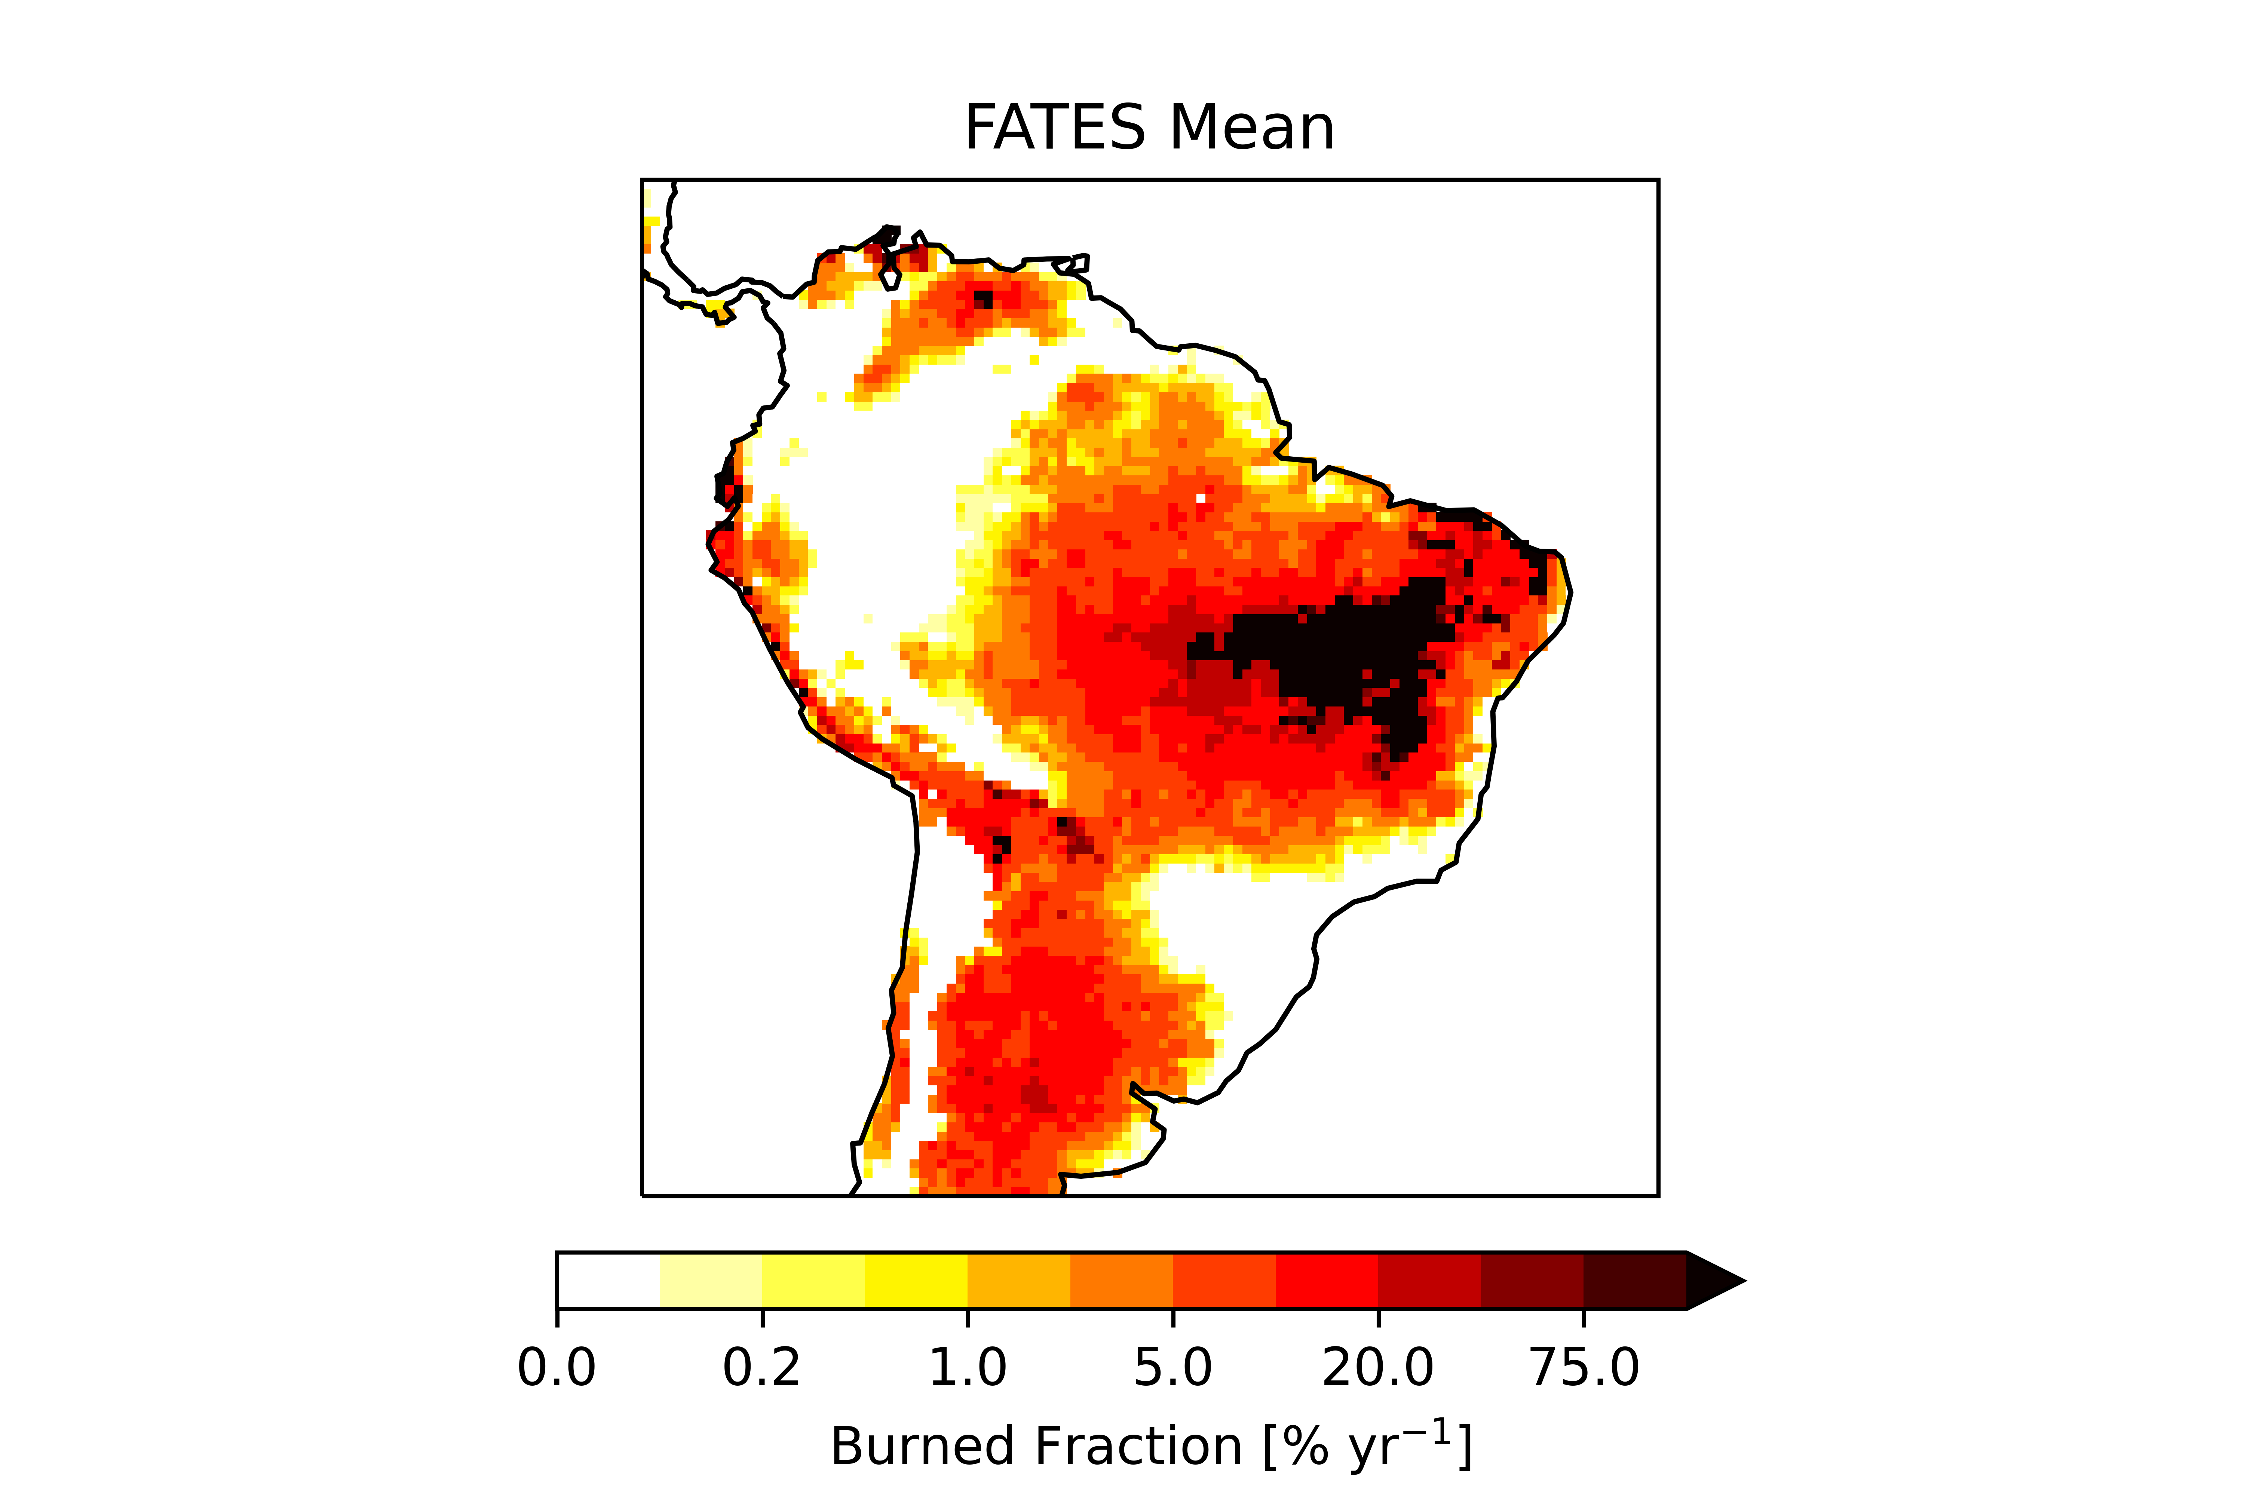
Size- and trait-based mortality impacts survival
Increasing tree size
DBH = 5.0
DBH = 10.0
DBH = 20.0
DBH = 40.0
DBH = 80.0
DBH = 100.0
Thin bark trees
Thick bark trees
Burned area [% yr⁻¹]
less
more
0.0 0.01 0.05 0.20 0.40 0.75
Fire mortality [fraction yr⁻¹]
Vulnerability/resistance is a function of feedbacks between traits and fire regime
Notes:
We are capturing the variable survival of these two types of trees.
All small trees vulnerable to fire, but as trees get taller they are better able to escape fire mortality (moving right on figure)
Trees with thicker bark more quickly escape fire mortality (lower row) and so are more resistant to fire.
These differences in survival create the pattern of emergent biogeography.
Ultimate vulnerability or resistance of these trees is a function of feedbacks between traits and fire regime
How important is the intensity of fire or possibility of burning?

Slide 18
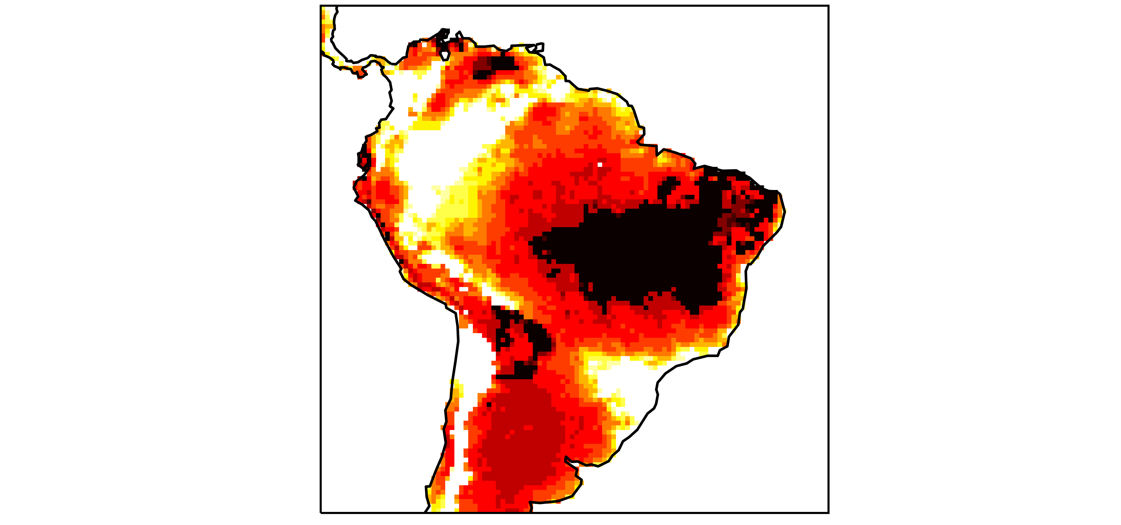
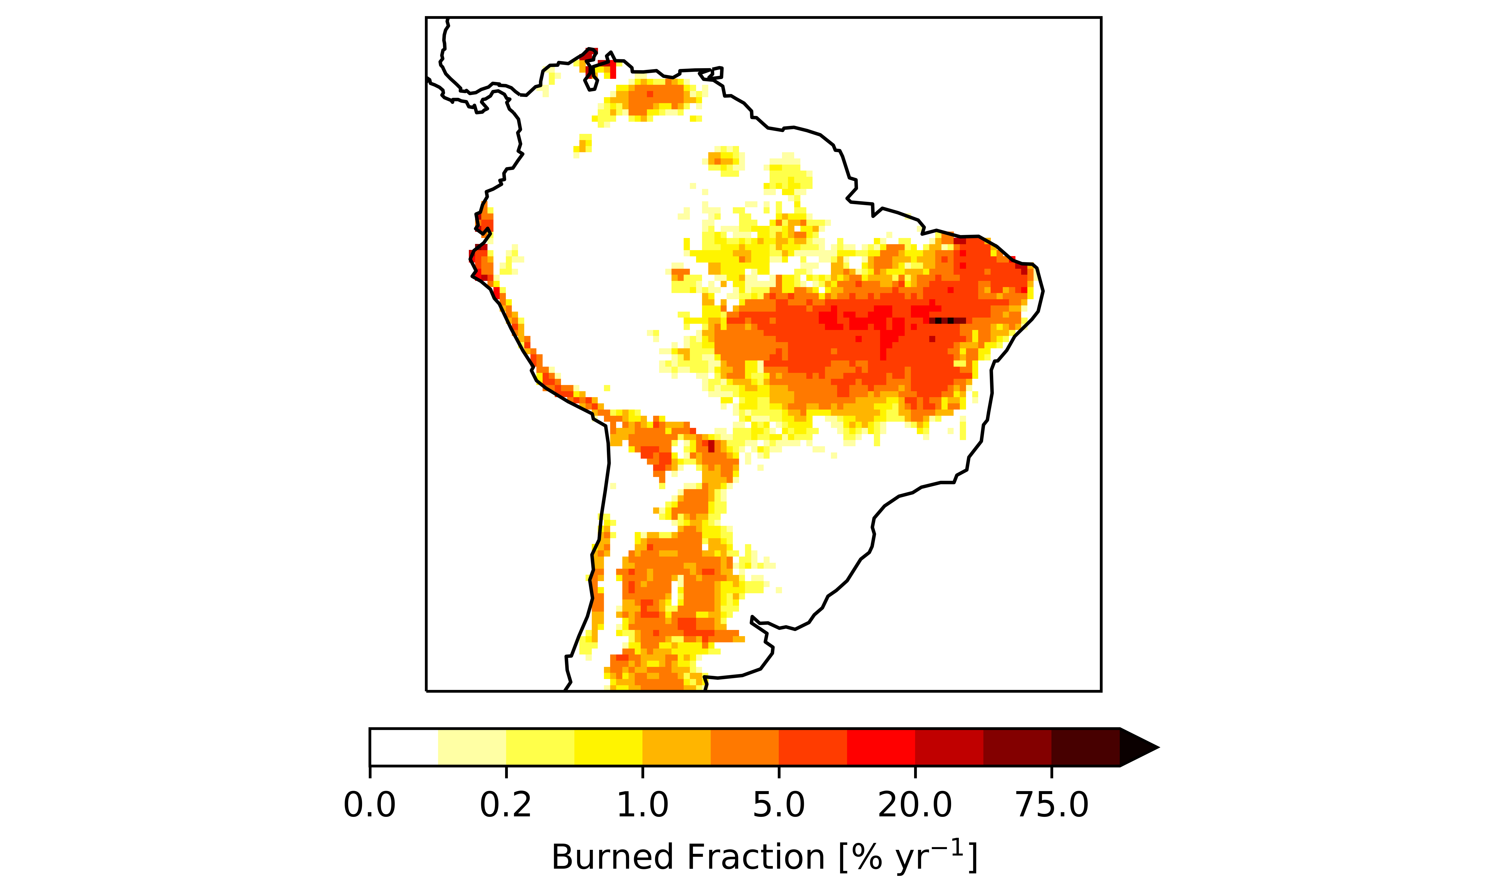
Shift in fire regime shifts biogeography
FATES
Thin bark tree
FATES
Thick bark tree
FATES
C4 grass
FATES
Burned fraction
more dry
fuels
Observations
Pellegrini et al 2017
Increase
drying
less
dry
fuels
Biomass [g C m⁻²]
Notes:
Changing the fire regime by creating drier fuels alters biogeography
More drying (shown top row) leads to more burning, more grass and expansion of thick bark tree.
Less drying (bottom row) allows the more competitive thin bark tree to outcompete the more expensive thick bark tree.
A shift in the fire regime has the capacity to shift the biogeography.
Emphasizes the connection between vegetation and fire. We are capturing this with the model.
Characterization of vegetation and connection of fuel drying to climate key to capturing this.

Slide 19
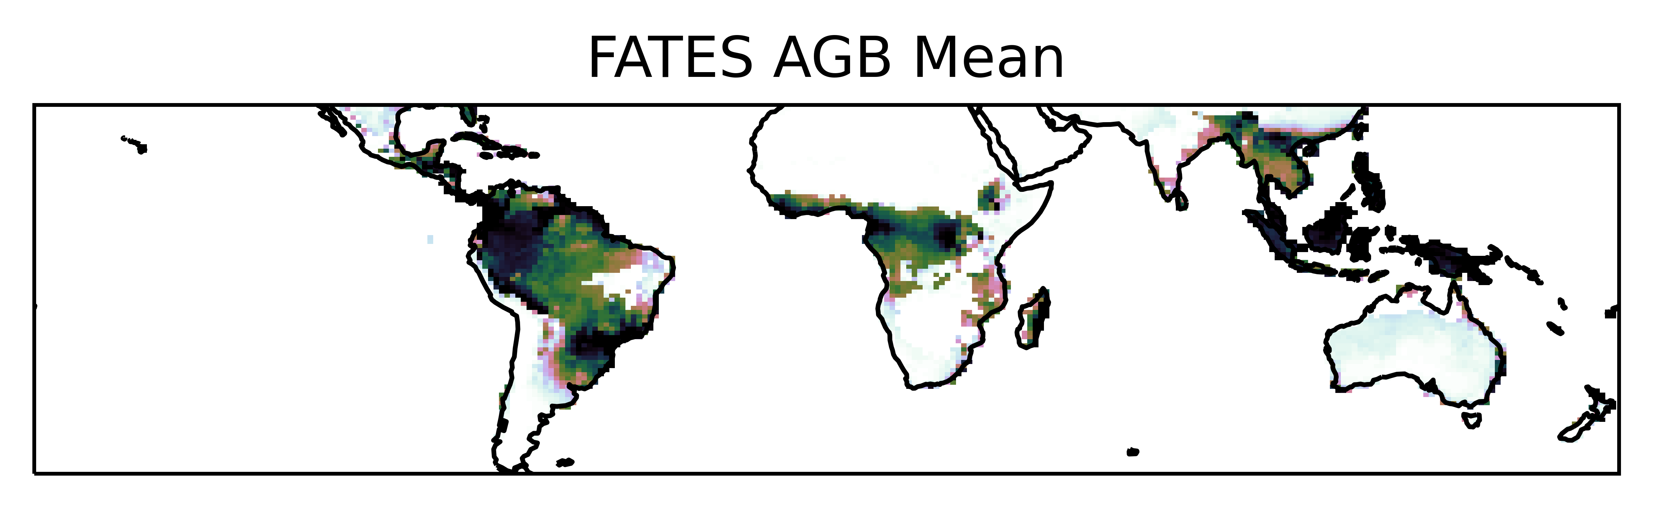
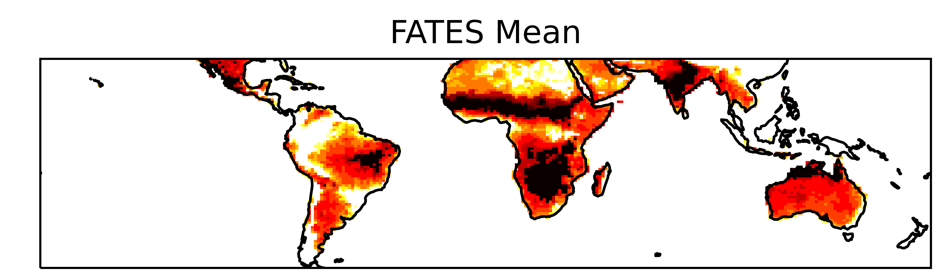
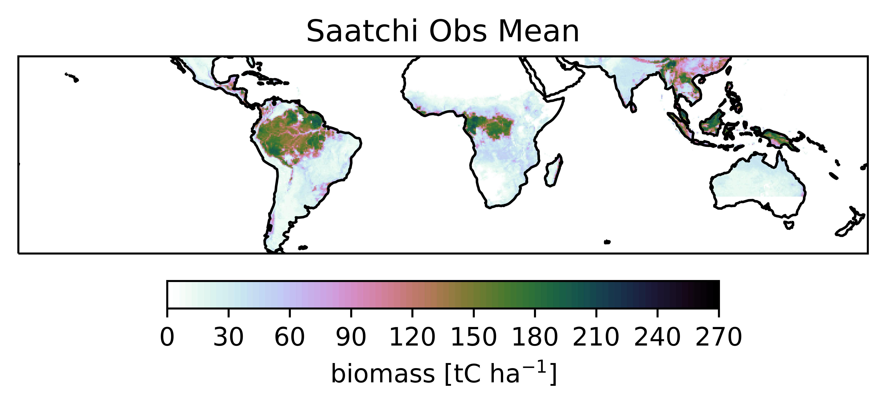
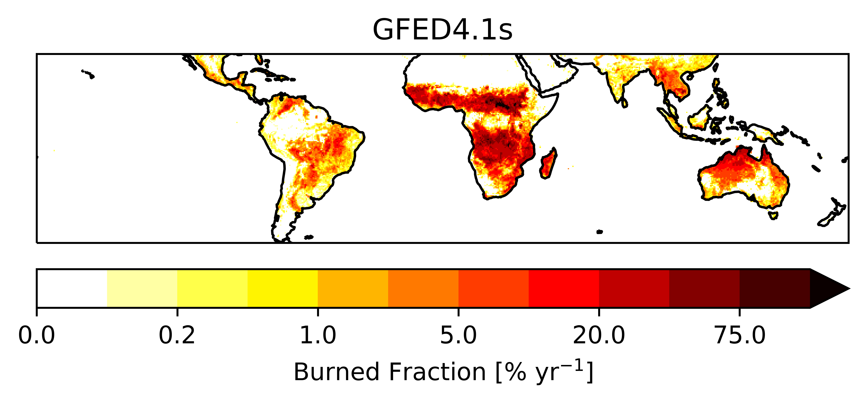
Conclusions
FATES captures dynamic biogeography and biomass
Fire feedbacks determine plant survival
Critical for tropical simulation
FATES Active fire
FATES Active fire
Observations Saatchi et al 2011
Observations GFED4.1s
Notes:
To capture biogeography in global scale simulation, FATES/VDMs must consider fire disturbance and fire adaptive traits
This disturbance needs to be dynamic with size-structure that will respond to and feedback onto fire behavior
This matters because these thin bark trees that hold high biomass stores are vulnerable to increases in fire, and this will be exacerbated by drying conditions
Drying fuels will promote increased burning and provide an advantage for grasses
Assessing the ability of the system to recover from changes in the fire regime are a priority for ongoing work.

Slide 20
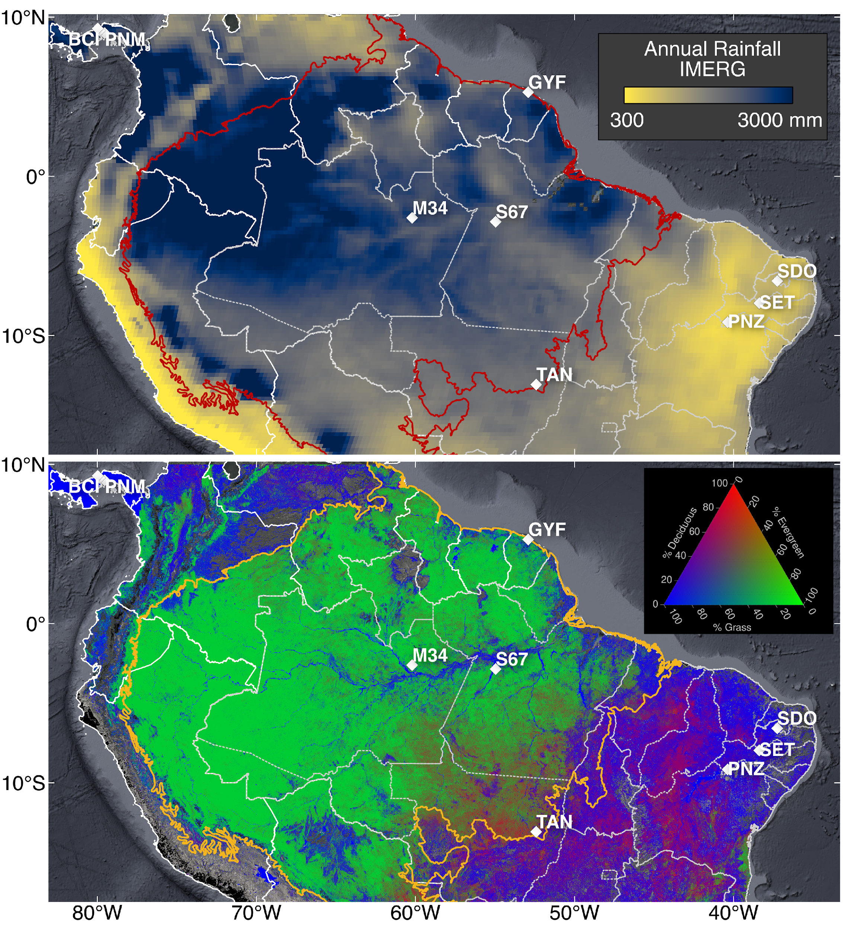
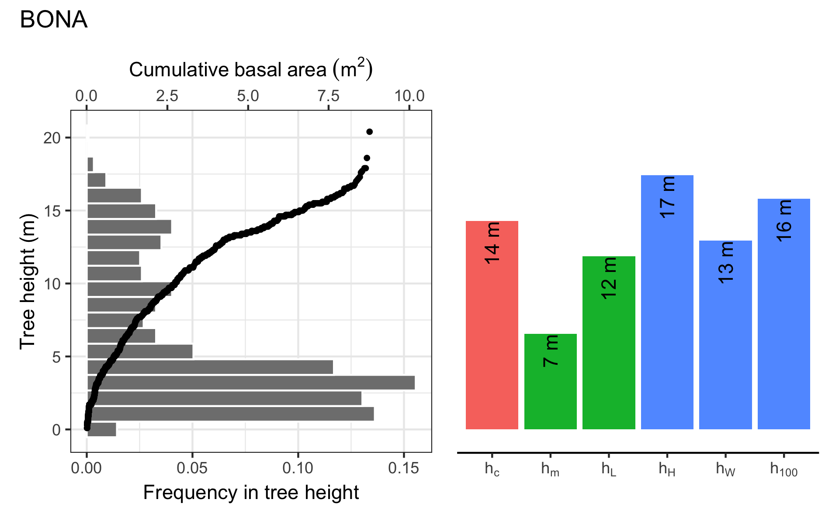
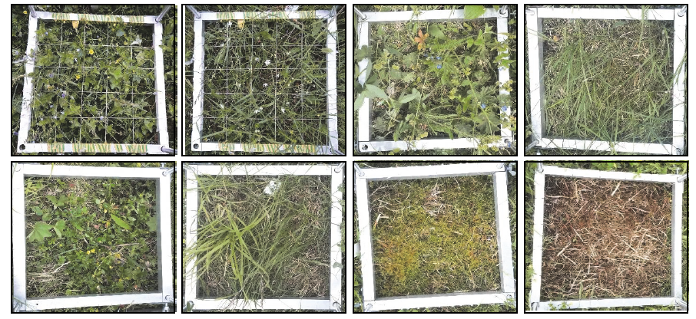
Plant Hydraulics
Plant Hydraulics
Root layers and plant-size root depth
Leaf humidity, stomata set transpiration
Mass balance at root nodes
Fire
Live fuel moisture
Crown fire
Reduced Complexity modes
Deciduous Phenology
Deciduous Phenology
Forest resilience to drought
Nutrients
C
N
C
N
FATES-SP mean GPP
Carbon/Nutrient Optimization
Canopy turbulence for mixed vegetation
PFT 1
Moss
PFT 2
Grass
PFT 1
Moss
Bare
Data from DeFries et al. (2000) GCB Figure credit Marcos Longo, LBNL

Slide 21
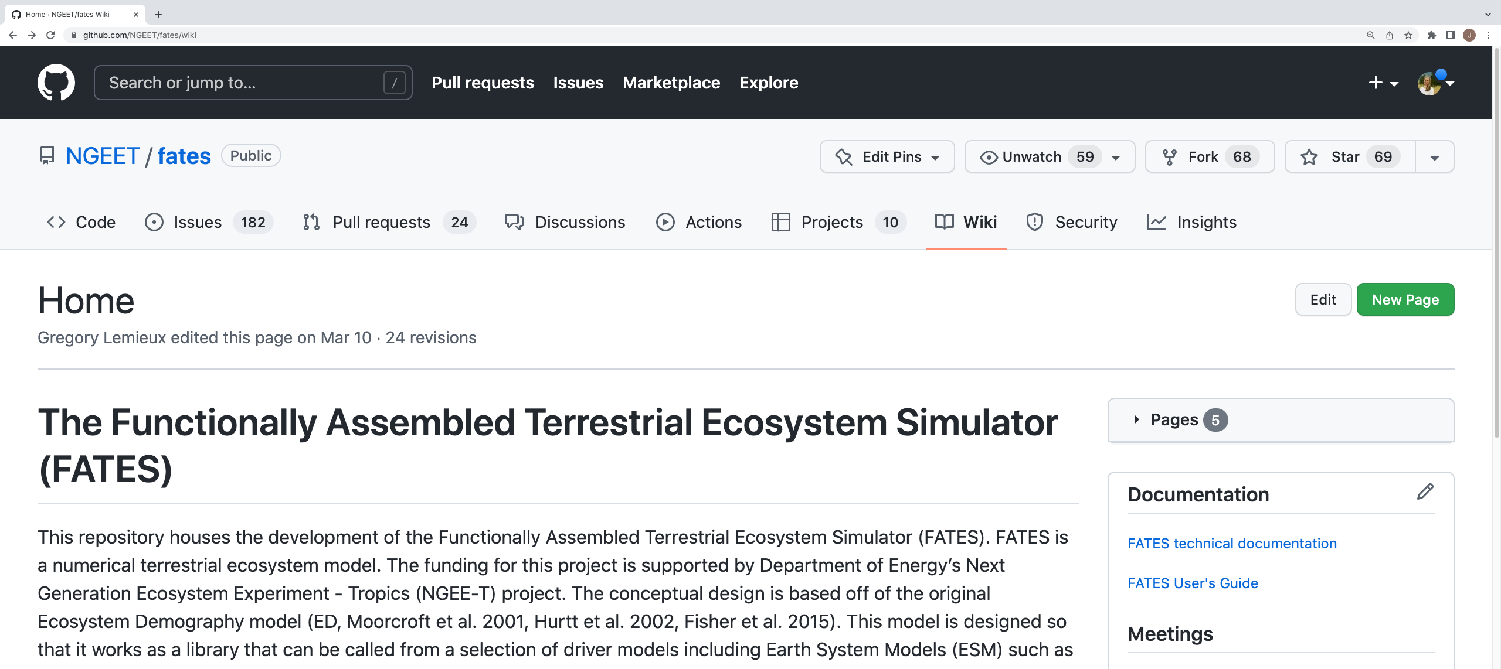
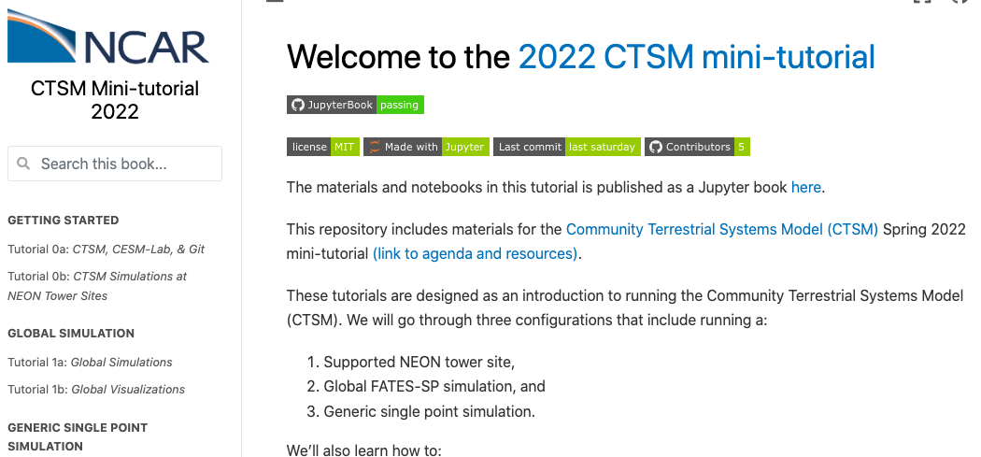
FATES code and information
https://github.com/NGEET/fates/wiki
Technical Documentation
&
User’s Guide
Tutorial materials
https://ncar.github.io/CTSM-Tutorial-2022/README.html

Slide 22
Acknowledgment
A portion of this research was supported as part of the Next Generation Ecosystem Experiments-Tropics, funded by the U.S. Department of Energy, Office of Science, Office of Biological and Environmental Research.
Thank You! Questions?
Contact details:
Jacquelyn Shuman jkshuman@ucar.edu

Slide 24
Conclusions
FATES captures dynamic biogeography and biomass
Fire feedbacks determine plant survival
Critical for tropical simulation
Total biomass [t C ha⁻¹]
burned fraction [%]
C4 grass biomass [g C m⁻²]

