Slide 1
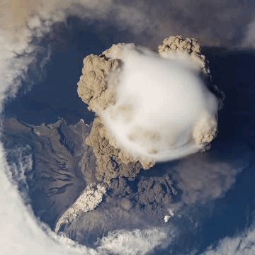
Volcanic forcing in CESM2
Sarychev Peak,
Kuril Islands
June 12, 2009
viewed from ISS
Mike Mills, WACCM Liaison
Ryan Neely & Anja Schmidt, University of Leeds
Dick Easter & Steve Ghan, PNNL
Andrew Conley, NCAR …and many others!

Slide 2
Volcanic forcing in CESM: a history
CESM1 (CMIP5, LENS): prescribed single mode
  CAM5: prescribed volcanic aerosol mass file (Ammann et al., 2003). Assumes 75% H₂SO₄/25% H₂O, wet effective radius = 0.426µm, σ(ln(r)) = 1.8
  WACCM4: prescribed volcanic surface area density file (Kinnison et al., 2007). Composition varies with T & H₂O, r_{eff wet} = 0.5 µm, σ(ln(r)) = 1.25
CESM2
  WACCM6: prognostic volcanic aerosol derived from SO₂ emissions (Mills et al., 2016)
  CAM6 Interim: prescribed single mode based on obs, varying radius, mass, and SAD (Neely et al., 2016)
  CAM6 CMIP6: 3 modes prescribed from WACCM6 output (Neely et al., in preparation)

Slide 3
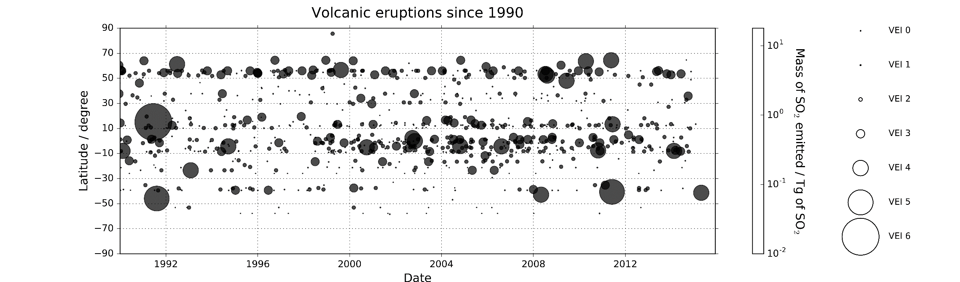
Volcanic eruptions since 1990
Volcanic eruptions increasingly well characterized
(Satellite retrievals, in-situ measurements, geochem. & geophys. monitoring)
1979 first TOMS volcanic SO₂ retrievals
Compiled volcanic emission dataset for use in climate models
Reported eruptions, Smithsonian Global Volcanism Program
Figure courtesy Anja Schmidt

Slide 4
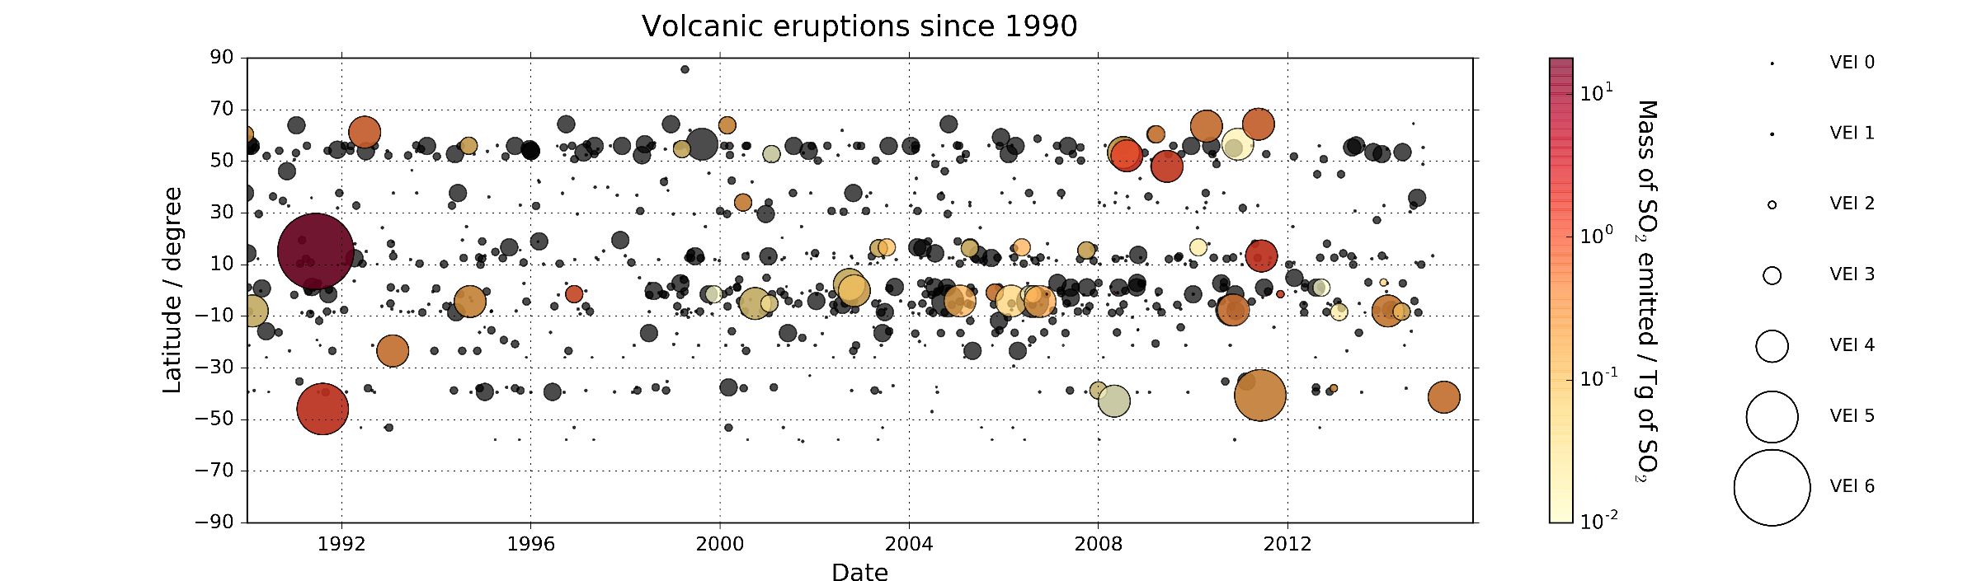
Volcanic eruptions since 1990
Volcanic eruptions increasingly well characterized
(Satellite retrievals, in-situ measurements, geochem. & geophys. monitoring)
1979 first TOMS volcanic SO₂ retrievals
Compiled volcanic emission dataset for use in climate models
1990-1994 12.85 Tg of SO₂ | 1995-1999 0.93 Tg of SO₂ | 2000-2004 0.93 Tg of SO₂ | 2005-2009 7.56 Tg of SO₂ | 2010-2015 8.55 Tg of SO₂
VolcanEESM SO₂ database: 1853-2016, 244 days of eruption
Figure courtesy Anja Schmidt

Slide 5
Stratospheric AOD
Total AOD, volcanic - background

Slide 6
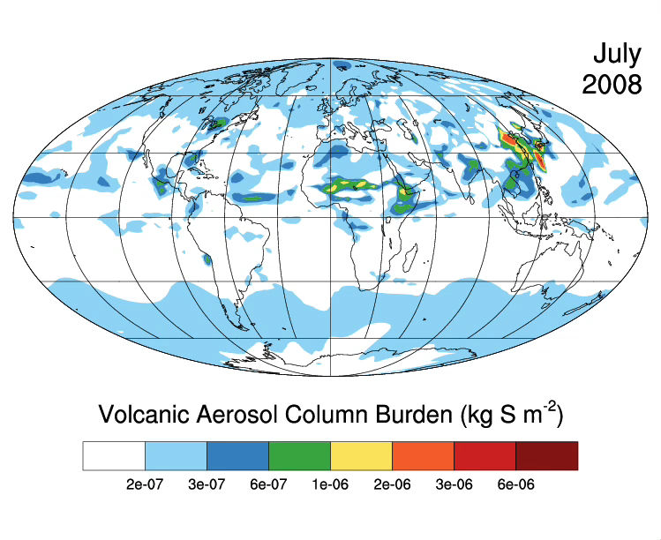

Slide 7
Northern mid-latitudes
Mills et al. (JGR, 2016)

Slide 8
Northern mid-latitudes
Mills et al. (JGR, 2016)

Slide 9
Tropics
Mills et al. (JGR, 2016)

Slide 10
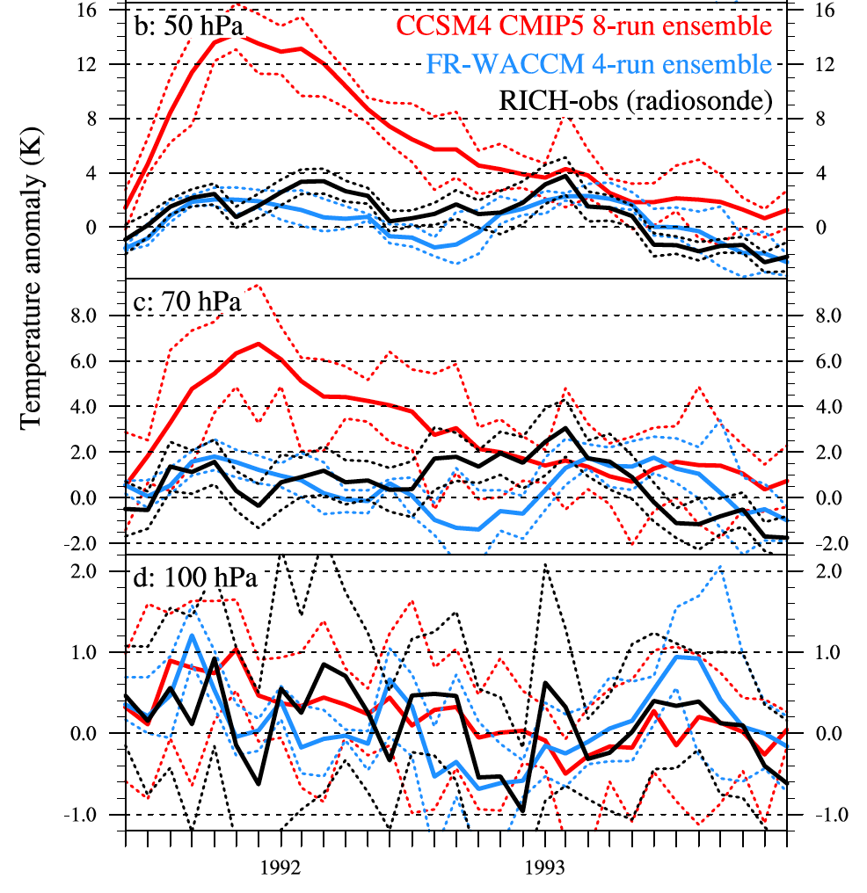
Temperature anomalies due to volcanoes are improved with Prognostic Treatment over CCSM4/CESM1
Mills et al. (JGR, 2016)

Slide 11
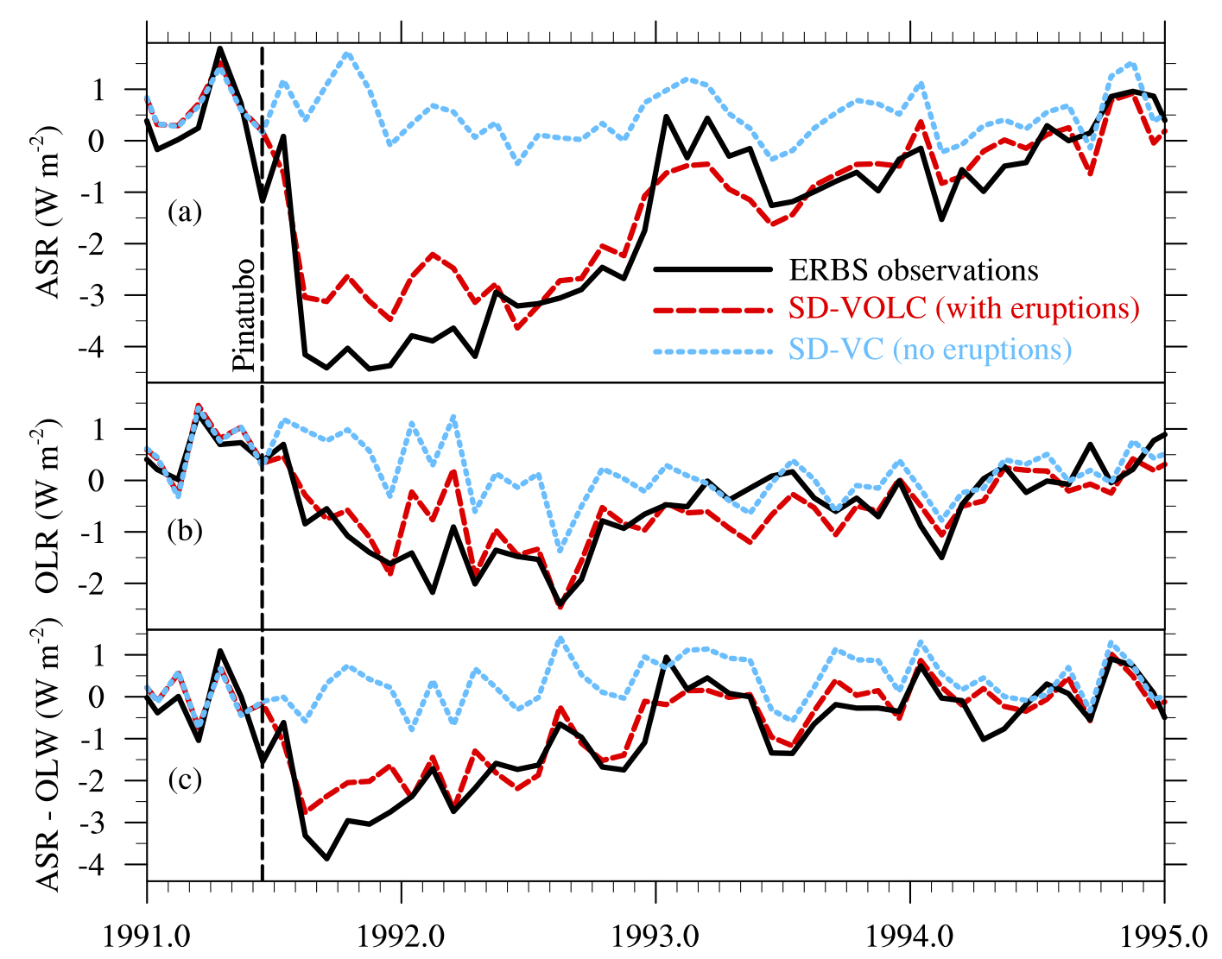
Absorbed solar and outgoing longwave radiation
Mills et al., in preparation

Slide 12
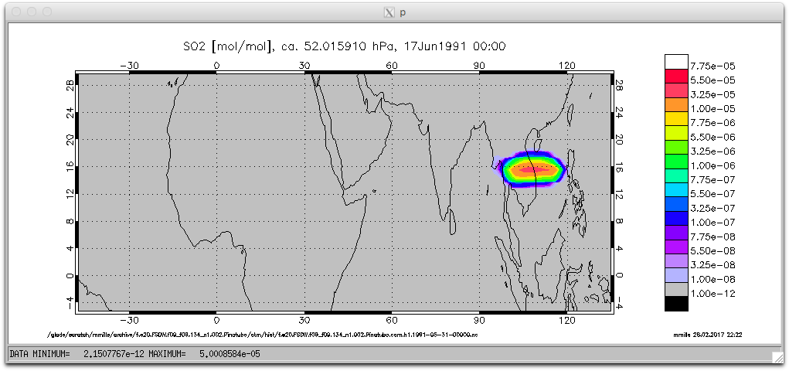
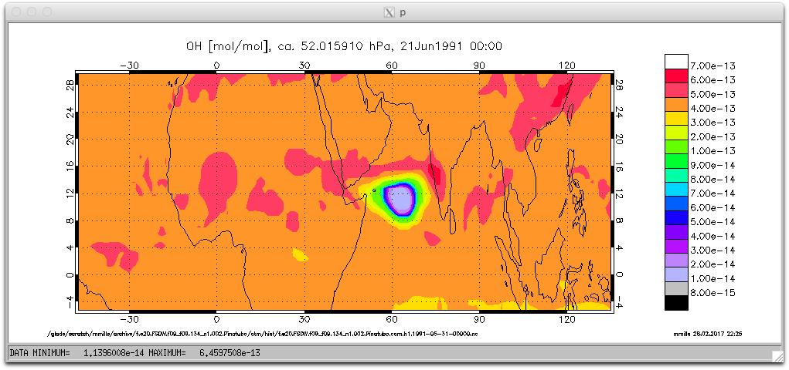
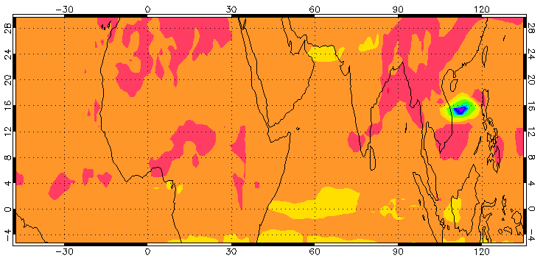
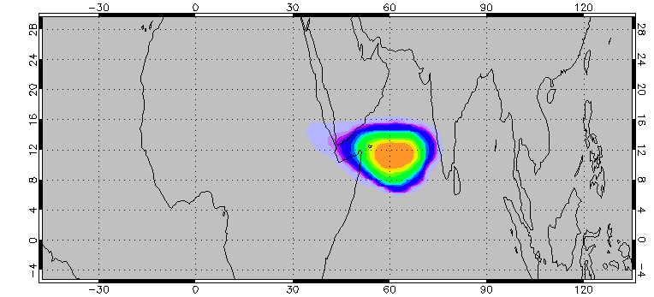
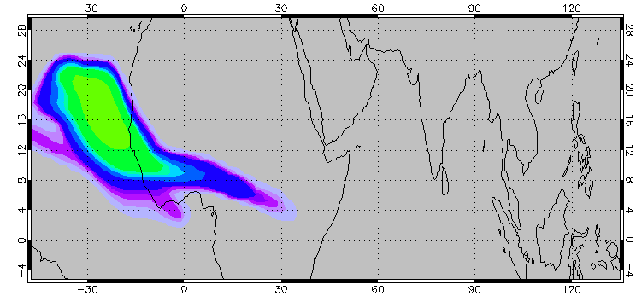
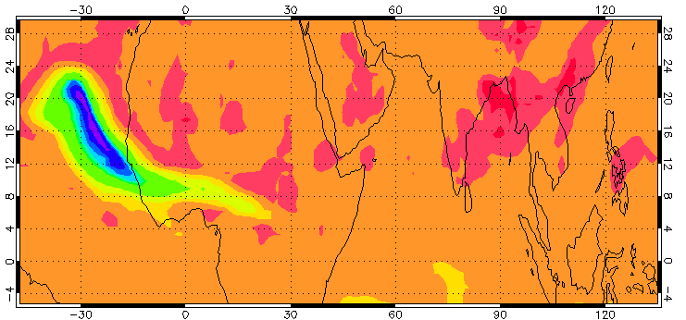
Day 2
Day 2
Pinatubo SO₂ at 50 hPa
OH at 50 hPa
OH depletion
Day 6
Day 6
Day 13
Day 13

Slide 13
OH depleted
OH recovered
Pinatubo
Cerro Hudson
Interactive OH chemistry is required to get the correct SO₂ lifetime.
Volcanoes will be prescribed in CAM from WACCM output.

Slide 14
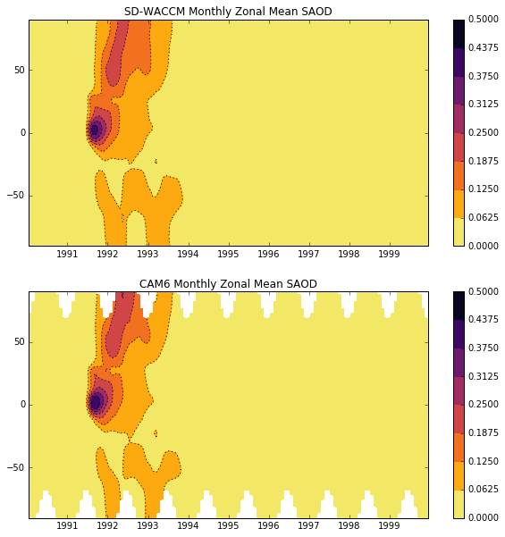
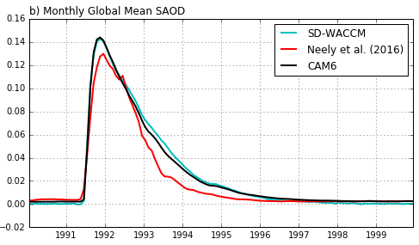
CAM volcanoes prescribed from WACCM output
Information from all 3 sulfate aerosol modes used.
WACCM6 SAOD
CAM6 SAOD
Figures courtesy Ryan Neely

Slide 15
Monthly global mean clearsky volcanic flux anomalies
Absorbed solar
Outgoing longwave
SD-WACCM
CAM6 prescribed with Neely et al. (2016)
CAM6 prescribed with WACCM 3-mode

Slide 16
WACCM Pinatubo ensemble variability
Tropics
Global
Thick: SD-WACCM
Solid: QBO W→E
Dashed: QBO E→W
23.4°N-90°N
23.4°S-90°S
Cerro Hudson

Slide 17
Summary
Prognostic volcanic aerosol from SO₂ emissions has been validated in WACCM, with significant improvements over volcanoes prescribed from observations.
Due to lack of interactive OH chemistry, volcanoes will be prescribed in CAM from WACCM output. Information from all aerosol modes is used, forcing with excellent agreement to WACCM.
Due to significant ensemble variability in volcanic evolution in WACCM, output from different WACCM runs should be used to force different CESM2 realizations.

Slide 18
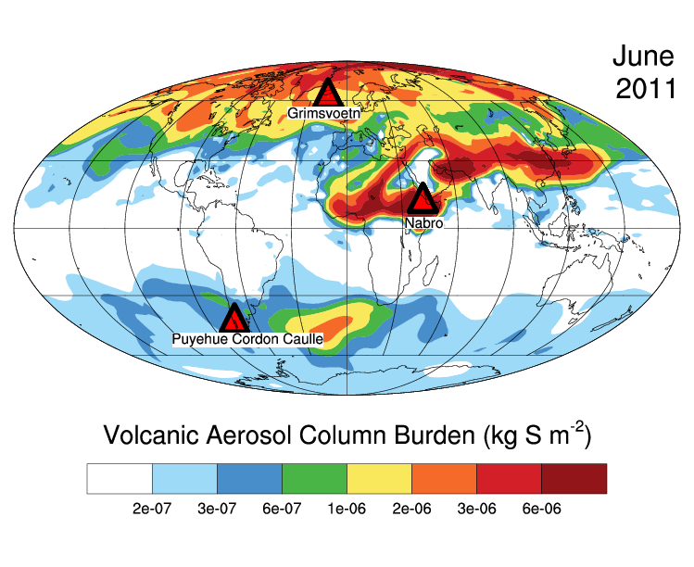
Thank you!

Slide 19
SD-WACCM simulations from “Global volcanic aerosol properties derived from emissions, 1990-2014, using CESM1(WACCM)," Mills et al. (JGR, 2016)

Slide 20
Sampled on balloon flight dates

Slide 21
Post-Sarychev eruption: calculated SAD = 10x CCMI
from Mills et al., JGR, 2016

