Slide 1
New Radiation
Andrew Conley¹²,
Mike Iacono¹³ , Bill Collins¹², Brian Eaton², Phil Rasch²,
Francis Vitt², Pat Worley², Jean-Francois Lamarque¹²,
And Many Others
¹Supported by DOE/SciDAC
²Supported by NSF/NCAR
³Supported by DOE/ARM

Slide 2
New Radiation Parameterization
RRTMG – A New Radiation Code for CAM
Science Tests
Integration Tests
New Interface for Radiative Constituents
Condensed Phase Optics
Clouds
Aerosols
Schedule

Slide 3
CAM Radiation
Authors:
V. Ramanathan
Jeff Kiehl
Bruce Briegleb
Bill Collins
Supported increasing complexity for 20 years.

Slide 4
RRTMG
Correlated-k code for gases in LW and SW from AER
Monte Carlo Independent Column Approximation for clouds
Continually updated to latest spectroscopic data bases
Much greater accuracy relative to LBL calculations
Ongoing validation in radiative closure experiments (ARM BBHRP)
Ozone optics validation through CCMVal

Slide 5
Climate Forcing Accuracy (RTMIP)*
LW Benchmark code is LBLRTM.
Experiments:
GHG :: 1860->2000 (all species)
CH4,N2O :: 0 ppm -> 2000
N2O, CFC :: 1860 -> 2000
CH4,CFC :: 1860 -> 2000
*Collins et al, 2006; Iacono et al 2008

Slide 6
Climate Forcing Accuracy (RTMIP)*
SW Benchmark code is CHARTS.
Experiments:
GHG :: 1860->2000 (all species)
CH4,N2O :: 0 ppm -> 2000
N2O, CFC :: 1860 -> 2000
CH4,CFC :: 1860 -> 2000
*Collins et al, 2006; Iacono et al 2008

Slide 7
Flux Differences (W/m^2) Global , 1 yr Means, No Aerosols, RT-coupled, Cloud Bugfix
 | Top | RRTMG-CAM | Surface | RRTMG-CAM
Shortwave | Net Clear Sky | -1.4 | Net All Sky | -3.2
 | Cloud Force | -1.6
Longwave | Net Clear Sky | -3.3 | Net All Sky | -0.8
 | Cloud Force | -3.0
 | NET | -2.7 | NET | -2.7
Top: let less solar in, less IR out.
Surface: less solar and radiates less IR.

Slide 8
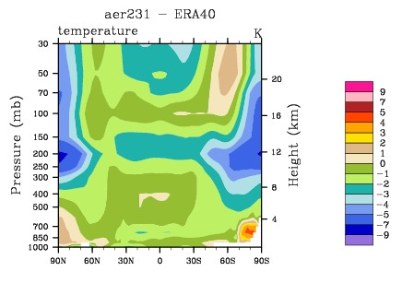
Climate Effects from New Radiation
CAM – ERA40 RRTMG-ERA40
No Aerosols, Old CAM cloud optics, RT coupled
See Mike Iacono’s Poster!

Slide 9
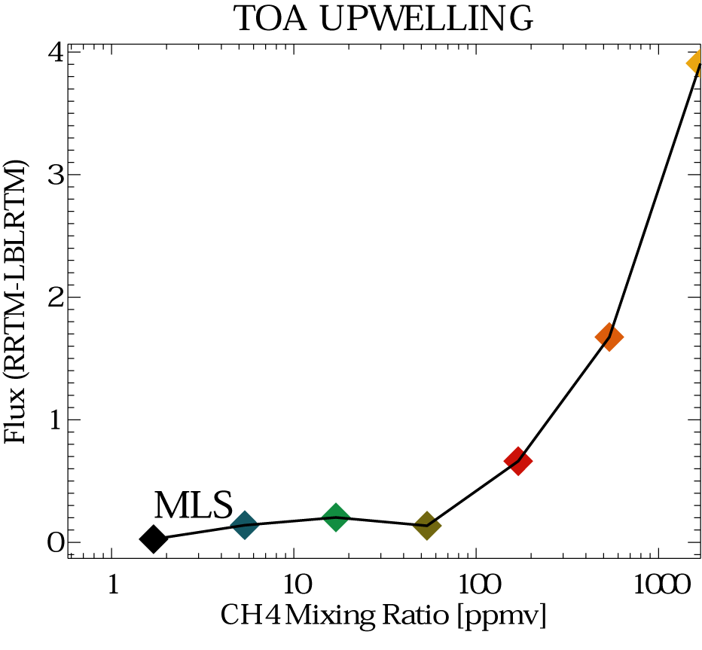
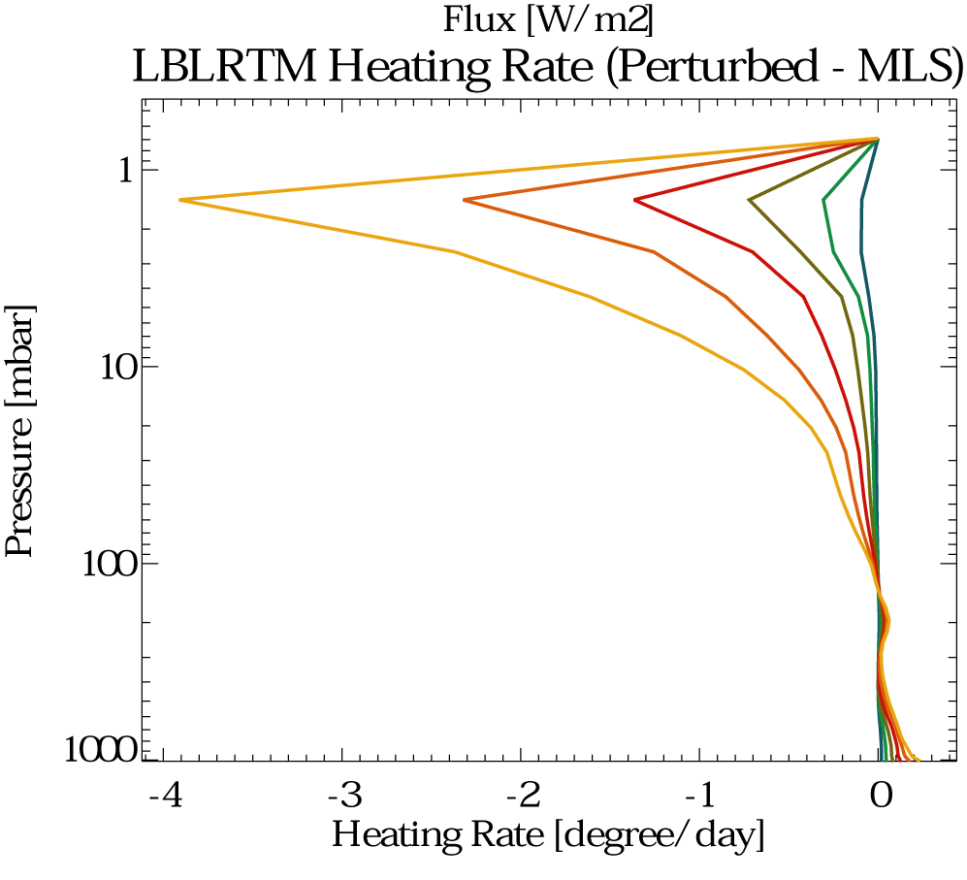
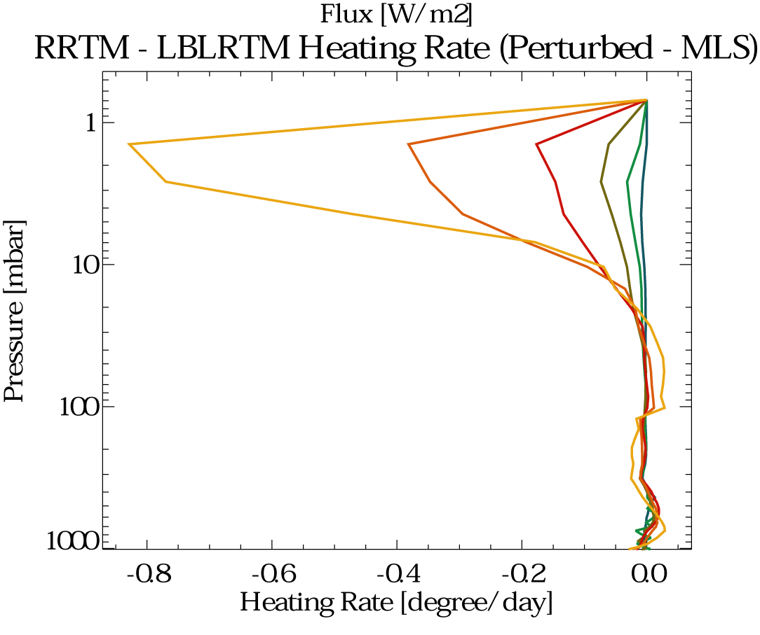
Methane Atmospheres
J. Delamere (AER)

Slide 10
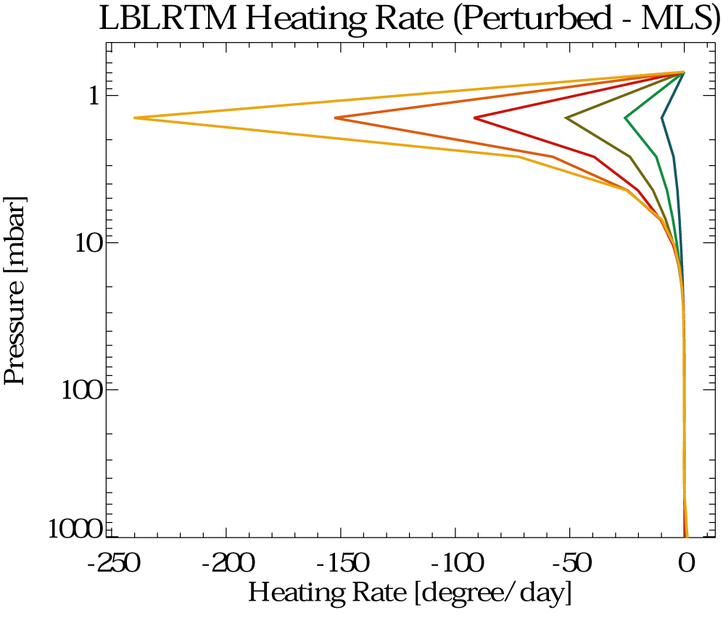
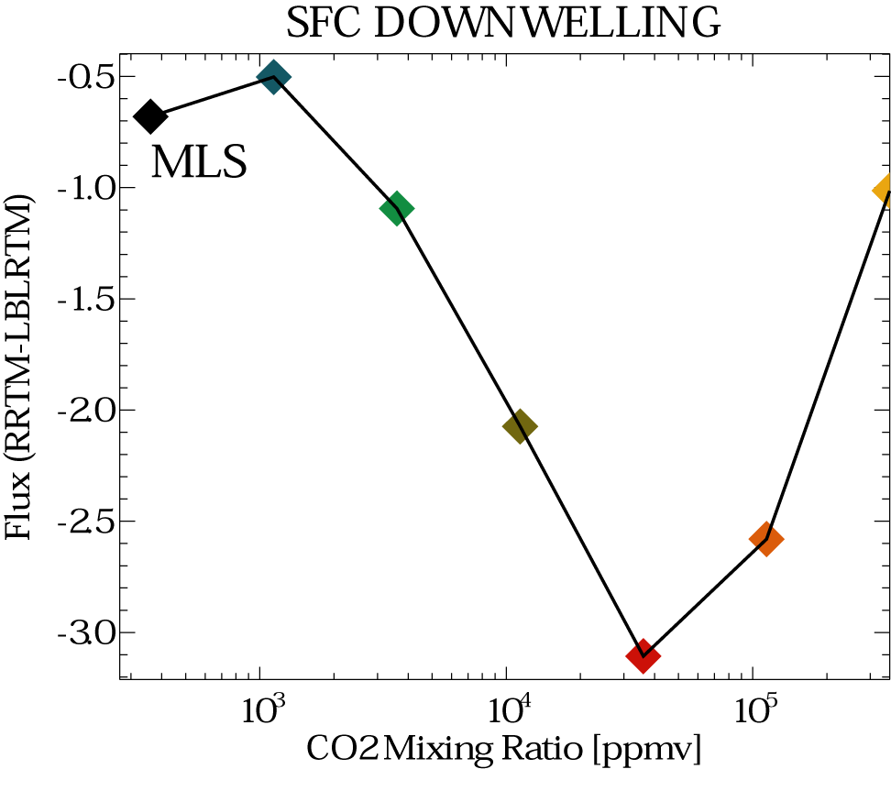
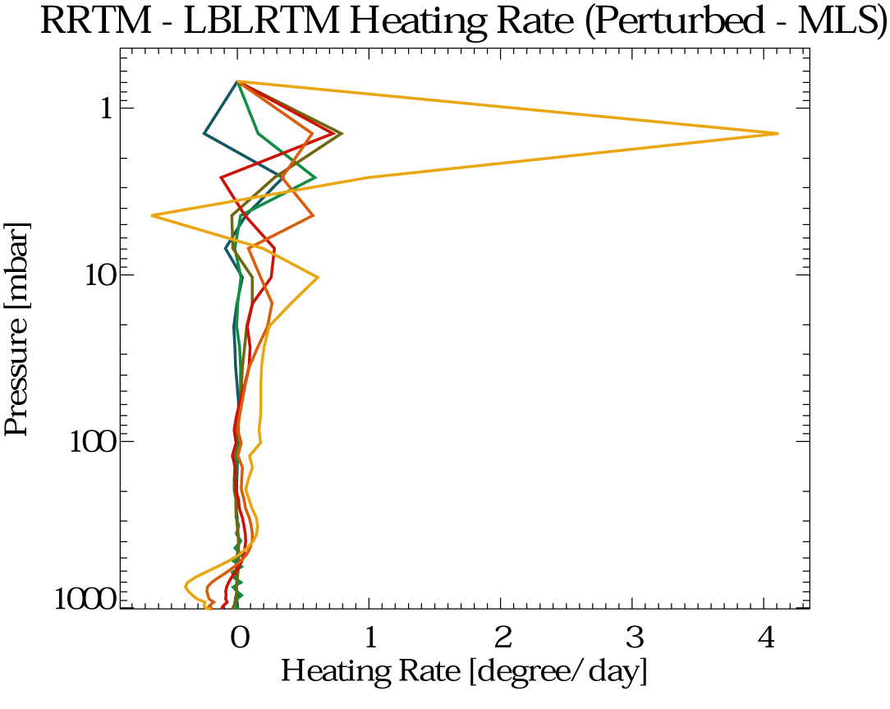
CO2 Atmospheres
J. Delamere (AER)

Slide 11
Integration Status Condensed Phase Optics
Liquid Cloud Optics
Using CAM3.5 Optics
Constructed optics for MG Clouds
Implemented 1st cut of MG Cloud Optics
Need to include in-cloud liquid variability
Ice Cloud Optics
Have Optics from David Mitchell
Need to be implemented and tested
Aerosol optics not yet integrated with RRTMG

Slide 12
Software Integration Status
Testing on NCAR machines relatively complete
Testing ongoing on DOE machines
Optimizations are ongoing
Removing CAM-specific elements from RRTMG
Soon to be part of trunk code as a configuration option

Slide 13
Computational Costs
Performance Ratio
Memory
CAMRT/RRTMG
PE
Fv 1.9X2.5, no aerosols
*Brian Eaton, Pat Worley

Slide 14
Questions?
RRTMG – A New Radiation Code for CAM
Science Tests
Integration Tests
New Interface for Radiative Constituents
Condensed Phase Optics
Clouds
Aerosols
Schedule

Slide 15
Interface for Radiative Constituents
Implemented for both CAMRT and RRTMG
Easy Forcing Computation
Namelist driven
Up to 10 diagnostic calls
Supports multiple representations
SW and LW
Explicit specification of radiative constituents – nothing hidden
Declaration of prognostic or diagnostic character of each species
Explicit link between microphysics and optics of each condensed species
Doesn’t change answers

Slide 16
Example Namelist*
rad_climate="'D_O3:O3', 'D_O2:O2', 'D_CO2:CO2', \
'D_N2O:N2O', 'D_CH4:CH4', 'D_CFC11:CFC11', \
'D_CFC12:CFC12', 'P_Q:H2O', \
'D_ocar1:/path/ocpho.nc', \
'D_ocar2:/path/ocphi.nc', \
'D_bcar1:/path/bcpho.nc', \
'D_bcar2:/path/bcphi.nc' \
'D_dust1:/path/dustv2b1.nc', \
'D_dust2:/path/dustv2b2.nc', \
'D_dust3:/path/dustv2b3.nc', \
'D_dust4:/path/dustv2b4.nc', \
'D_sulf:/path/sul.nc' "
*Created by build-namelist.
Notes:
1) D_ vs P_ 2) source_camname:microphysics/opticsfile 3) Contents of file – optics method name, optical data, microphysics data.

Slide 17
Radiation
Gas Optics
Heating Rates
Fluxes
Aerosol Rad Props
OD, SSA, ASM
Cloud Rad Props
OD, SSA, ASM
Gas Distributions
Rad_Constituents
Namelist
Mass Distribution Sources
PhysProp for each Mass
SeaSalt1
Dust3
PhysProps
Optical Data
Size Distrib Data
Hygroscopicity
Sulfate
…
CloudOpt

Slide 18
Questions?
RRTMG – New Radiation Code for CAM
Science Tests
Integration Tests
New Interface for Radiative Constituents
Condensed Phase Optics
Clouds
Aerosols
Schedule

Slide 19
Condensed Phase Optics
All new optics target RRTMG
Clouds
Gamma size distribution liquid clouds (MG micro)
Ice Clouds (Mitchell Optics)
Aerosols
Target Species
Species Specifications
Requirements for Contributions

Slide 20
Liquid Cloud Optics
Microphysics code (from Morrison and Gettelman) diagnoses in-cloud droplet distribution
First version of optics is implemented
Optical data compares well (when limited to specific case) to AER results
Model testing on-going
Meaning of in-cloud liquid water variability

Slide 21
Liquid Cloud Optics (visible)

Slide 22
Ice Cloud Optics
Provided by David Mitchell (DRI)
Parameterized in terms of Effective (radiative) diameter
Effective diameter diagnosed by microphysics parameterization
Computed using MADA code (Similar to FDTD in the case of no small mode crystals)

Slide 23
Aerosol Specification
Dry Size Distribution (mean log(r), sigma(log(r)))
Hygroscopic Growth Model
Composition (internal/external mixture)
Dry complex index of refraction (.2 -> 1000 micron)

Slide 24
Aerosol Status
Optics for CCSM4 aerosols will probably be based on the BAM but are awaiting specs from AMWG
(CAM3.5) Externally Mixed Species
Tropospheric Sulfate (ammonium sulfate)
Dust (4 bins)
Carbonaceous (4 Species)
Sea Salt (4 bins)*
Volcanic Aerosol (Stratospheric H2SO4)
(CAM3.5) Optics mostly based on OPAC (1998) data
(CAM3.5) Optics not mapped to RRTMG bands

Slide 25
Aerosol Specification?
CAM3 Optics Assumptions
Emission/Transport/Deposition Assumptions
MG Cloud Microphysics Assumptions
Appear in Diverse Sections of Code – Rarely in file data

Slide 26
Volcanic Species
Mass specification is broken in CAM3.5
Chemists
Surface Area Density Distribution (time evolving)
Fixed Number
Prognostic Mass
Climate/CAM
One bin with fixed size
Specified time evolving mass
Welcome to join our discussion (ACD/CGD)

Slide 27
External Optical Contributions
Reproducibility/Traceability
Data and Methods Archived
Spectrally resolved (SW and LW) and RRTMG-band:
Mass-specific Extinction
Mass-specific Absorption
Single-scattering Albedo
Asymmetry Parameter

Slide 28
Questions?
RRTMG – A New Radiation Code for CAM
Science Tests
Integration Tests
New Interface for Radiative Constituents
Condensed Phase Optics
Clouds
Aerosols
Schedule

Slide 29
Schedule of Experiments
RRTMG, old cloud optics
Change to Mitchell Ice Optics
Change to MGC cloud optics
Add BAM Diagnostic aerosol forcing
Study and modifications from CCSM
CCSM/SOM runs
BAM interacting with microphysics (Which interactions?)

Slide 30
Future Work
Offline Radiation
Optics for internally mixed aerosols
Move subcolumn generation out of radiation so that it can be coupled with subscale dynamics and perhaps in-cloud liquid water path variability
Initialization step mie computation (run time?)
Photolysis

Slide 31
Questions?
RRTMG – A New Radiation Code for CAM
Science Tests
Integration Tests
New Interface for Radiative Constituents
Condensed Phase Optics
Clouds
Aerosols
Schedule

