Slide 1
Benchmarking of chemical mechanisms
Jean-François Lamarque, Peter Hess and Philip Cameron-Smith
CCSM meeting, June 18, 2008

Slide 2
Rationale for benchmarking
Three main chemical mechanisms (list of reactions and rates) are available: full, intermediate and fast. They differ in their decreasing representation of hydrocarbon chemistry and therefore their decreasing computational cost
Gas-phase tropospheric chemistry only
Full mechanism: 79 species
Intermediate mechanism: 39 species
Fast mechanism: 28 species

Slide 3
Purpose of interactive chemistry
Provides distribution of radiatively-active greenhouse gases (troposphere and stratosphere)
Provides distribution of oxidants for aerosol production (both online and offline)
Provides distribution of secondary-organic aerosols
Provides distribution of air quality
Provides interaction with biogeochemistry: nitrogen deposition, ozone damage

Slide 4
Approach for benchmarking
Simulation with relevance to air quality
Simulation with relevance to climate
High-resolution simulation (0.47°x0.63°)
Driven by observed meteorology
Compared with MIRAGE campaign observations (Mexico City pollution)
Medium-resolution simulation (1.9°x2.5°)
Driven by observed meteorology
Two sets of emissions: base case and perturbed (30% reduction of Southeast Asia industrial sector, based on CCSP simulations) to study the response to a change in emissions
Use full mechanism as “Truth”

Slide 5
Air quality: Comparison with Mexico City surface observations
Day of Year (2006)
Red: Full mechanism
Green: Intermediate mechanism
Blue: Fast mechanism
Dots: observations
On most days, full and intermediate capture well the diurnal cycle and amplitude; the fast mechanism is much lower

Slide 6
Air quality: Comparison with aircraft observations
Day of Year (2006)
Red: Full mechanism
Green: Intermediate mechanism
Blue: Fast mechanism
Dots: observations
On most days, full and intermediate capture well the background and plume ozone; the fast mechanism captures well the background.
CO is will captured by all.

Slide 7
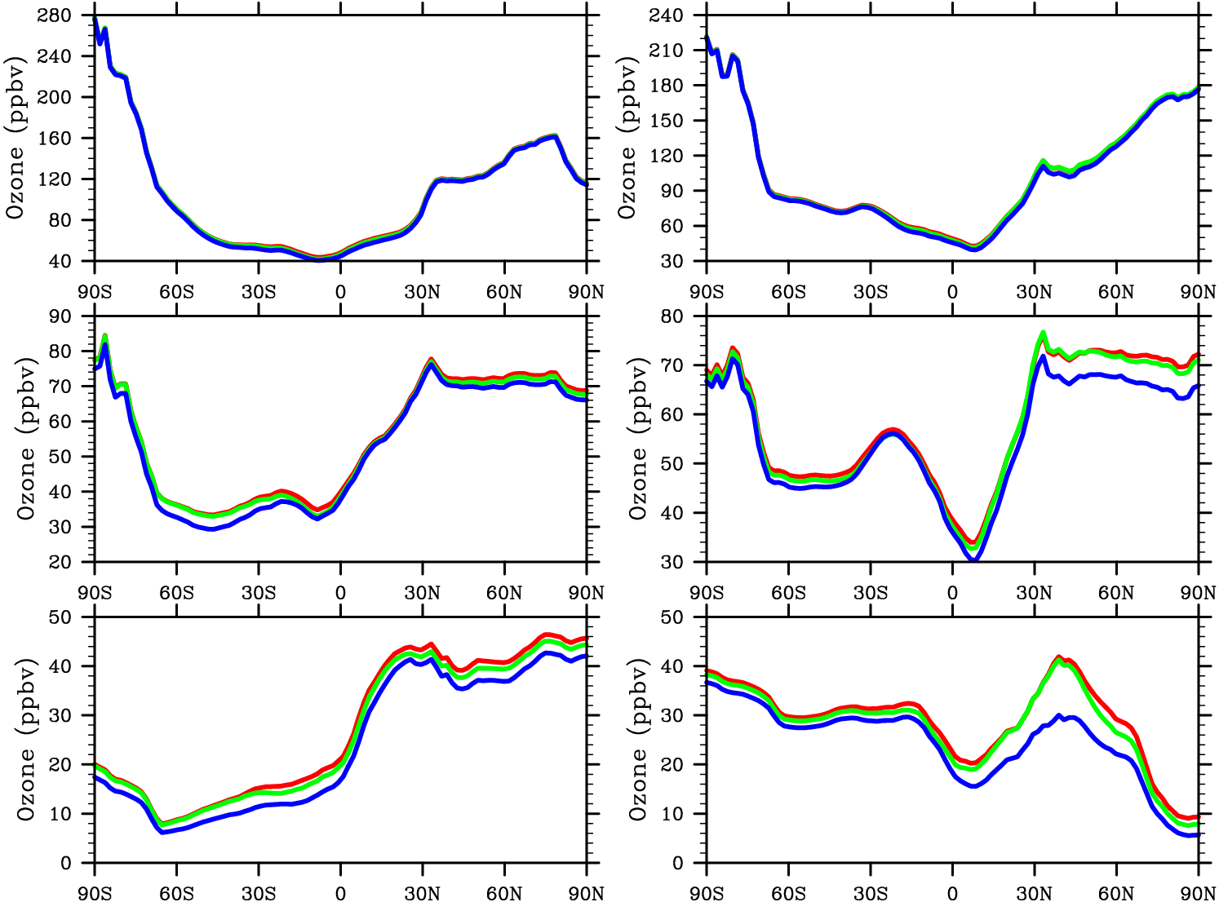
Climate: base emissions
300 hPa
Ozone mixing ratio
500 hPa
Surface
January
July
Red: Full mechanism
Green: Intermediate mechanism
Blue: Fast mechanism
Very good agreement amongst methods in radiatively important upper-troposphere ozone (but fixed stratosphere!); larger bias for the fast mechanism at lower altitudes

Slide 8
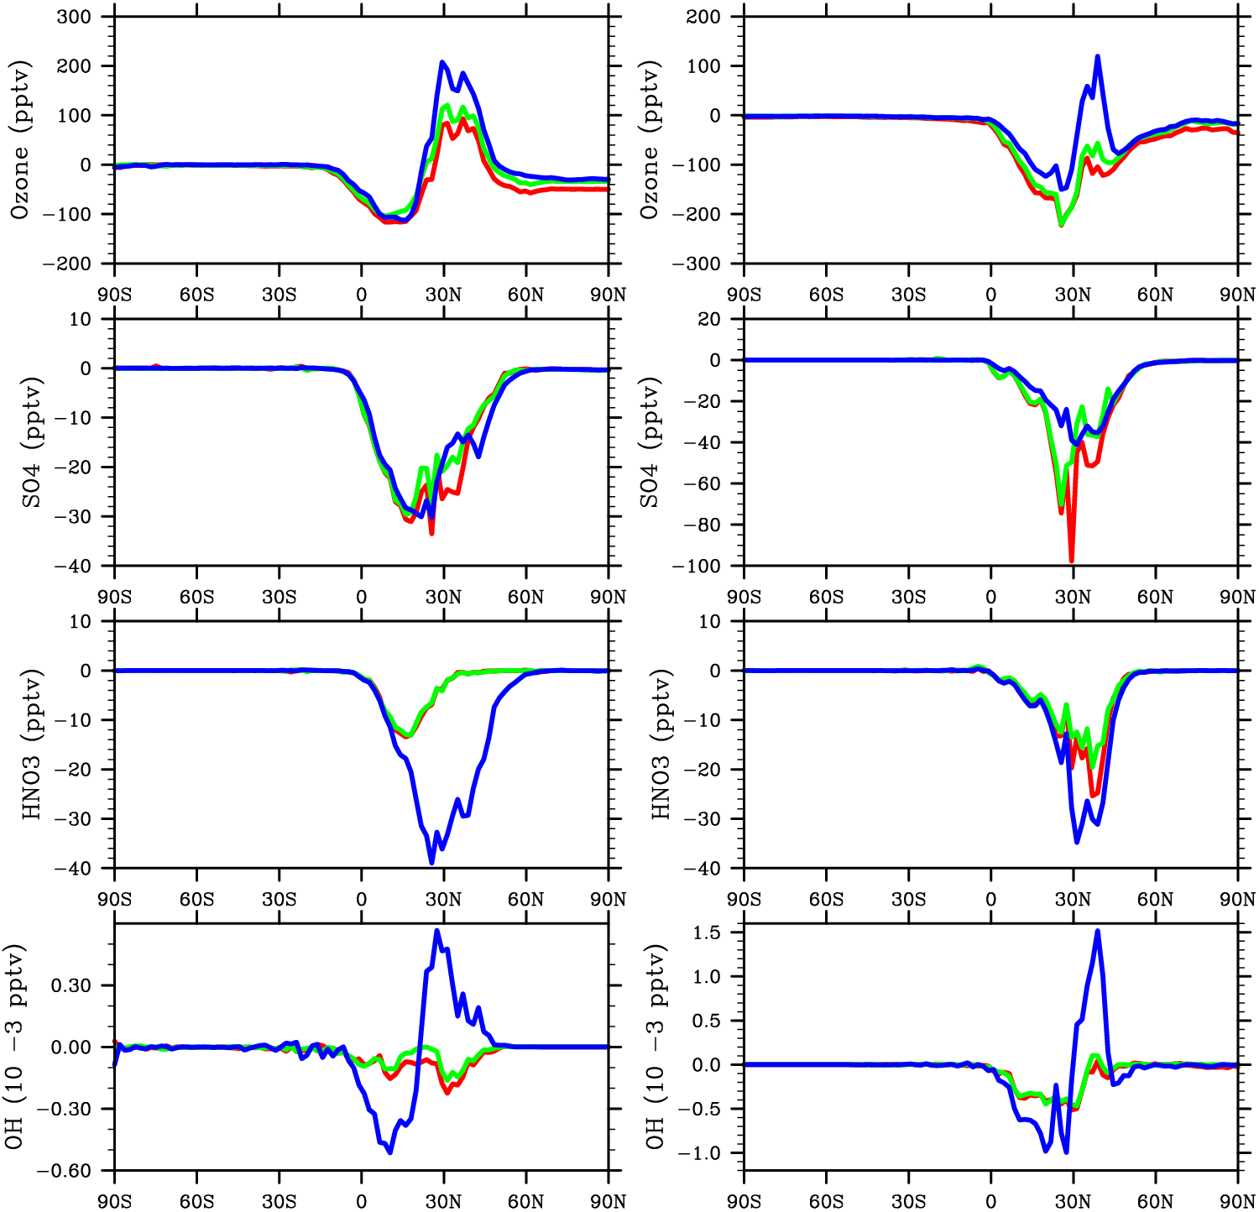
Climate: change in emissions
Sulfate: important for indirect effect
Change in surface mixing ratio
Nitric acid: important for nitrogen deposition
OH: important for methane lifetime
January
July
Red: Full mechanism
Green: Intermediate mechanism
Blue: Fast mechanism
Response in surface ozone and sulfate well captured; stronger biases for the fast mechanism for HNO₃ and OH

Slide 9
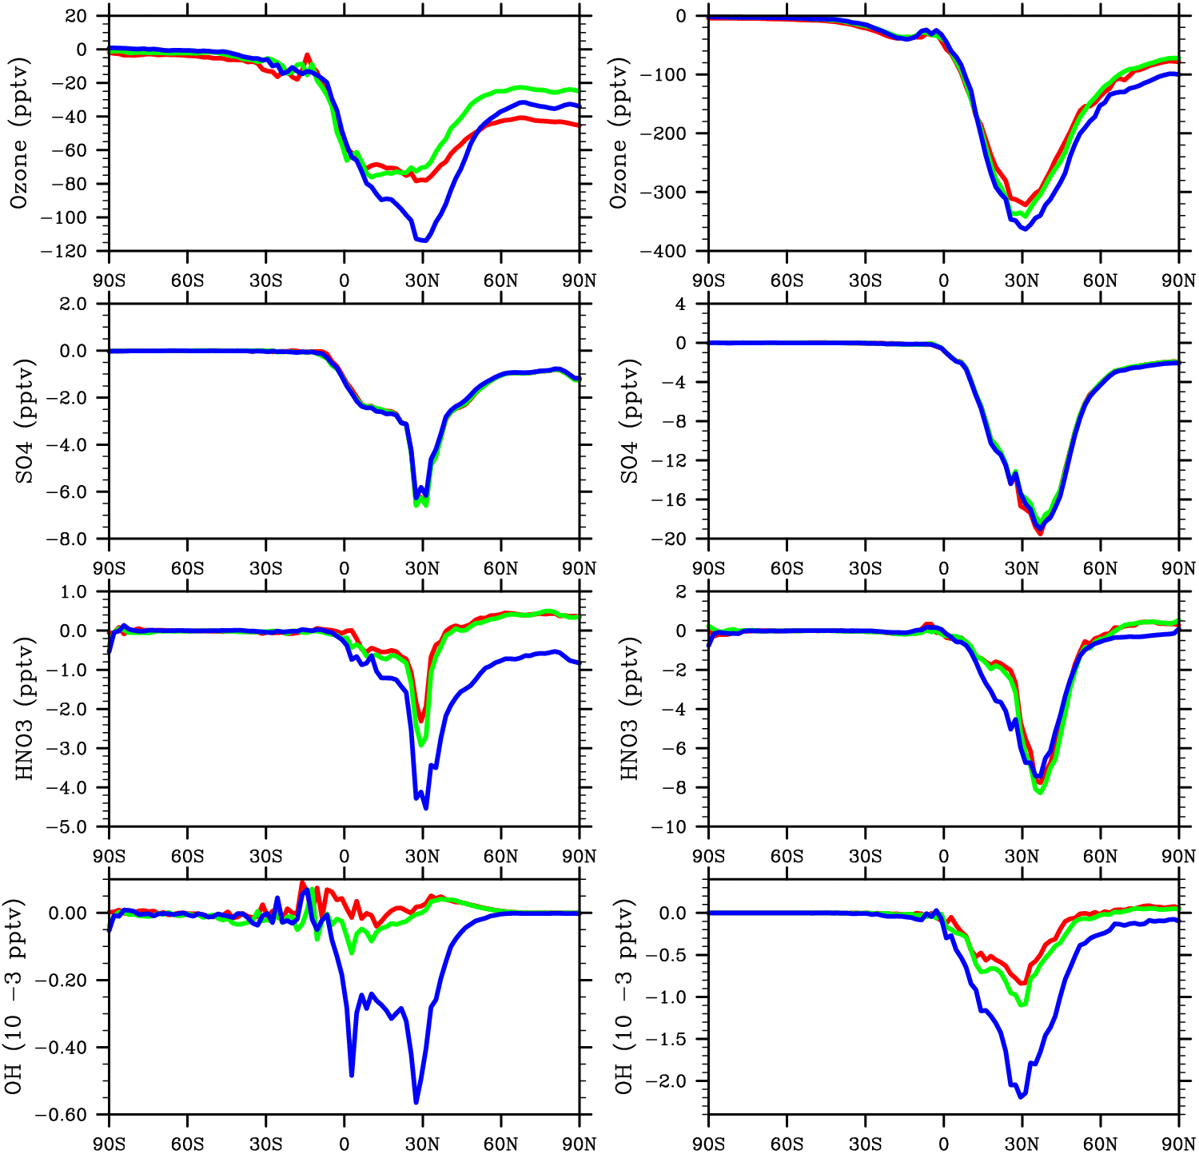
Climate: change in emissions
Change in 500 hPa
mixing ratio
Red: Full mechanism
Green: Intermediate mechanism
Blue: Fast mechanism

Slide 10
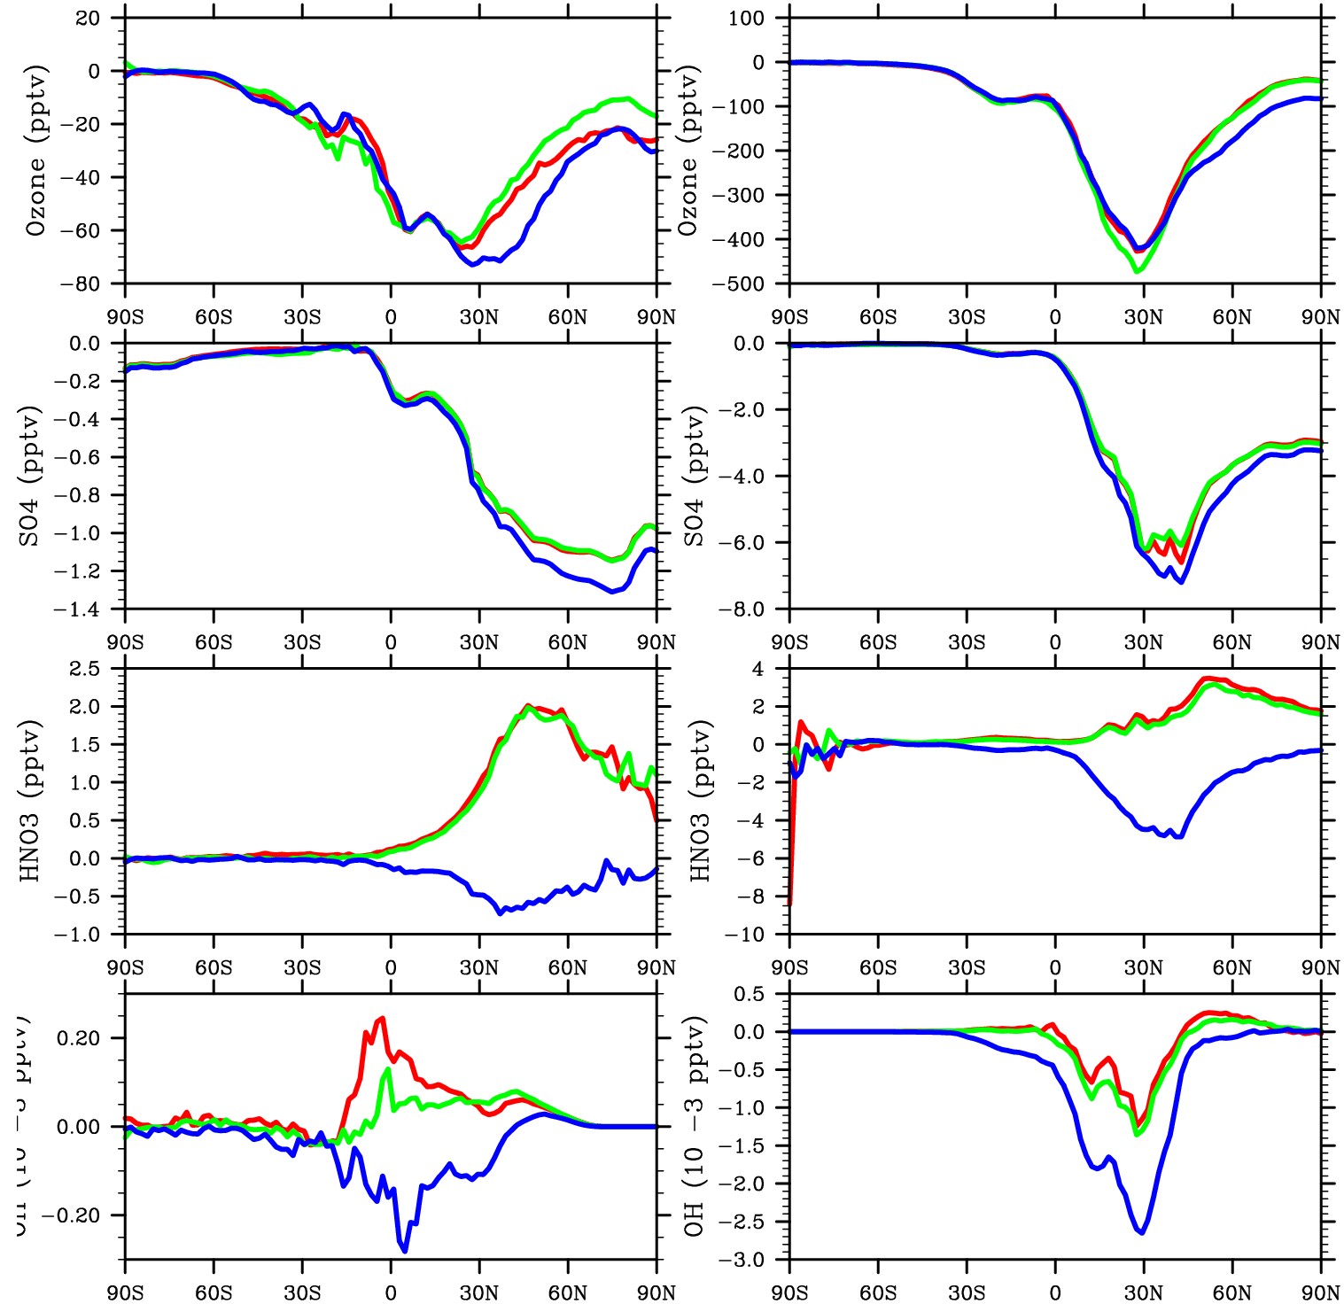
Climate: change in emissions
Change in 250 hPa
mixing ratio
Red: Full mechanism
Green: Intermediate mechanism
Blue: Fast mechanism

Slide 11
Conclusions
Background ozone is well represented by all chemical mechanisms
Response in ozone and sulfate to changes in emissions is similar in all three mechanisms
For the diagnostics selected, the intermediate mechanism is closer to the full mechanism and to observations than the fast mechanism, especially in strongly polluted regions
Computational cost:
Full = 5x CAM (3 tracers)
Intermediate = 1/2 of full
Fast = 1/3 of full, and could be reduced further for troposphere-only applications)

