Slide 1
Scientific Workflow Management
CCSM Software Engineering Working Group Session
6/19/2008
Scott Klasky
R. Barreto, C. Jin, J. Lofstead, M. Parashar,
N. Podhorszki, K. Schwan, A. Shoshani,
M. Vouk, M. Wolf

Slide 2
Outline
ADIOS.
Workflow.
  What is a workflow
  What advantages over python.
  Monitoring workflow.
  Coupling workflow.
  Movie.
  Marriage of ADIOS + workflow.
  Napkin drawing of climate workflow.
Dashboard.
Conclusions.

Slide 3
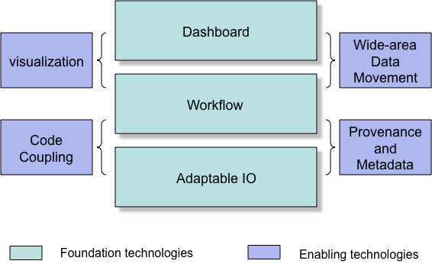
End to End Computing at ORNL
Combines
  Petascale Applications.
  Petascale I/O techniques.
  Workflow Automation.
  Provenance capturing system.
  Dashboards for real-time monitoring/controlling of simulations, and creating social spaces for scientists.
Approach: place highly annotated, fast, easy-to-use I/O methods in the code, which can be monitored and controlled, have a workflow engine record all of the information, visualize this on a dashboard, move desired data to user’s site, and have everything reported to a database.

Slide 4
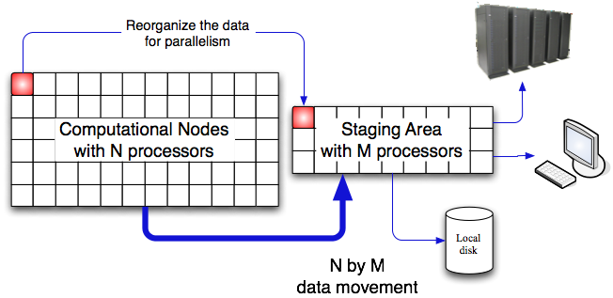
ADIOS Overview – Design Goals
ADIOS is an I/O componentization, which allows us to
  Abstract the API from the IO implementation.
  Switch from synchronous to asynchronous I/O at runtime.
  Change from real-time visualization to fast I/O at runtime.
Combines.
  Fast I/O routines.
  Easy to use.
  Scalable architecture
  (100s cores) millions of procs.
  QoS.
  Metadata rich output.
  Visualization applied during simulations.
  Analysis, compression techniques applied during simulations.
  Provenance tracking.
Notes:
Fast and Easy and Portable for most of the codes. We will not guarantee all codes will work, but most codes will work.

Slide 5

ADIOS Overview
Scientific Codes
External
Metadata
(XML file)
Overview
  Allows plug-ins for different
  I/O implementations.
  Abstracts the API from the
  method used for I/O.
Simple API, almost as easy
as F90 write statement.
Both synchronous and asynchronous
transports supported without code changes.
Best practices/optimize IO routines for all supported transports “for free”
Componentization.
  Don’t worry about IO implementation.
  Components for IO transport methods, buffering, scheduling, and eventually feedback mechanisms.
Change I/O method by changing XML file only, with metadata inside.
Will support strong-coupling (code-code) in the future using a shared global memory address space
ADIOS API
buffering
schedule
feedback
MPI-IO
MPI-CIO
pHDF-5
POSIX IO
pnetCDF
LIVE/DataTap
Viz Engines
Others (plug-in)
Notes:
Please remember that we support both synchronous and asynchronous IO methods!!!

Slide 6
ADIOS APIs Example
GTC - restart.F90
call adios_get_group (grp_id, “restart”)
call adios_open (buf_id, grp_id, “restart.bp”)
call adios_close (buf_id)
ADIOS_WRITE (buf_id,mpi_comm_world)
ADIOS_WRITE (buf_id,nparam)
ADIOS_WRITE (buf_id,mimax)
ADIOS_WRITE (buf_id,zion)
…
ADIOS_GWRITE(buf_id,grp_id)
Notes:
This summer we will allow people to use a group write to write out all of the data described in a group in the xml file. This will be done with pre-processing techniques (python) during the Make. This will be released in ADIOS 1.0 this fall.

Slide 7
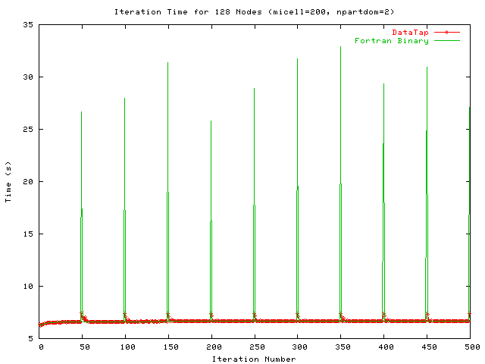
Initial ADIOS performance.
MPI-I/O method.
  GTC and GTS codes have achieved over 25 GB/sec on Cray XT at ORNL.
    30GB diagnostic files every 3 minutes, 1.2 TB restart files every 30 minutes, 300MB other diagnostic files every 3 minutes.
  Chimera code speed up by 6.5% (overall time).
DART: <2% overhead for writing 2 TB/hour with XGC code.
DataTap vs. Posix
  1 file per process (Posix).
  5 secs for GTC
  computation.
  ~25 seconds for Posix I/O
  ~4 seconds with DataTap

Slide 8


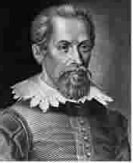
EFFIS is a marriage between Kepler and ADIOS and the dashboard.
ADIOS is being modified to send the I/O (and coupling) metadata from the compute nodes over to Kepler.
  We send the file information( including the path).
  We send the metadata that is contained.
    Variables, + other annotations.
  We can send commands to inform Kepler what to do.
The information is NOT sent if there is no one listening; i.e. not dependent on Kepler).
The information is saved in a database.

Slide 9
What is the Kepler Workflow Framework?
Kepler is a proven DOE technology from the SDM center for
orchestrating scientific workflows, which aid construction
and automation of scientific problem-solving processes.
Kepler workflow framework
  Captures provenance information for
    Data provenance (Where did my data come from?)
    Data movement and data replication (e.g., during code coupling)
    Tar files stored on HPSS (at NERSC or ORNL)
    Workflow actions saved in log files for user debugging
  Is more powerful than Python scripts
    Allows pipeline-parallel processing with ease
    Allows work to continue even if some scripts/components fail
    Allows checkpoint/restart of the workflow
    Easy to modify workflow for a continuously changing group of scientists
  Provides an excellent connection to databases
    Allows for easy queries of shots from coupled simulations
    Large SDM effort to save provenance data into database
Notes:
Move statement on Kepler to top; adjust color scheme to enhance readability; minor rewording of some sub-bullets (removed “you”)

Slide 10
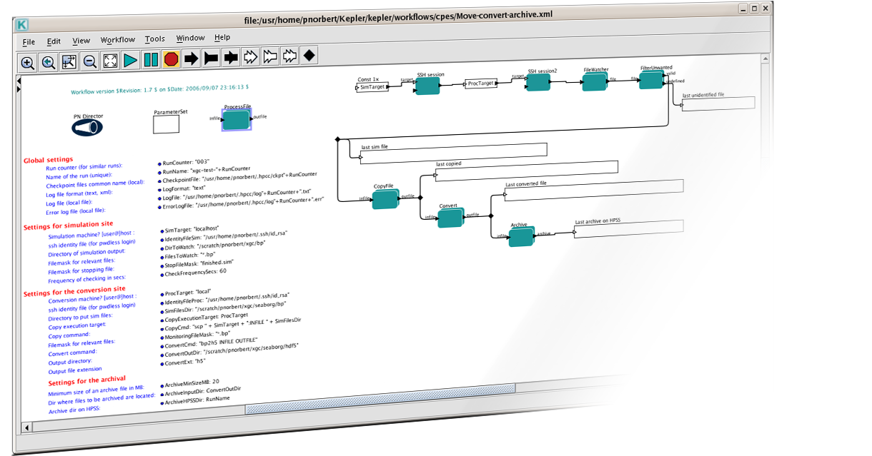

Workflow automation needs in
Center for Plasma Edge Simulation
Automate the data processing pipeline
and simulation monitoring
  Transfer of simulation output to remote machine
  Execution of conversion routines
  Image creation, data archiving, dynamic monitoring
Automate the code coupling pipeline
  Run simulation on a large supercomputer
  Check linear stability on another machine
  Re-run simulation if needed
Requirements for petascale computing
  Easy to use
  Dashboard front-end
  Dynamic monitoring
  Parallel processing
  Robustness
  Configurability
Notes:
Remove “Fusion” from title; change the vague “its” in fist bullet to “simulation”; adjust capitalization

Slide 11
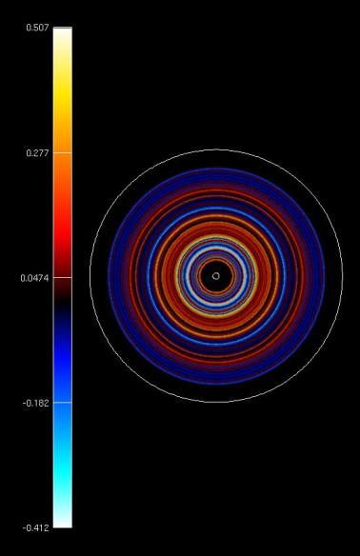
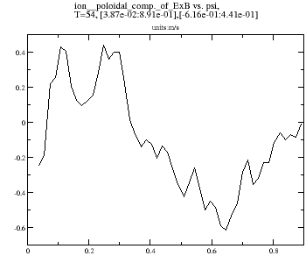
Workflows for monitoring a simulation
NetCDF files
  Transfer files to e2e system on-the-fly
  Generateimages using grace library
  ArchiveNetCDF files at the end of simulation
Binary files from ADIOS
  Transfer to e2e system using bbcp
  Convert to HDF5 format
  Generateimages with AVS/Express (running as service)
  Archive HDF5 files in large chunks to HPSS
Record Provenance information for everything!

Slide 12
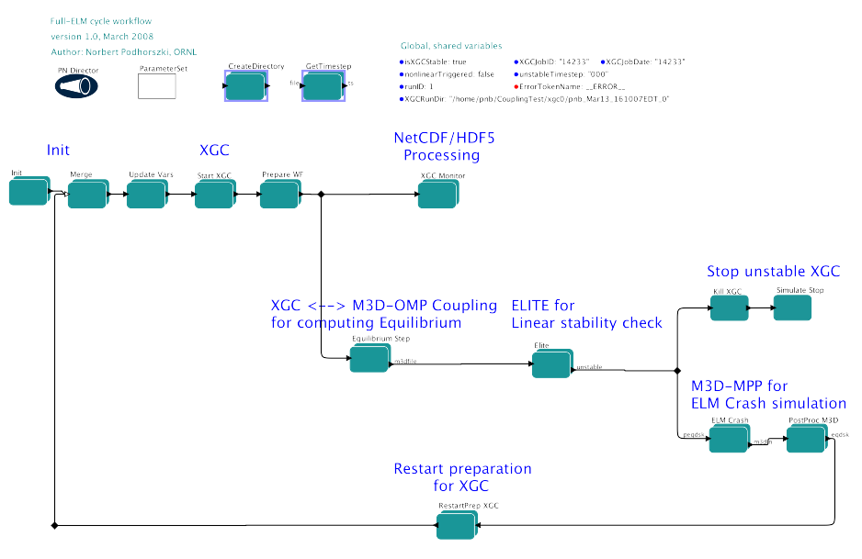
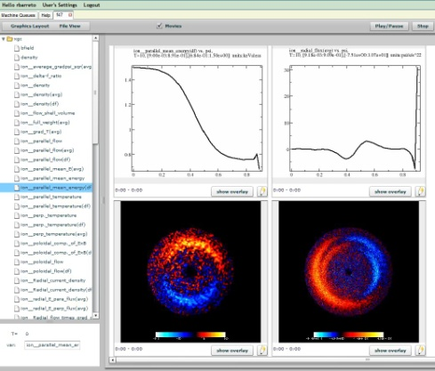
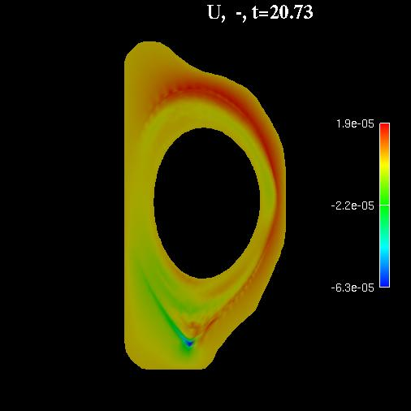
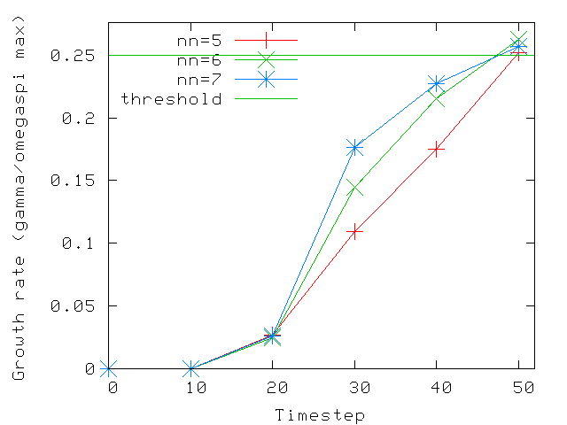
Coupling Fusion codes for Full ELM, multi-cycles
Run XGC until ELMS are unstable
M3D coupling data from XGC
  Transfer to end-to-end system
  Execute M3D: compute new equilibrium
  Transfer back the new equilibrium to XGC
  Execute ELITE: compute growth rate, test linear stability
  Execute M3D-MPP: to study unstable states (ELM crash)
  Restart XGC with new “helaled” equilibrium from M3D-MPP

Slide 13
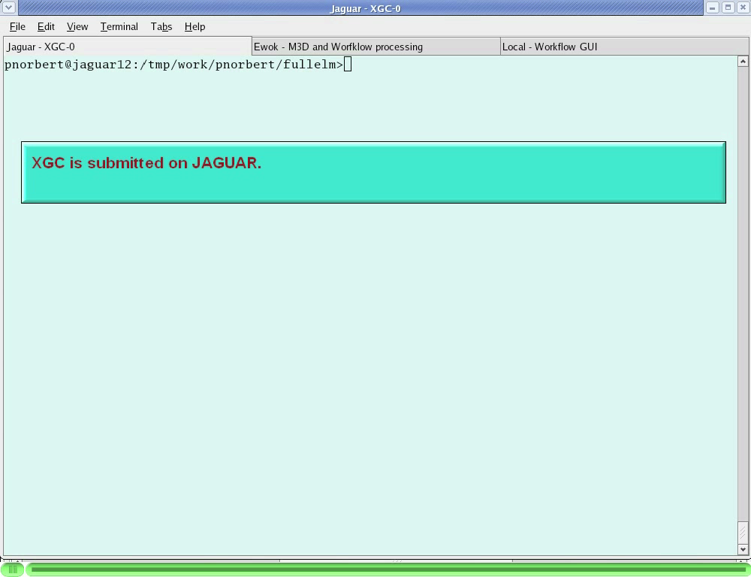
Kepler Movie

Slide 14
Climate workflow
Running CCSM cases
Run an ensemble of several cases at once
  one case consists of many jobs executed repetitively
Run jobs at NCCS and other resource
  one-time-password access from outside
Archive output on the fly to HPSS while the job is running
Make images from diagnostic output on the fly and put on the dashboard
  to monitor the current status of each case
Experiment
definition
(5-10 CCSM cases)
Step 2
Step 2
Step 2
Run CCSM case-job
Run CCSM case-job
Run CCSM case-job
Archive Output &
clean-up disks
Step 1
Archive Output &
clean-up disks
Archive Output &
clean-up disks
Get codes from SVN
Diagnostic images
Diagnostic images
Diagnostic images
Build components
Resubmit job
Resubmit job
Get data sets
Resubmit job
Step 3
Post-process output

Slide 15
Design Criteria for the Dashboard
Goal: provide users an easy way over the web to dynamically monitor simulation progress, to view images and movies, to perform basic analysis, and to move files to their site
New design criteria for FSP codes on leadership class computers
  Must support very large and small data, in a scalable fashion
New security with One Time Passwords
  Unrealistic to think that we can monitor jobs via one type of data output
  Unrealistic to think that we can move data from a large parallel disk to user space
Data management must be incorporated into the design
  Database back-end is as important as front-end
  Provenance display is very important to monitor long-running jobs
Must be able to monitor computers/jobs from all resources
Need to plug-in new visualization routines into the display
Need to plug-in new analysis routines into the system
Need to collaborate via shared space
Make it robust by using enterprise web-2 technologies
Notes:
Show dashboard design criteria first. Minor formatting changes to text.

Slide 16
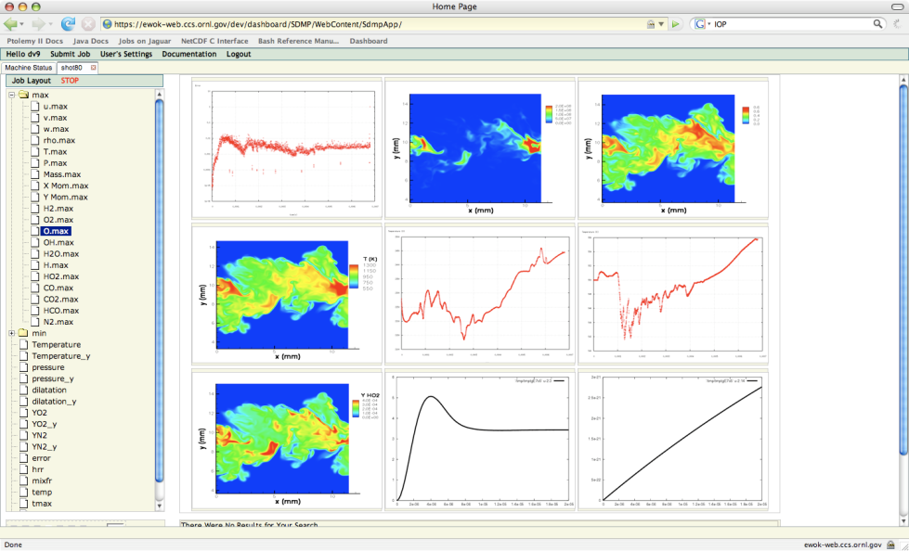
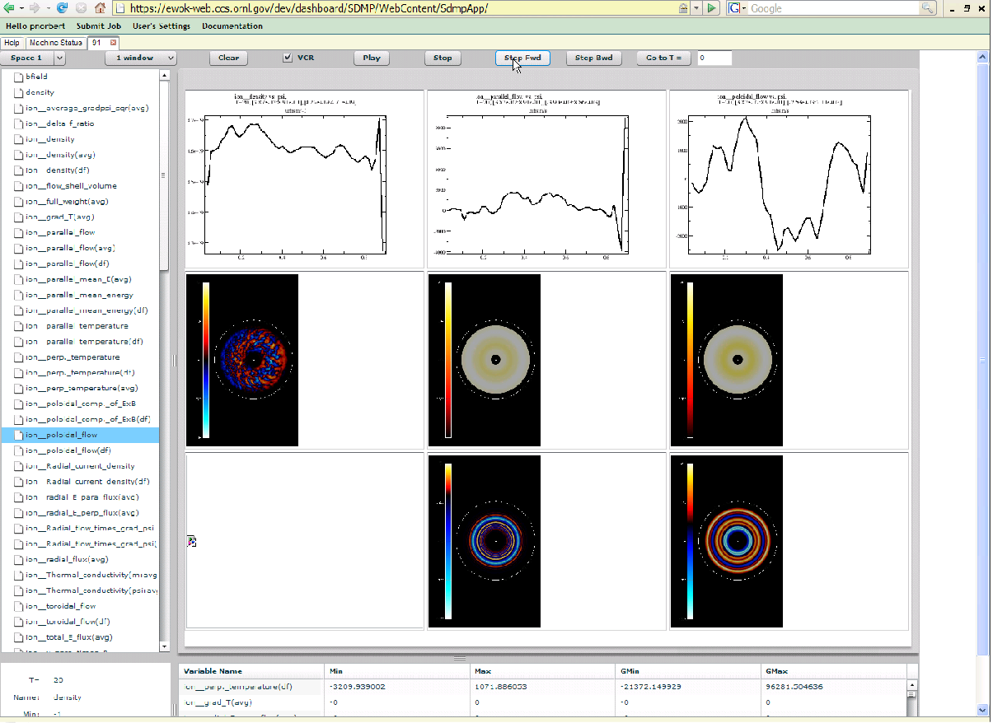
Dashboard: Simulation Monitoring
A basic browser-based visualization tool
Local interaction for graphs/visualizations
Server used for data manipulation, extraction
Server used for more complex analysis
Allows for pan and zoom locally
Asynchronously queries
MySQL for database support

Slide 17
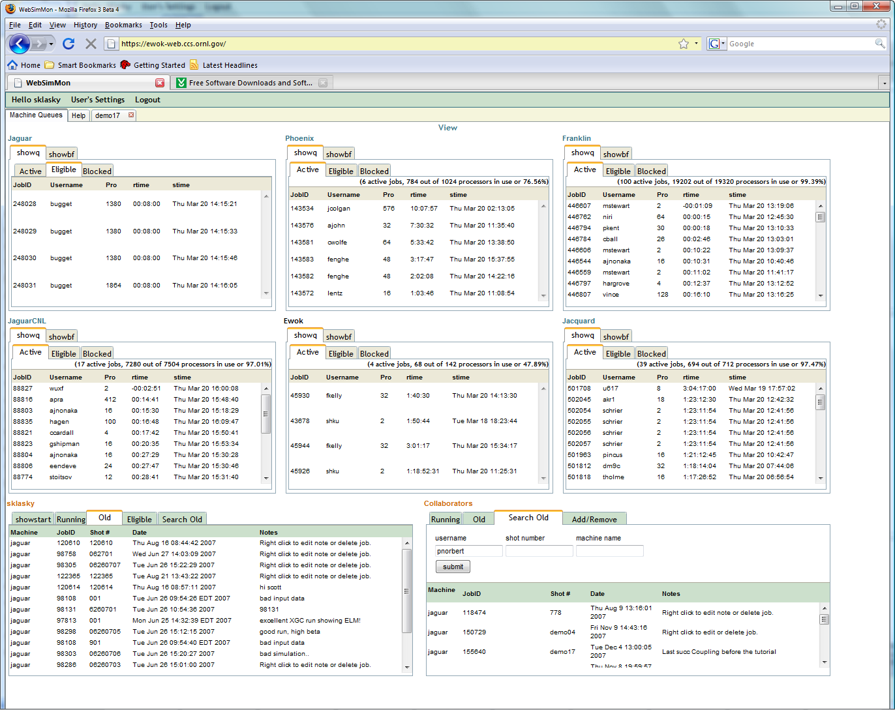
Dashboard: Job Monitoring
Monitors machines, simulations and DB
Secure login with OTP
Job submission
and kill
Search old jobs
See collaborators
jobs
Annotations/Notes
Text display/movies
Notes:
First bullet: added “with OTP”. Reposition text for better spacing.

Slide 18
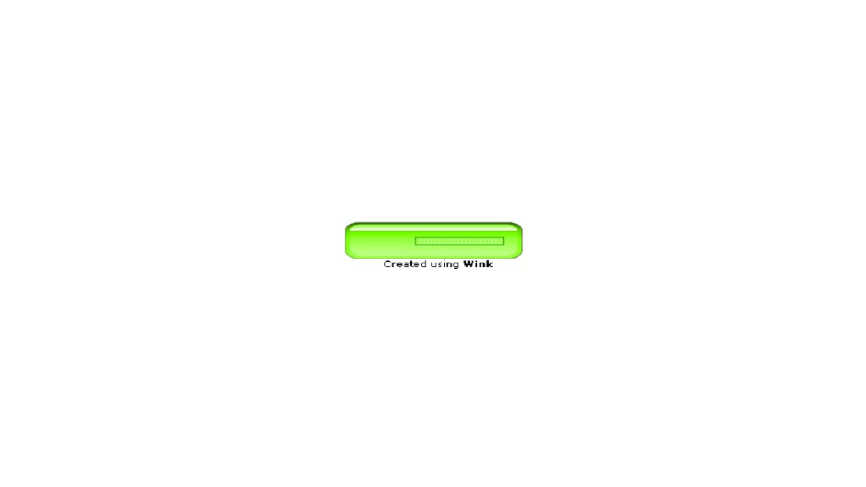
Dashboard movie

Slide 19
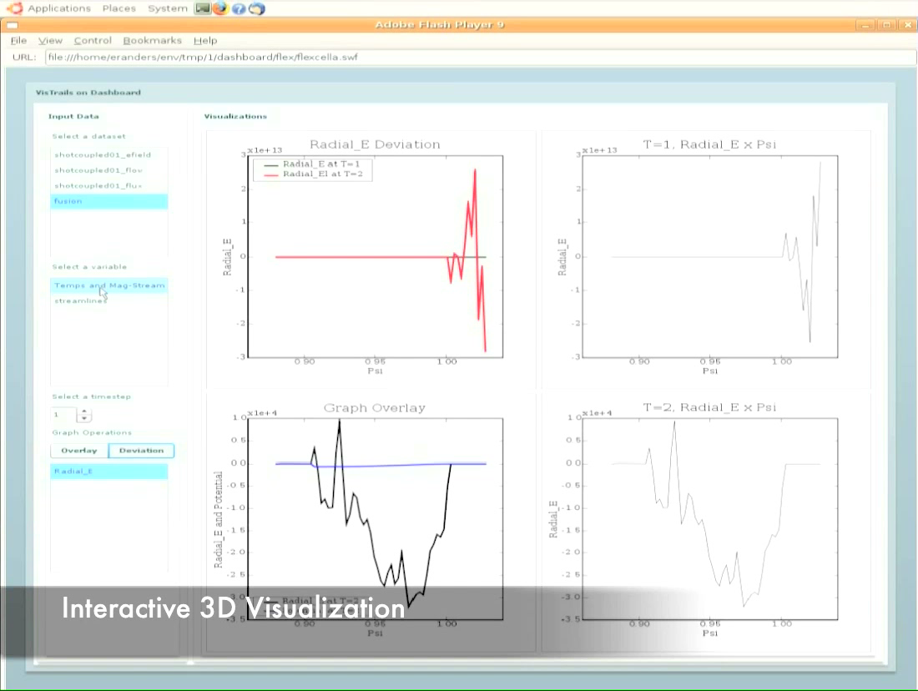
Dashboard 3D capabilities.

Slide 20
Collaborative Analysis Features
Basic analysis on dashboard will feature
  Calculator for simple math, done in Python
  Hooks into “R” for pre-set functions
  Ability to save the analysis into a new function
  2d and time history plots (initial version)
  Full 3d plots (in future version)
Advanced analysis will contain
  Parallel backend to VisIT server, VisTrails, Parallel R, and custom MPI/C/F90 code
  We will allow users to place executable code into the dashboard
In progress: a portable dashboard!

Slide 21
Conclusions
ADIOS is an I/O componentization.
  ADIOS is being integrated integrated into Kepler.
  Achieved over 20 GB/sec for several codes on Jaguar.
  Used daily by CPES researchers.
  Can change IO implementations at runtime.
  Metadata is contained in XML file.
Kepler is used daily for
  Monitoring CPES simulations on Jaguar/Franklin/ewok.
  Runs with 24 hour jobs, on large number of processors.
Dashboard uses enterprise (LAMP) technology.

